Slide 1
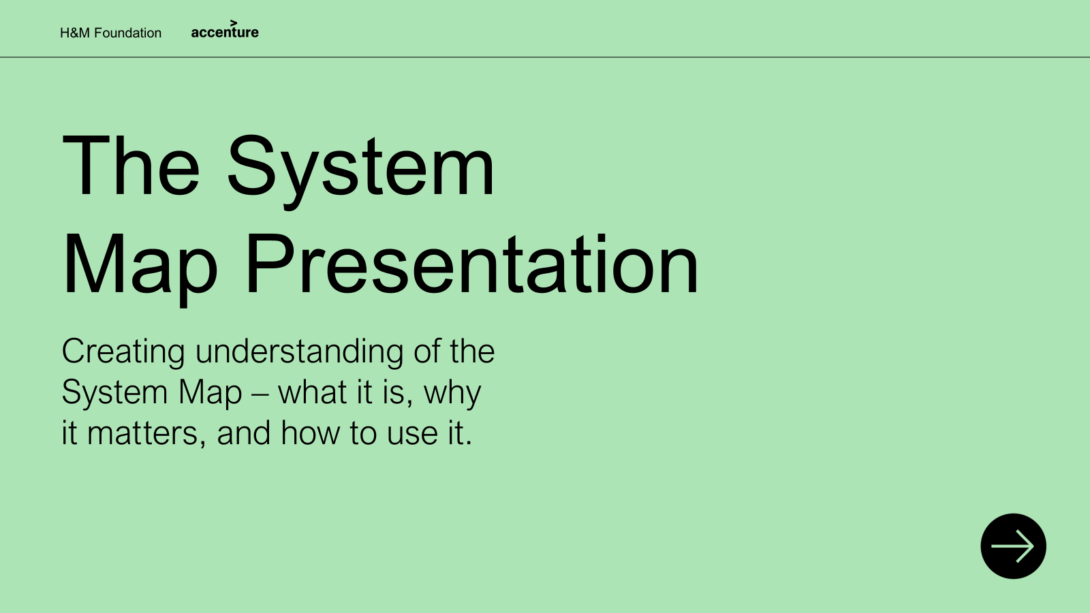
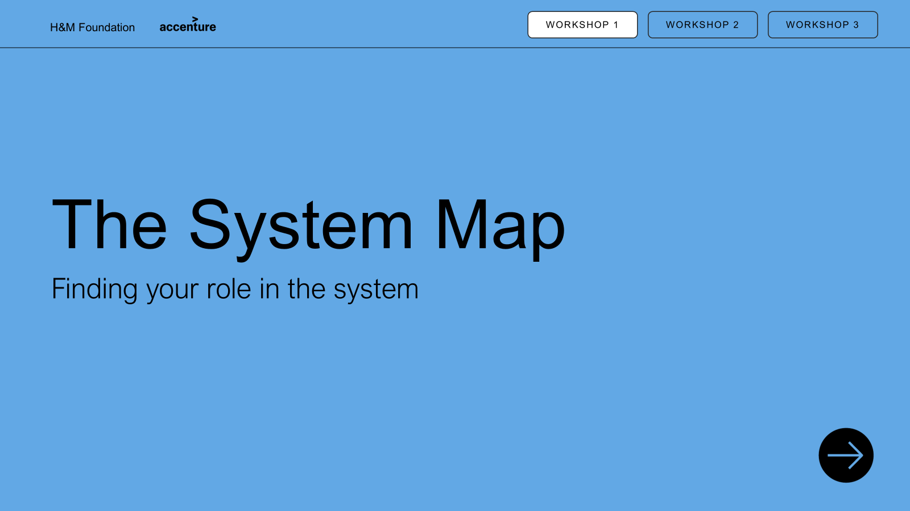
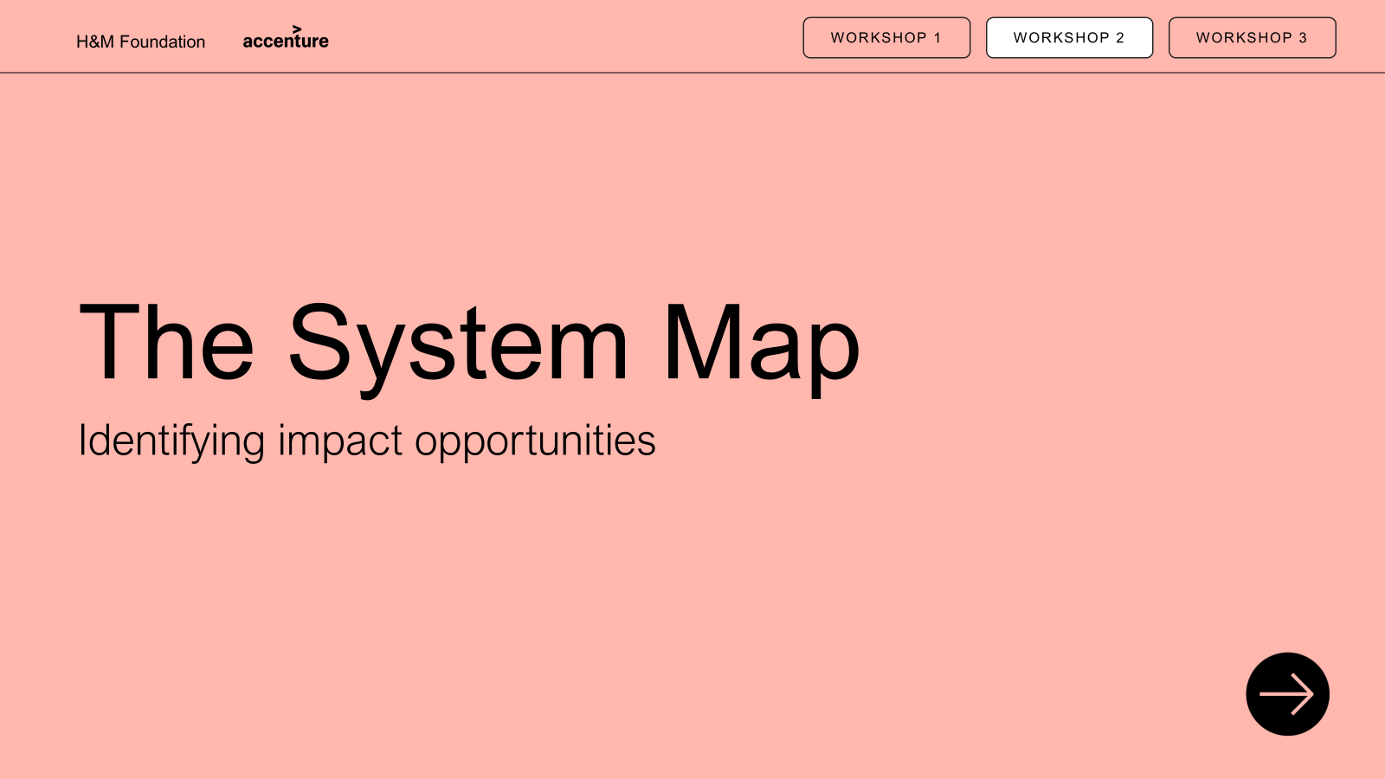
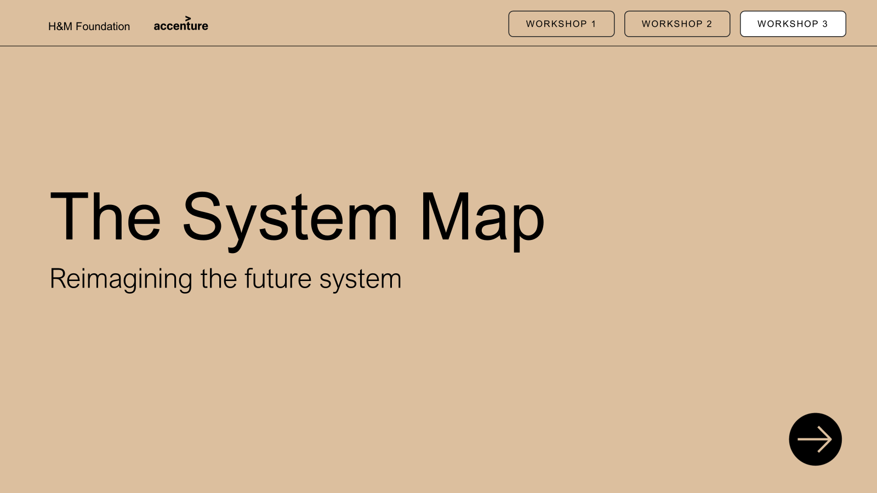
Executive summary: System Map presentation material
PRESENTATION
WORKSHOP 1
WORKSHOP 2
WORKSHOP 3
PURPOSE: This presentation material is developed to introduce the System Map and enable its practical use. The System Map is a flexible framework for making sense of the fashion system by bringing key stages, actors, and levers into one place. The following material introduces the map’s purpose, structure, and use, supporting users in understanding how the fashion system works and where change can be made. Optional workshops provide a deeper understanding of the fashion system, one’s position within it, opportunities for impact, and what a future system could look like to enable decarbonisation.
PARTICIPATION: This material is developed for all actors—whether you are actively working within the system or influencing it from the outside—from industry insiders and innovators to policymakers, investors, donors, researchers, and civil society. It is also designed to support new users engaging with the System Map for the first time.
PRESENTATION: It is optional how much of the material you choose to use—you may deliver only a keynote presentation or build it out with Workshops 1–3. Each workshop builds on the previous one, but the number of workshops you include and when you run them is entirely
up to you.
Content
Internal facilitator guide
Introduction: Trends shaping the industry of the future and purpose of visualizing the system
Read the map: Explain the map layers and elements (layers, flow actors)
Bring map to life: Brief examples of flows to relate to the map
Final: Inspire to start building on the map
Content
Internal facilitator guide
Introduction and purpose
Background
Exercise 1: Place yourself on the map
Exercise 2: Map relationships and influences
Exercise 3: Reflect on opportunities for collaboration
Wrap-up and group synthesis
System Map
30 min: Keynote presentation
Workshop 1
60 min: Finding your role in the system
Creating understanding of the System Map – what it is, why it matters, and how to use it
Opening discussion to familiarise with the map and identifying roles in the system
Content
Internal facilitator guide
Introduction and purpose
Background
Exercise 1: Find what impacts the system
Exercise 2: Place forces on the map
Exercise 3: Turn challenges into opportunities
Exercise 4: Reflect on opportunities for change
Wrap-up and group synthesis
Optional printable content
Content
Internal facilitator guide
Introduction and purpose
Background
Exercise 1: Start finding changes to the map
Exercise 2: Reimagine the System Map
Exercise 3: Start moving the needle
Wrap-up and group synthesis
Optional printable content
Workshop 2
90 min: Identifying impact opportunities
Workshop 3
120 min: Reimagining the future system
Identifying key impacting forces in the system and identifying opportunities to act
Developing the system to achieve decarbonisation though greater, and just impact
Contact Details: We are excited for you to use this material and spread the impact. While the material is public, we ask that it be used with care and credit — to support thoughtful, respectful dialogue and action. For any questions or clarification, we ask you to reach out to info@hmfoundation.com. You can credit us in any preferred way, but here is a suggestion hmfoundation.com/system-map/

Slide 2
Internal facilitator guide: Overview presentation approach
PRESENTATION
WORKSHOP 1
WORKSHOP 2
WORKSHOP 3
Background
Preparation
Follow-up
PURPOSE: The purpose of this presentation is to build a shared understanding of the fashion system as an interconnected whole and to introduce the System Map as a practical tool for navigating complexity, power, influence, and change.
The presentation prepares participants to actively use the System Map in workshops and decision-making, shifting from siloed thinking to becoming informed changemakers within the system.
PARTICIPANTS:
No limit to number of participants
Presentation can be held physical or digital, recommend physical for higher engagement
Any participants in or outside of the system can take part in the presentation
PRESENTATION: Start to familiarise
and prepare by
Understand the System Map yourself — be comfortable explaining it as one perspective, not a fixed truth
Know your audience — anticipate where they may feel defensive, confused, or curious
Practice the storyline — prepare your own words that you feel comfortable with and creates a story
Prepare prompts, not answers — be ready to ask reflective questions like “Where do you see yourself on this map?”
Set the tone — emphasize learning, openness, and exploration over right/wrong conclusions
MATERIALS AND TOOLS: Optional but effective to have the System Map (printed or digital) for participants to follow. – See the System Map Guide on the H&M Foundation website.
DOCUMENTATION:
Capture interesting discussions and perspectives sparked by the material to identify what could be developed further
Note any concrete feedback from participants on the presentation or suggested next steps
Document where questions, confusion, or misunderstandings arose to refine content, framing, or facilitation
REALISING OUTCOMES:
Shared understanding of the System Map and how actors, flows, and power connect
Confidence to locate one’s role and influence and identify leverage points for change

Slide 3
Internal facilitator guide: Keynote presentation agenda
PRESENTATION
WORKSHOP 1
WORKSHOP 2
WORKSHOP 3
Agenda | Time | Slide | Instructions | Key takeaway | Tips
1. Introduction | 8min | 5-11 | Welcome participants and set expectations: “This keynote introduces one model of the fashion system — not solutions.” Highlight why the session exists: shifting from awareness → understanding → action Walk through global forces reshaping the fashion industry (climate, geopolitics, regulation, tech) using the slides as prompts Make the link: systemic pressure → systemic response required | Participants understand why a systems perspective is necessary and the purpose of visualising the fashion system | Keep the tone accessible: no need for technical depth yet Use relatable examples (e.g., weather disruptions, regulation pressure) Avoid diving into the map — the goal is context-setting
2. How to read the map | 10min | 12-14 | Introduce the three layers: value chain, carbon, and systemic forces Explain the map’s elements (actors, bus routes, bus stops, lighthouses) Show how to read the map: not linear, not perfect, but a tool for sensemaking | Participants understand the map’s elements | Keep reinforcing: “There is no single ‘correct’ interpretation.” Use a pen or pointer to show flow between islands Pause to check comprehension before moving on
3. Bring the map to life | 7min | 15-18 | Walk participants through the example step by step, showing where it starts on the map and how it moves across actors, flows, and value-chain stages Point out what changes and why, highlighting the trigger (e.g. regulation or innovation) and the ripple effects it creates Pause to reflect, asking participants what surprised them or where they see risks, trade-offs, or opportunities | Participants see the map as dynamic and alive — not as a static illustration — and understand how decisions cascade across the system. | Familiarize yourself with the examples beforehand to use the map as a conversation tool, not a script — focus on guiding attention and curiosity rather than explaining every detail Emphasise interdependence rather than complexity
4. Final word | 5min | 19-20 | Bring the narrative home: “If we don't see the system, we can't change it.” Connect back to participants’ roles: where they sit, who they depend on, and which choices influence system outcomes Invite them to take the next step (whether that is workshops or internal reflection) | Participants leave with clarity about their role in the system and why systems thinking is essential for impactful change. | Keep it human: use a reflective, motivational tone Avoid jumping into problem-solving — the aim is readiness, not answers If WS1 follows later, mention it briefly; if not, position the keynote as a standalone tool they can use

Slide 4

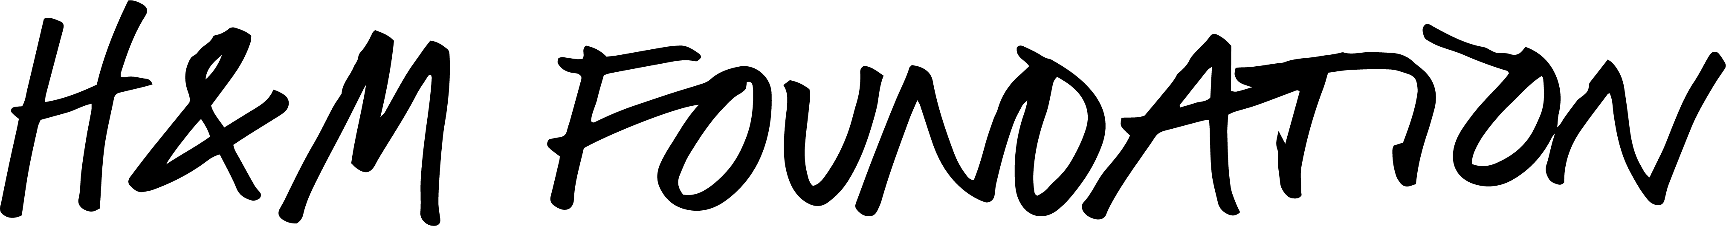
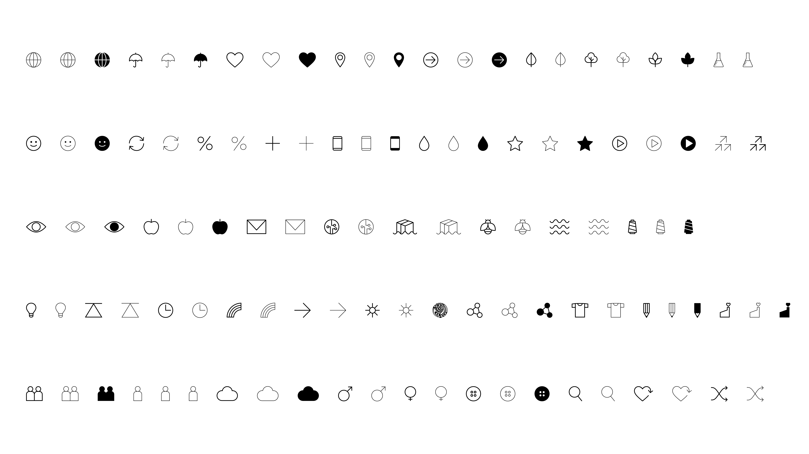
The System
Map Presentation
Understanding of the System Map –
what it is, why it matters, and how to use it.
30 min

Slide 5
01
Introduction

Slide 6
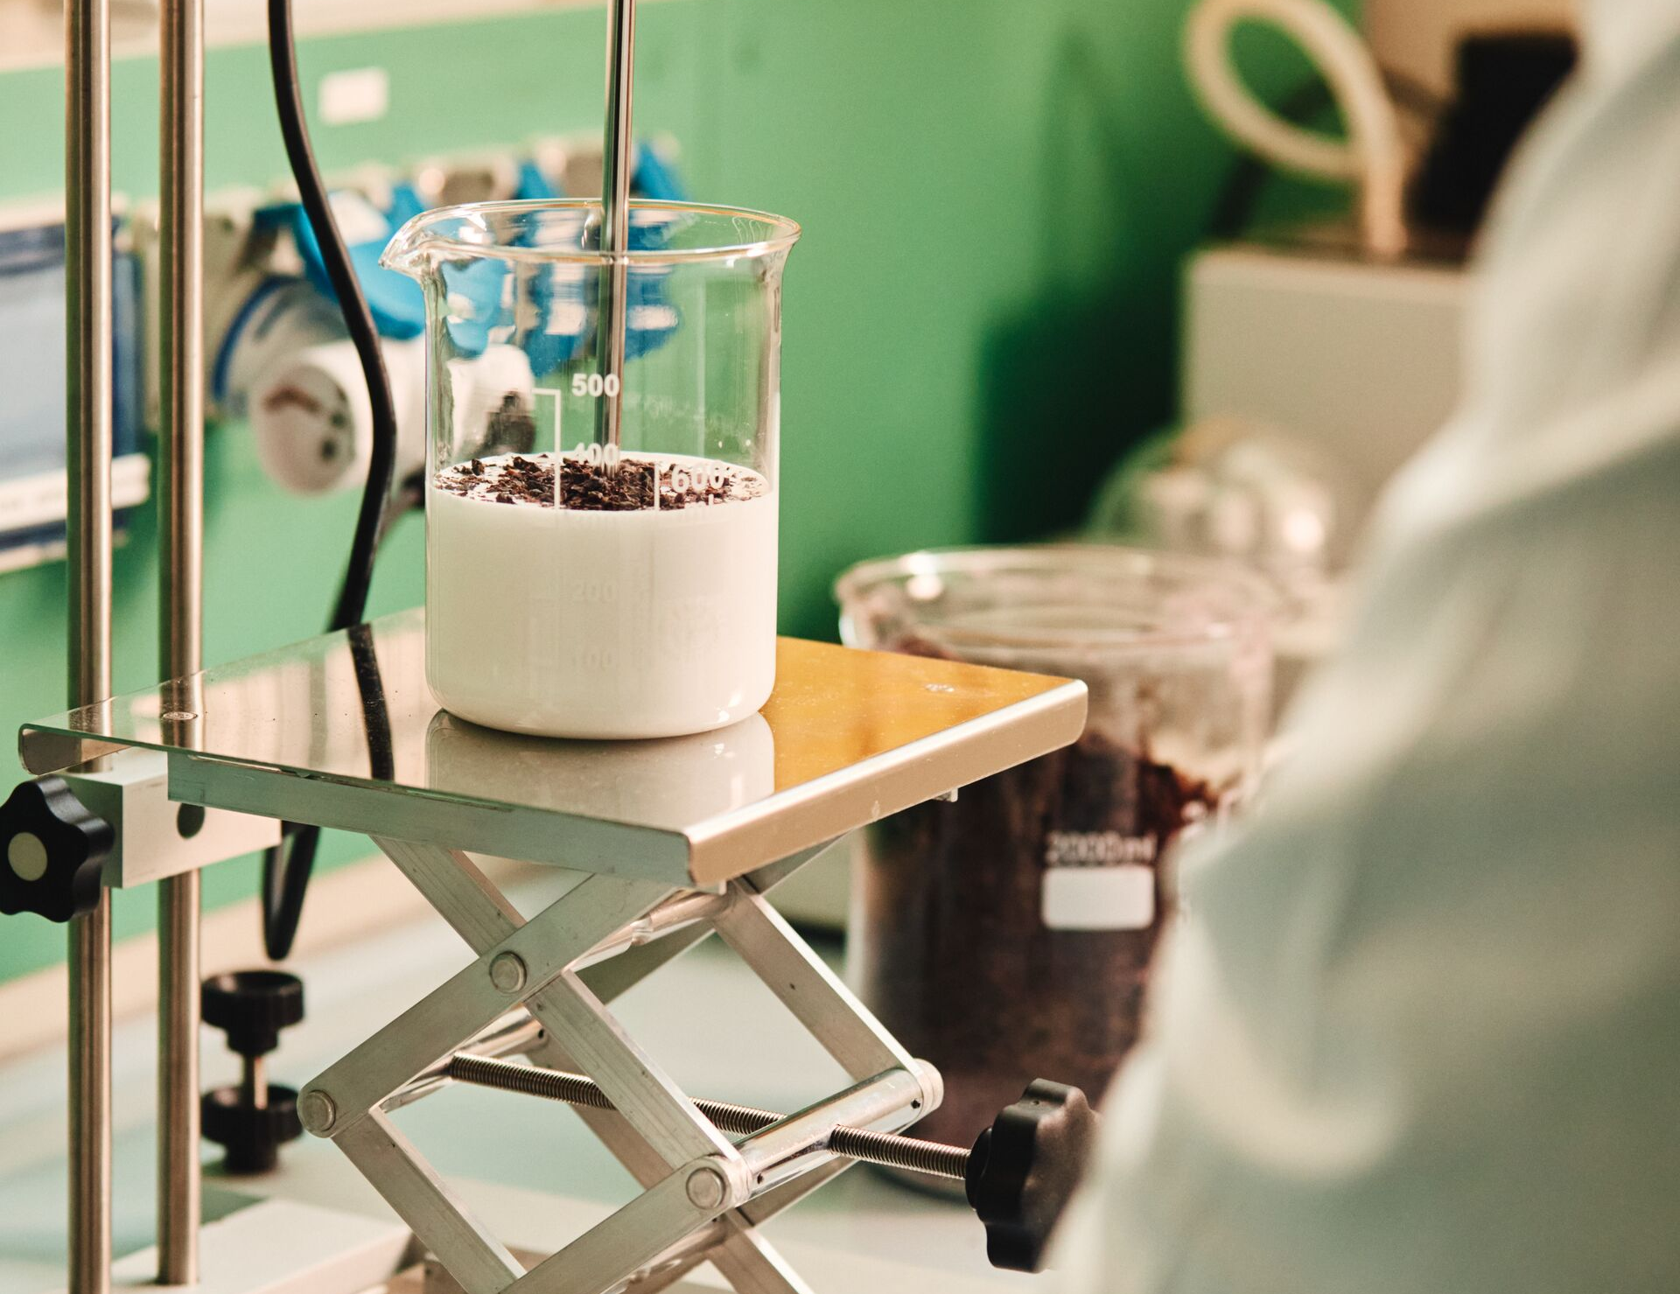
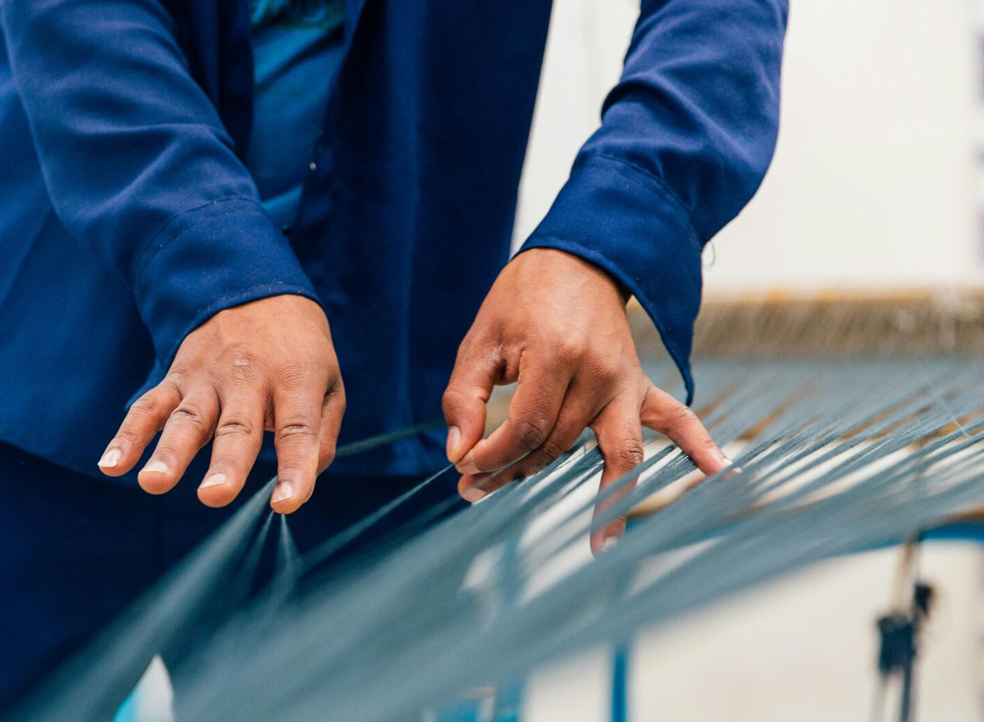



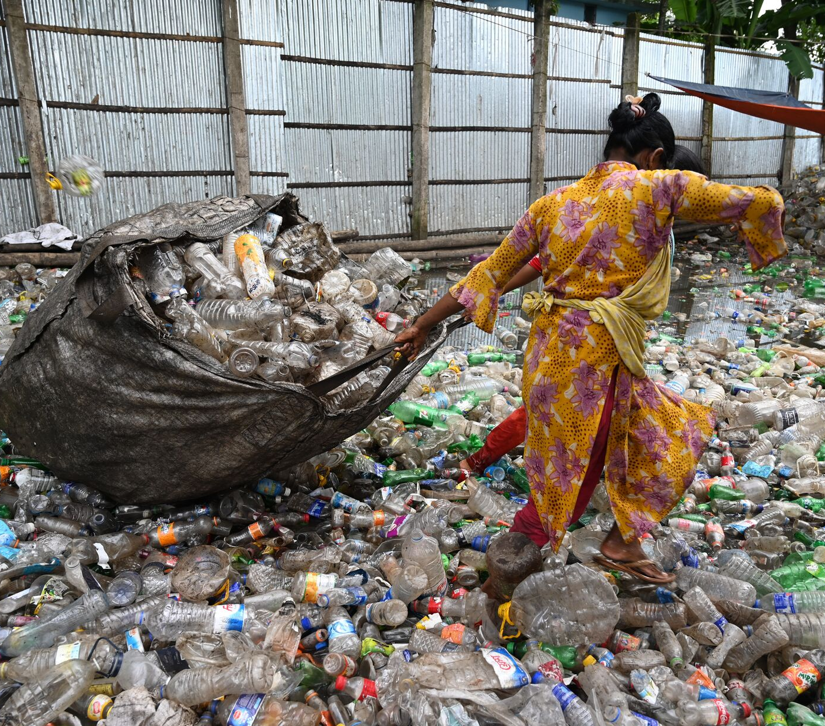
The world is changing
Global trends accelerate the need for systemic transformation of the fashion industry.
Adoption
of AI and digitalisation
Regulations
Climate risk and extreme weather
The politicisation
of sustainability
Growing
geopolitical uncertainty
Need for decarbonisation models
6

Slide 7
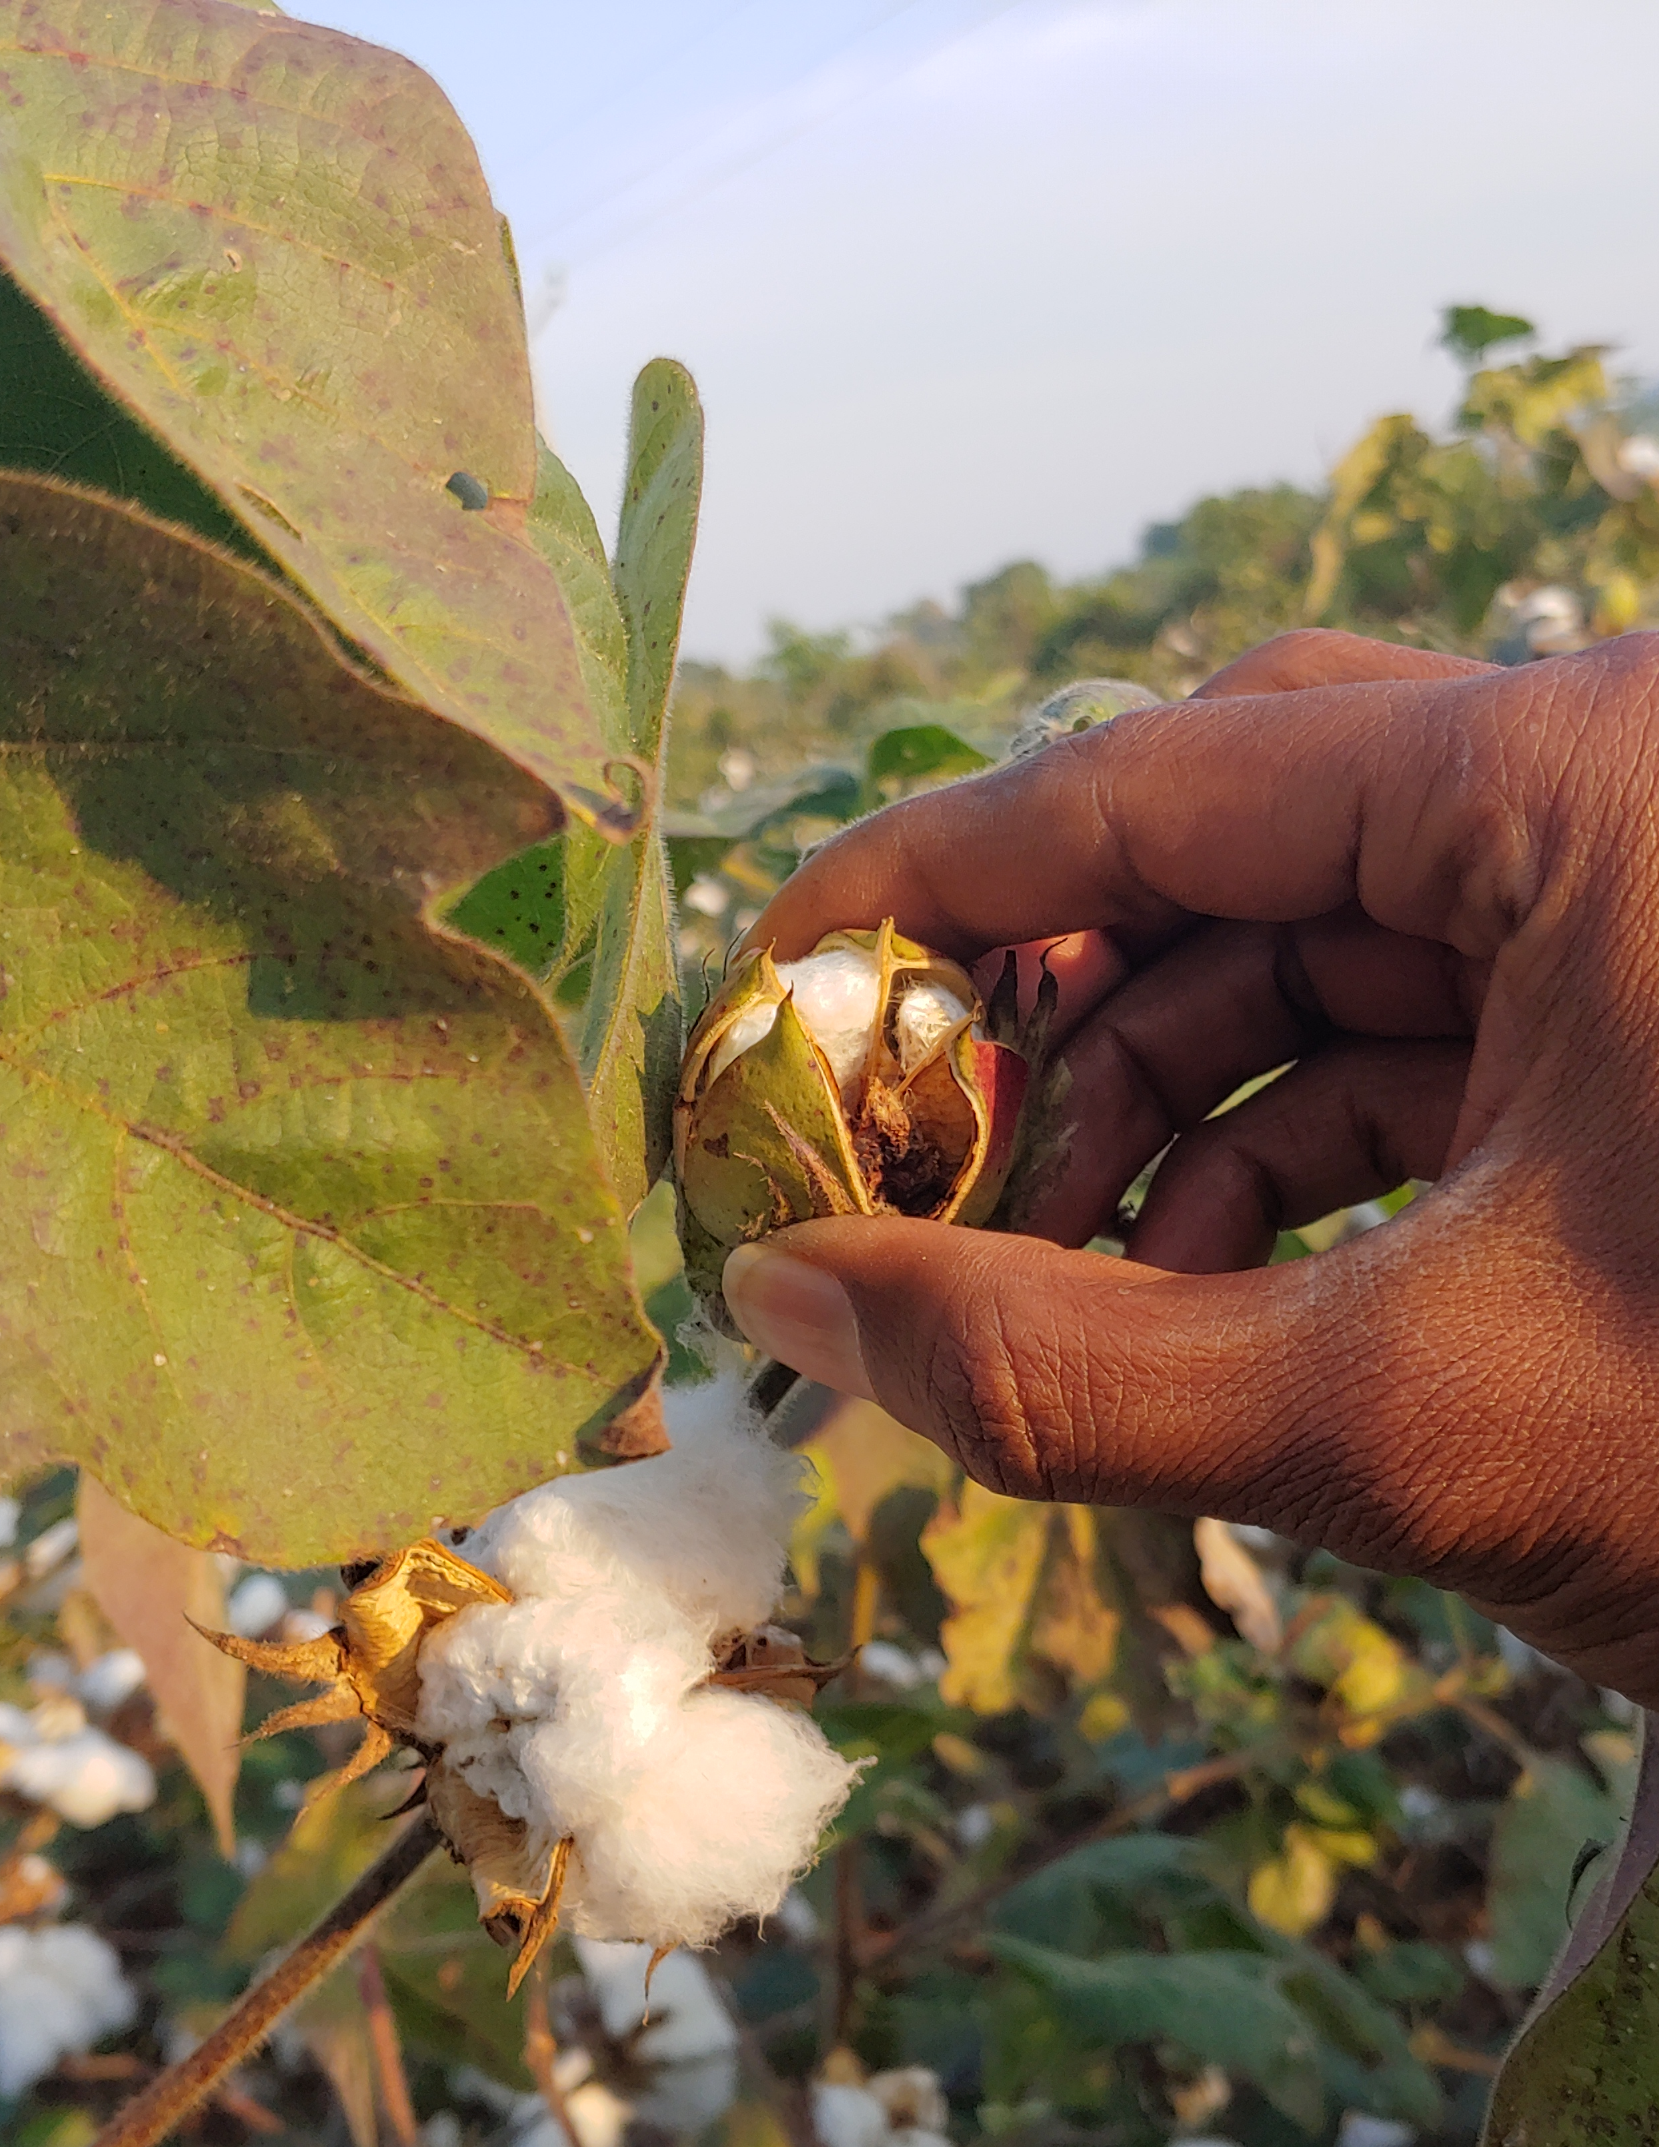
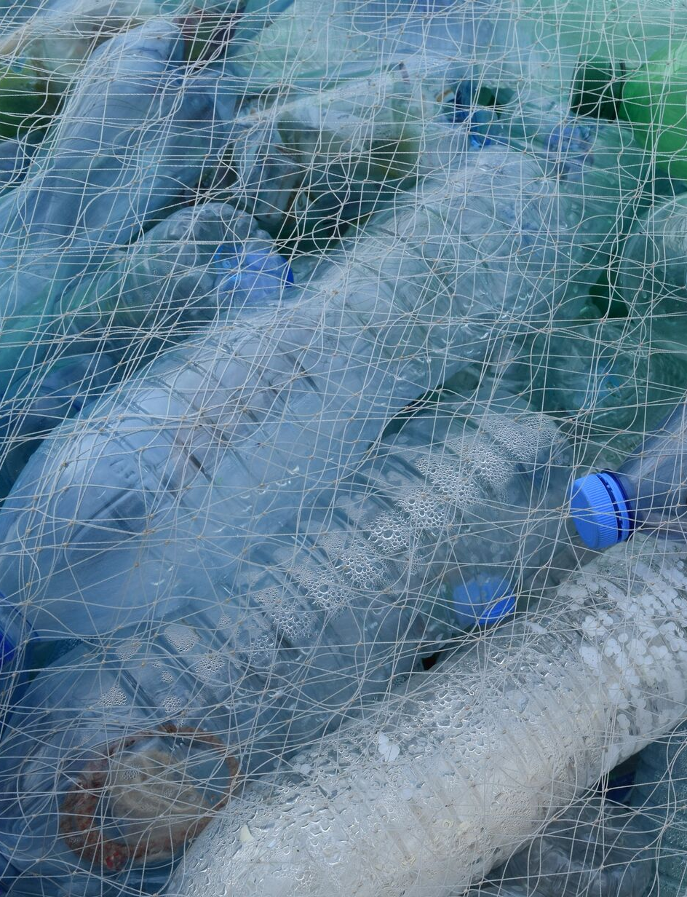

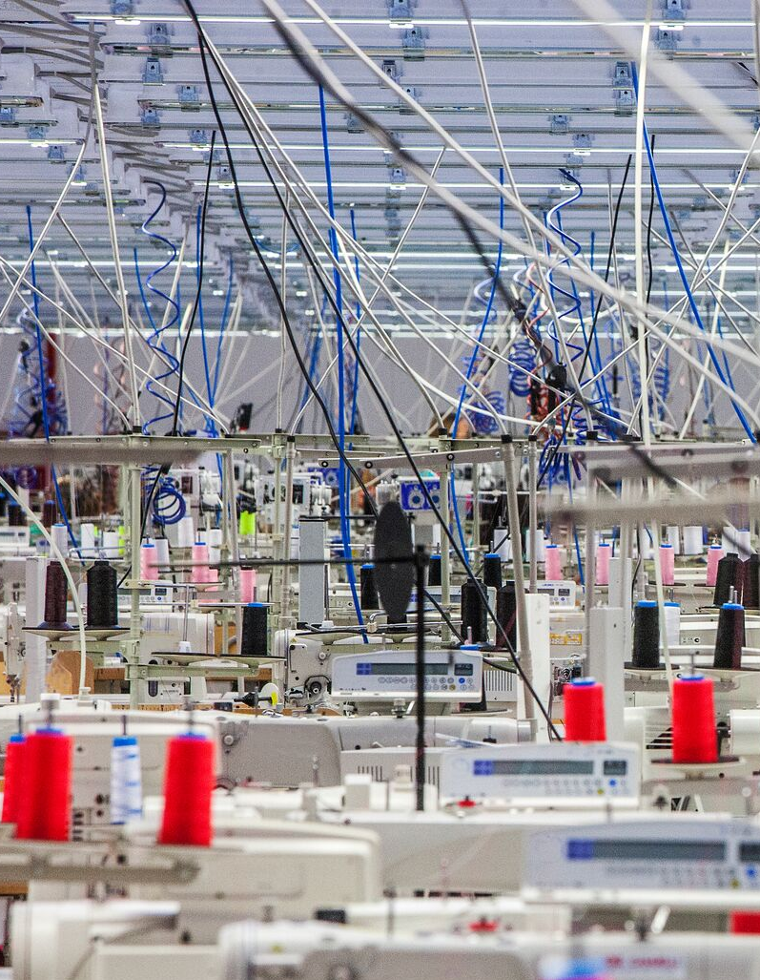

There is an urgent need for a climate and
sustainable shift at scale in the fashion industry
Biodiversity:
Cotton occupies approximately 2–3% of cropland, yet accounts for an estimated 10–20% of global insecticide use¹
Ocean: Synthetic textile laundering is a major driver for microplastic pollution in the world's ocean²
Water: Fashion and textile sector is one of the largest users of freshwater³
Climate: The textile industry accounts for around 2-8% of global emissions⁴
Land: Apparel supply chains are linked to soil degradation and habitat loss⁵
To create lasting change, climate and sustainable shift must be paired with a just transition that considers who bears the costs and who benefits
Sources 1 | FAO ; United Nations Environment program (UNEP) “Sustainability and Circularar Textiles” ; Better Cotton Initiative (BCI) 2 | OECD “Policy Scenarios for Eliminating Plastic Pollution by 2040” 3&4 | United Nations Environment Programme (UNEP) 4 | Apparel Impact Institute Annual Report 5 | United Nations Convention to Combat Desertification (UNCCD) “Fashion & Land”
7

Slide 8
We might see these problems, but only when we view the industry as an interconnected system can we achieve systemic change
Thinking
Understanding
Doing
Systemic Change
Seeing the problems
Identifying change
Becoming a changemaker
01
Long-term, holistic change instead of quick-fixes in silos.
The fashion system is under pressure – from emissions, waste and working conditions – but awareness alone does not change incentives or decisions.
A systems lens
shows that pricing, governance, targets, culture and relationships really shape outcomes – but nothing changes until these insights are turned into concrete choices.
Insights are translated into adjusted targets, processes, and partnerships, enabling day-to-day decisions
to align with long-term goals and gradually shape how the system behaves.
02
Confronting and resolving root causes instead of reinforcing biases and fallacies.
03
Prioritising high impact action without ignoring the effect of changes in other parts of the system.

Slide 9
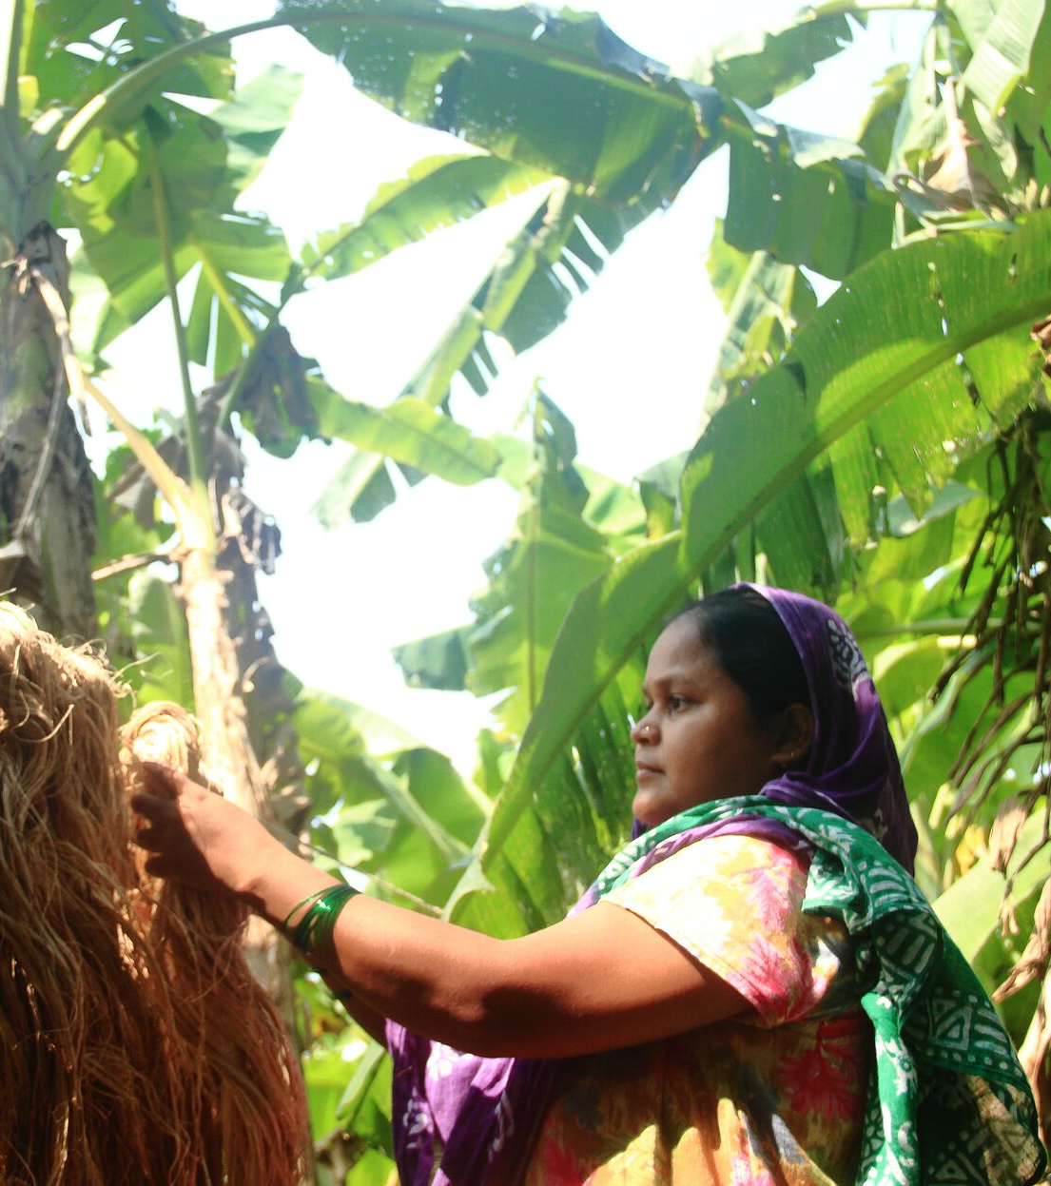
The good news is, we are all part of the system
From consumers to suppliers, brands and changemakers. Whether actors are actively part of the system or contribute from the sidelines, everyone plays a role.
Some benefit…
Some are exploited…
Some never see the system…
Seeing the system and being open about what needs to change is the key starting point.

Slide 10
So, what can the system look like?
10

Slide 11
Introducing the system map: one way of visualising the fashion system today
It’s not perfect. It’s not
the only map. It’s not linear.
You may see it in a
completely different
way, and that’s okay.

Slide 12
02
How to read the map

Slide 13
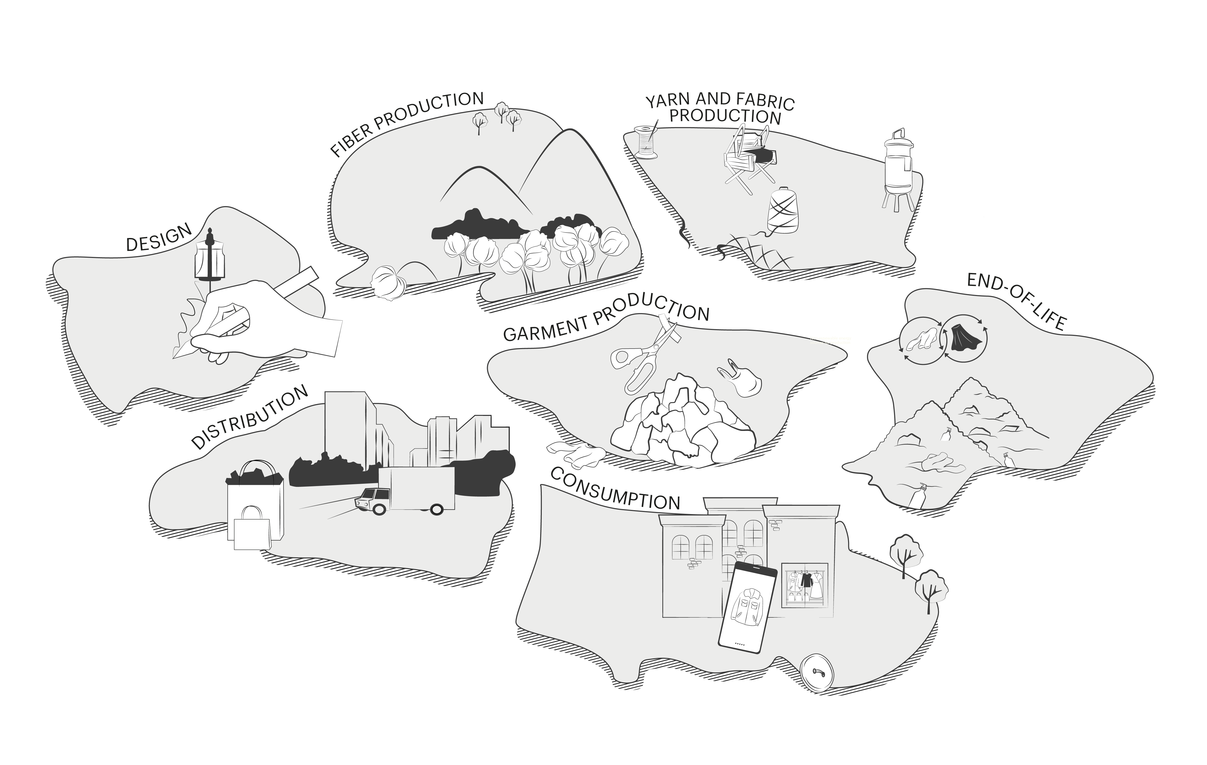
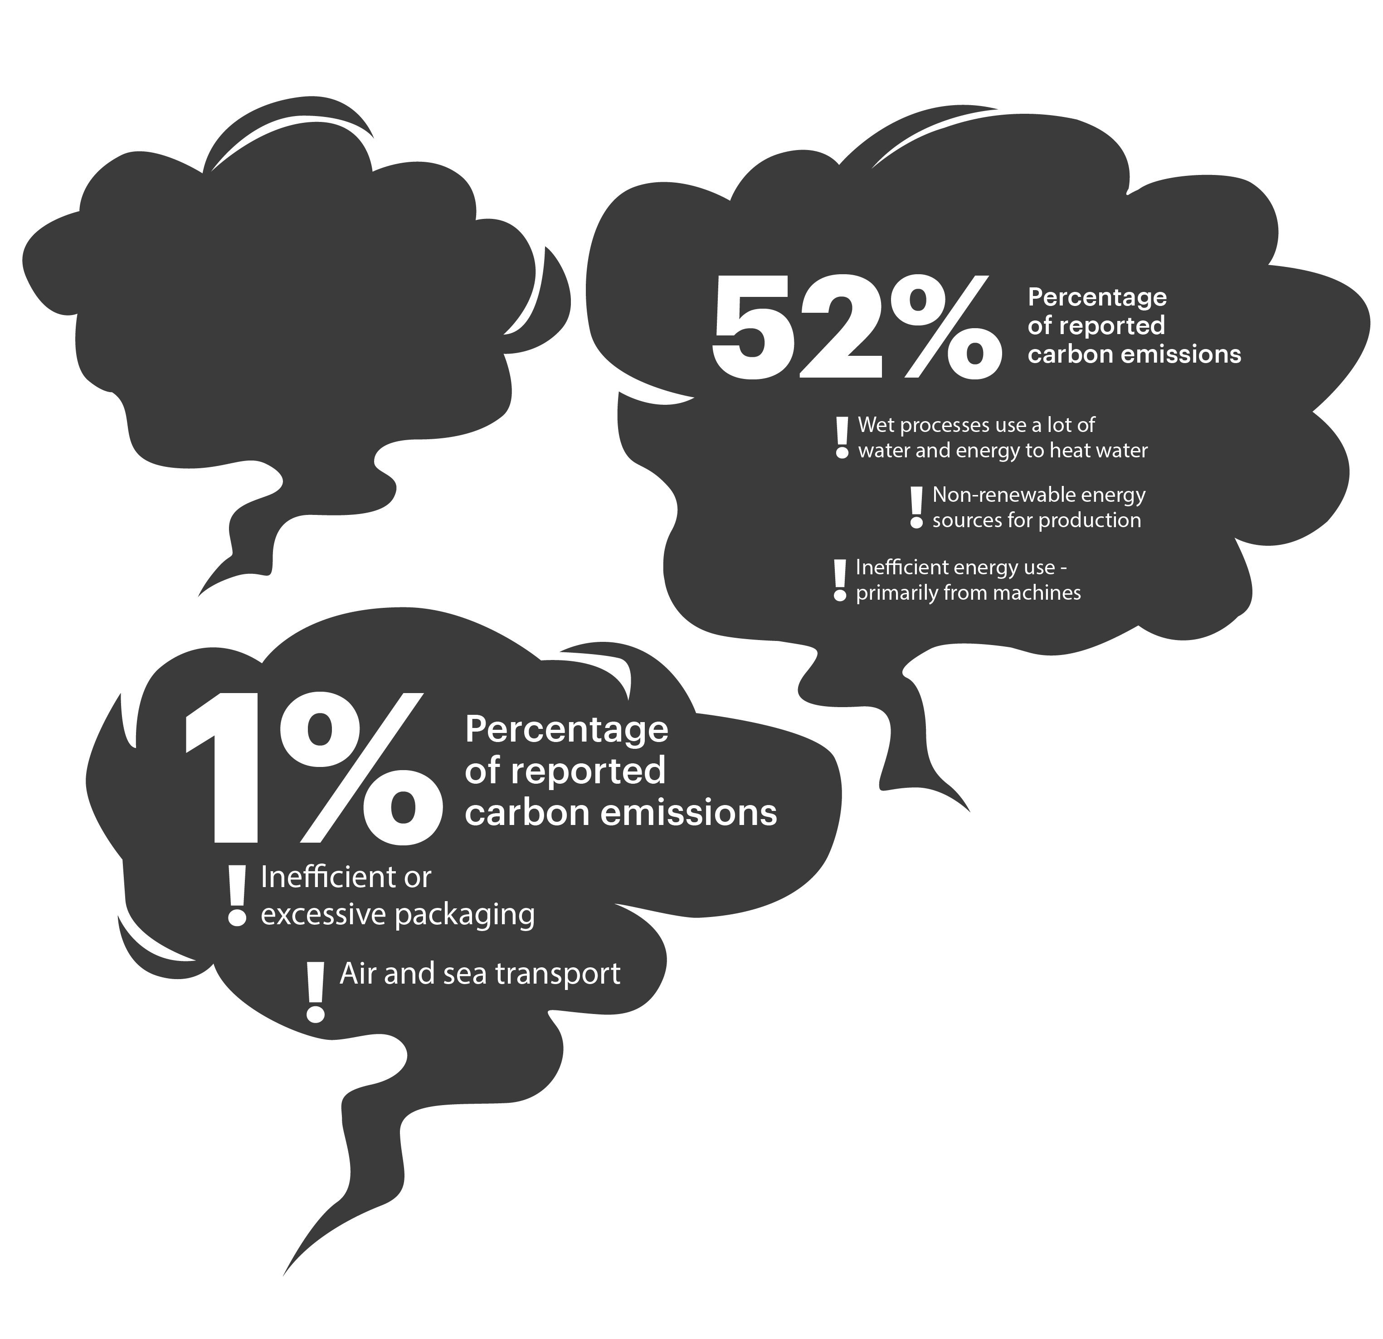
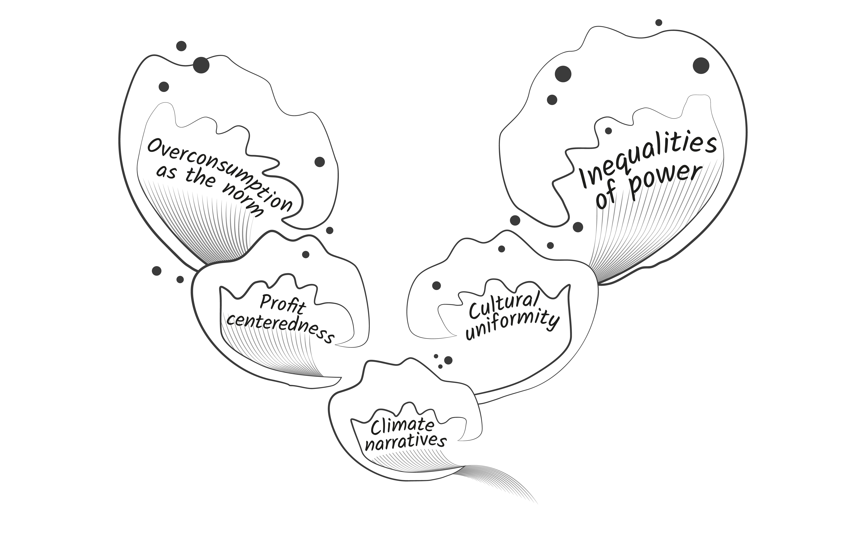
The map has three layers
Layer 1: The value chain
The basic steps and stages of the fashion value chain are shown as islands on the map - such as design island or consumption island.
This should feel familiar to most
of us - it is the value chain.
Layer 2: Carbon
Smoke clouds show the share
of emissions for each island
or stage. Exclamation marks
flag key drivers to spark decarbonisation conversations.
Layer 3: Systemic forces
Macro forces – such as cultural norms and power dynamics - subtly or forcefully influence
how the system works and which decarbonisation efforts
will succeed.

Slide 14
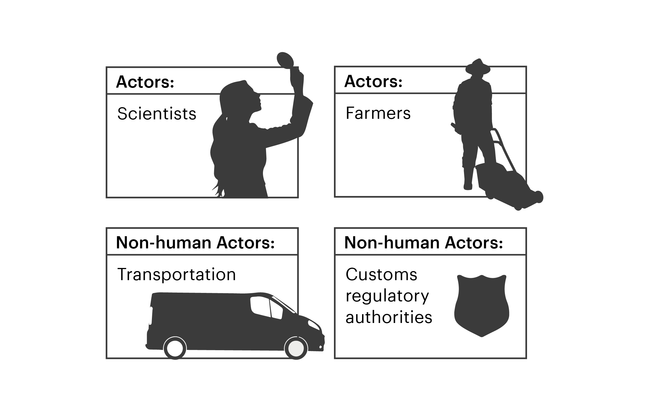
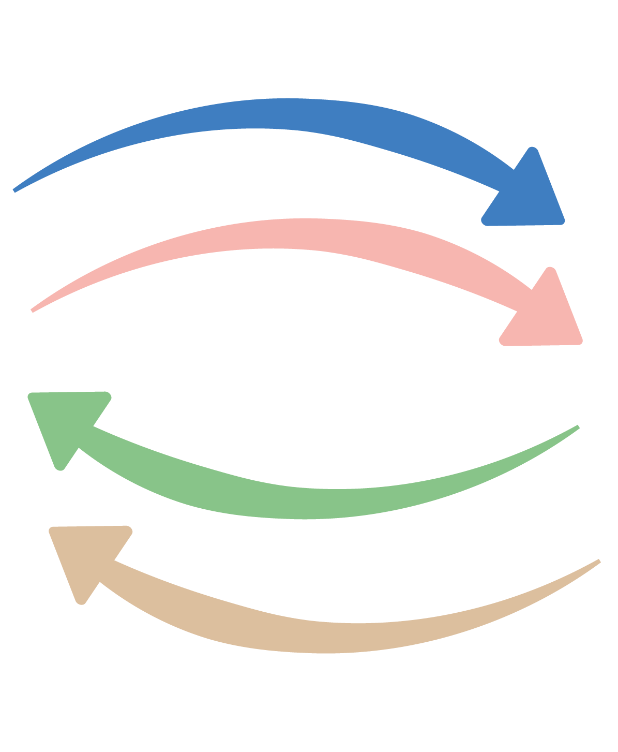
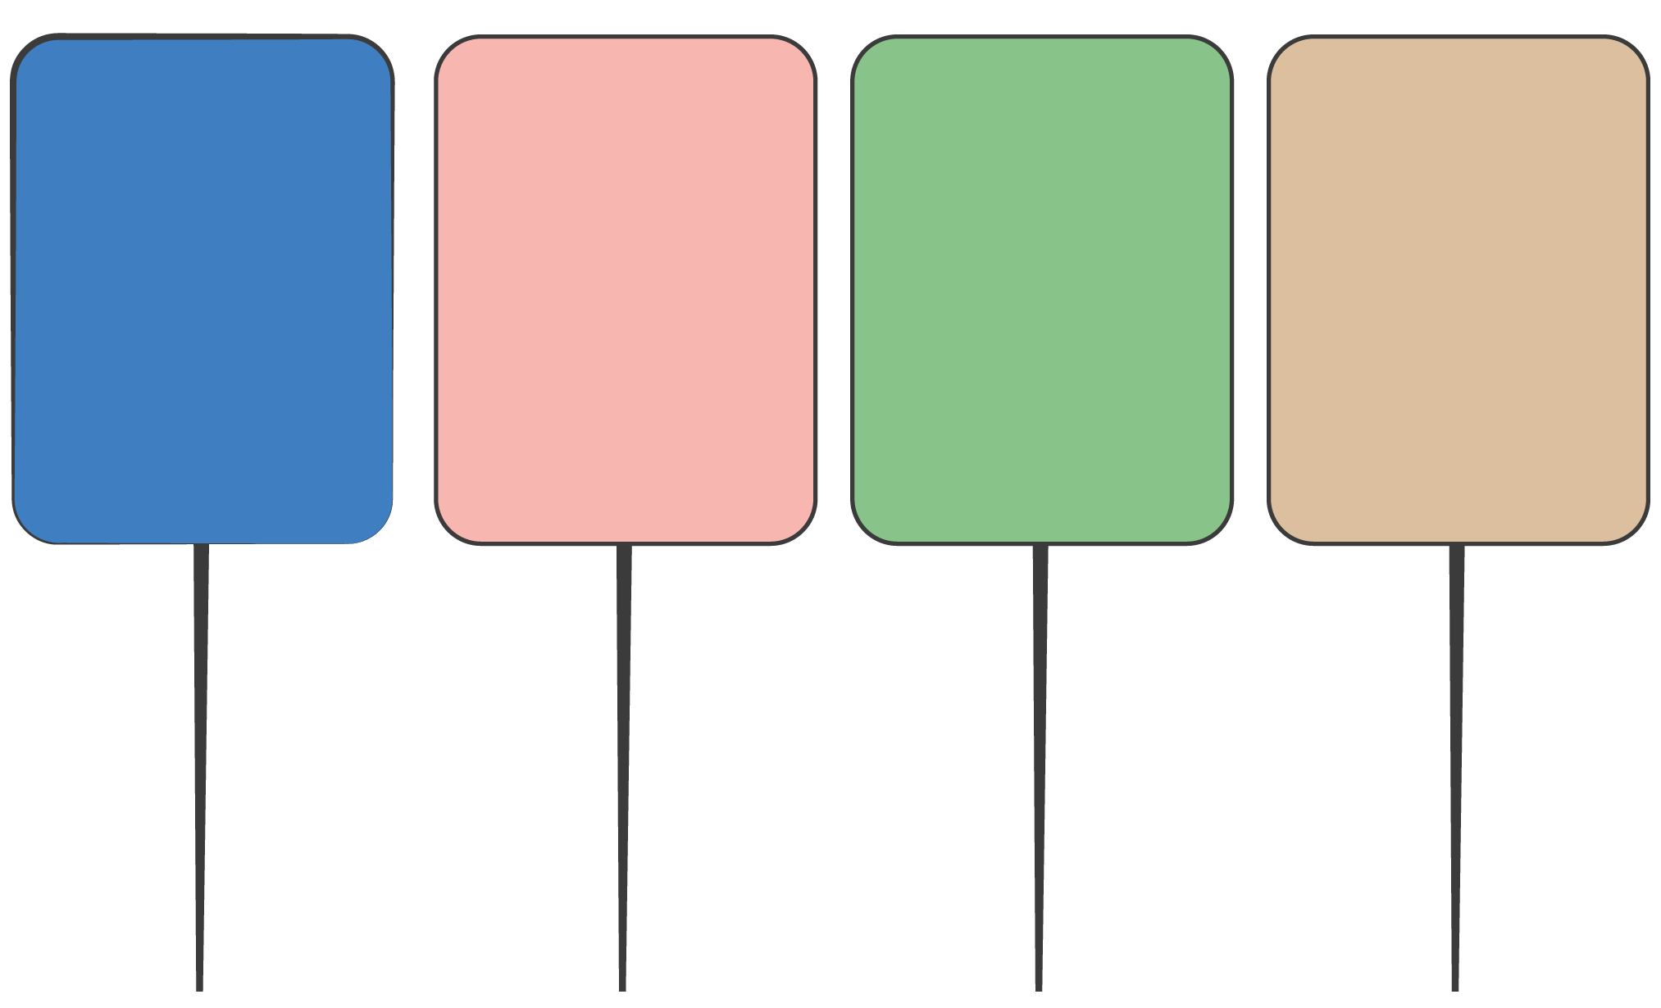
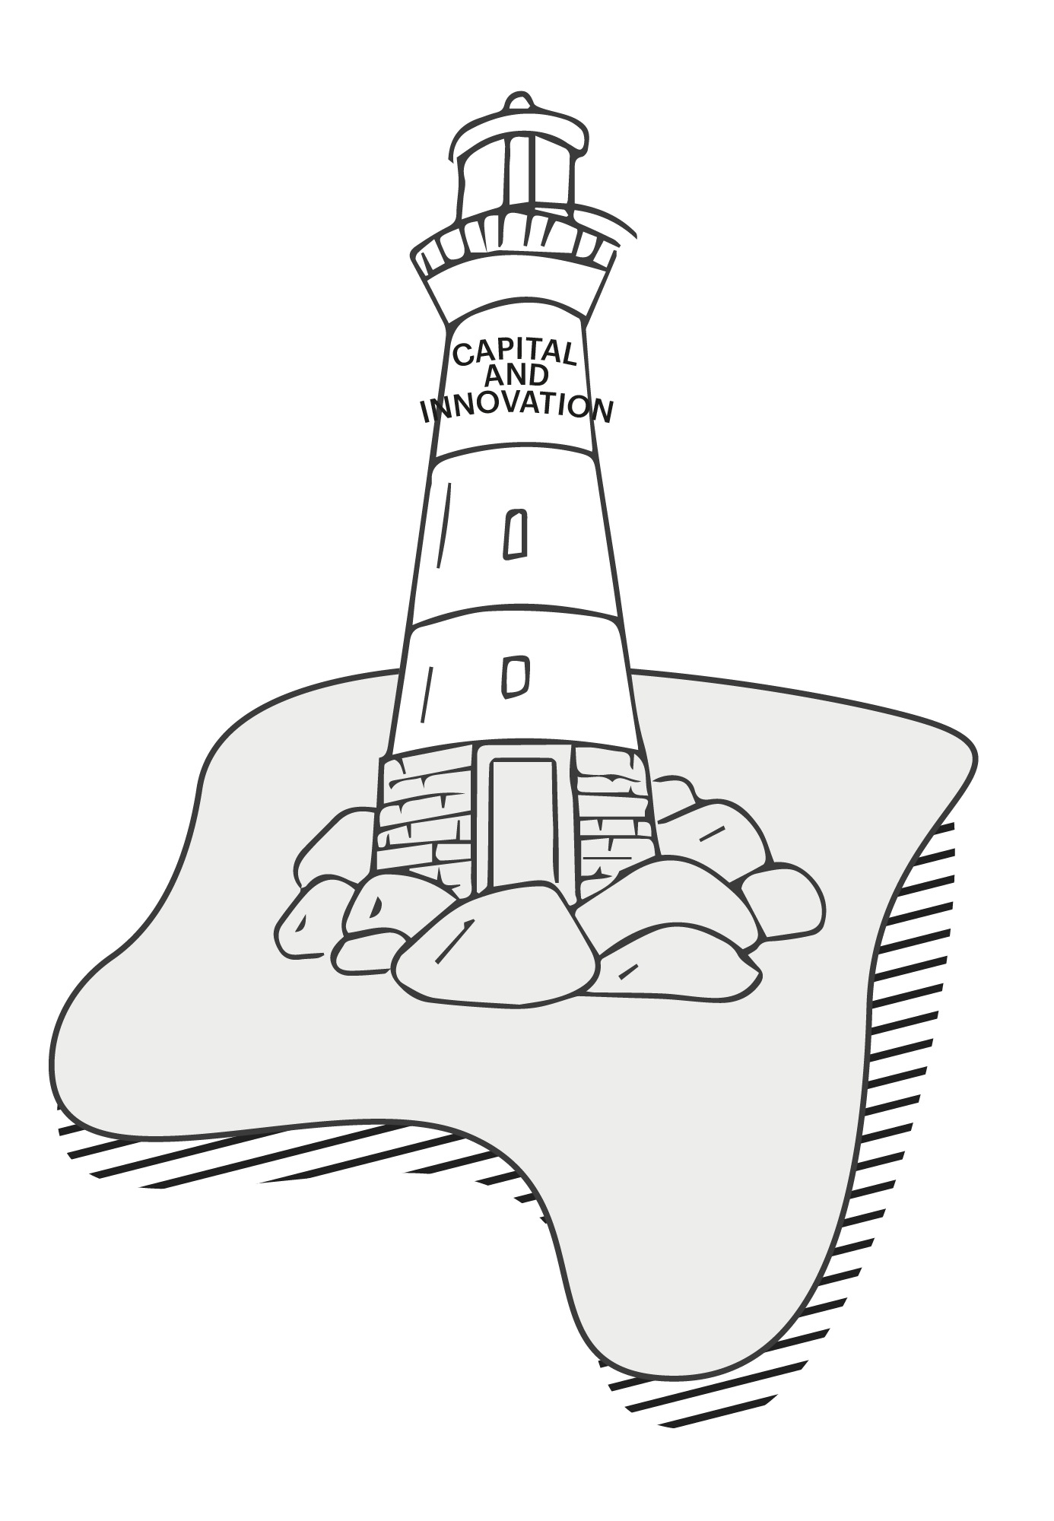
There are additional elements connecting the map
Actors are the people, organisations and technologies shaping fashion — from those who run it to those who contribute to it.
Bus routes trace four flows —
compliance, capital and funding, innovation, and demand — showing how they move through the system.
Bus stops mark leverage points along each route – when brands place orders and regulators set standards. They highlight where change or enablers shift behaviours of routes.
Lighthouses represent actors that influence multiple parts of the value chain at once—such as standard-setters or global initiatives—signalling where system-wide steering power sits

Slide 15
03
Bringing the map to life

Slide 16
Here are two examples that help explain how to read and use the map
Compliance
Let’s look at how regulation reallocates responsibility and raises the minimum standards for system-wide behaviour.
Innovation
Let’s look at how new capabilities and technologies reconfigure processes, roles, business models and expectations.
PROVOCATION:
PROVOCATION:
How might forthcoming rules reshape the system?
Which innovations could accelerate decarbonisation
in your context?

Slide 17
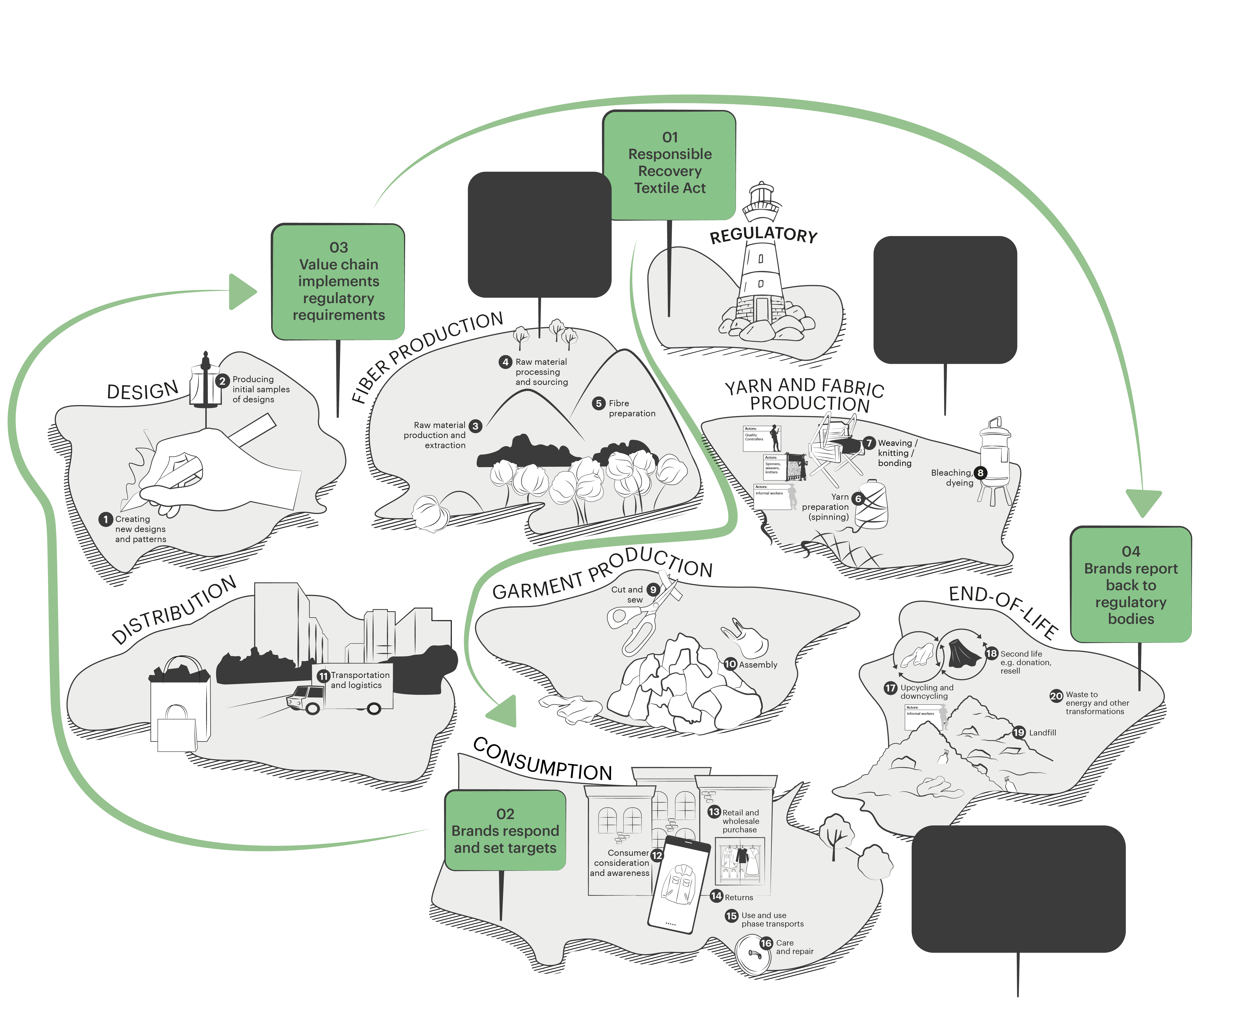
Let's look at how compliance shapes the system
Compliance
Innovation
Responsible Recovery
of Textiles Act (Sept 2024)
This Act shifts end-of-life accountability onto brands, making producers responsible for collecting, repairing and recycling garments.
It shows how regulation can relocate responsibility to the companies placing
products on the market.
Garments are designed to be repurposed at end-of life stage
Fibers that
are easier to recycle are the norm
Change drivers
Designing garments for recovery from the outset
Strengthening traceability across the value chain
Building collaborative systems with recyclers and regulators to demonstrate compliance
Takeaway: Circular design, traceability and take-back schemes become basic licence to operate, not optional projects.
Brands could benefit from getting customers directly involved in repurposing OR recycling / collection
Bus stops
Changes

Slide 18
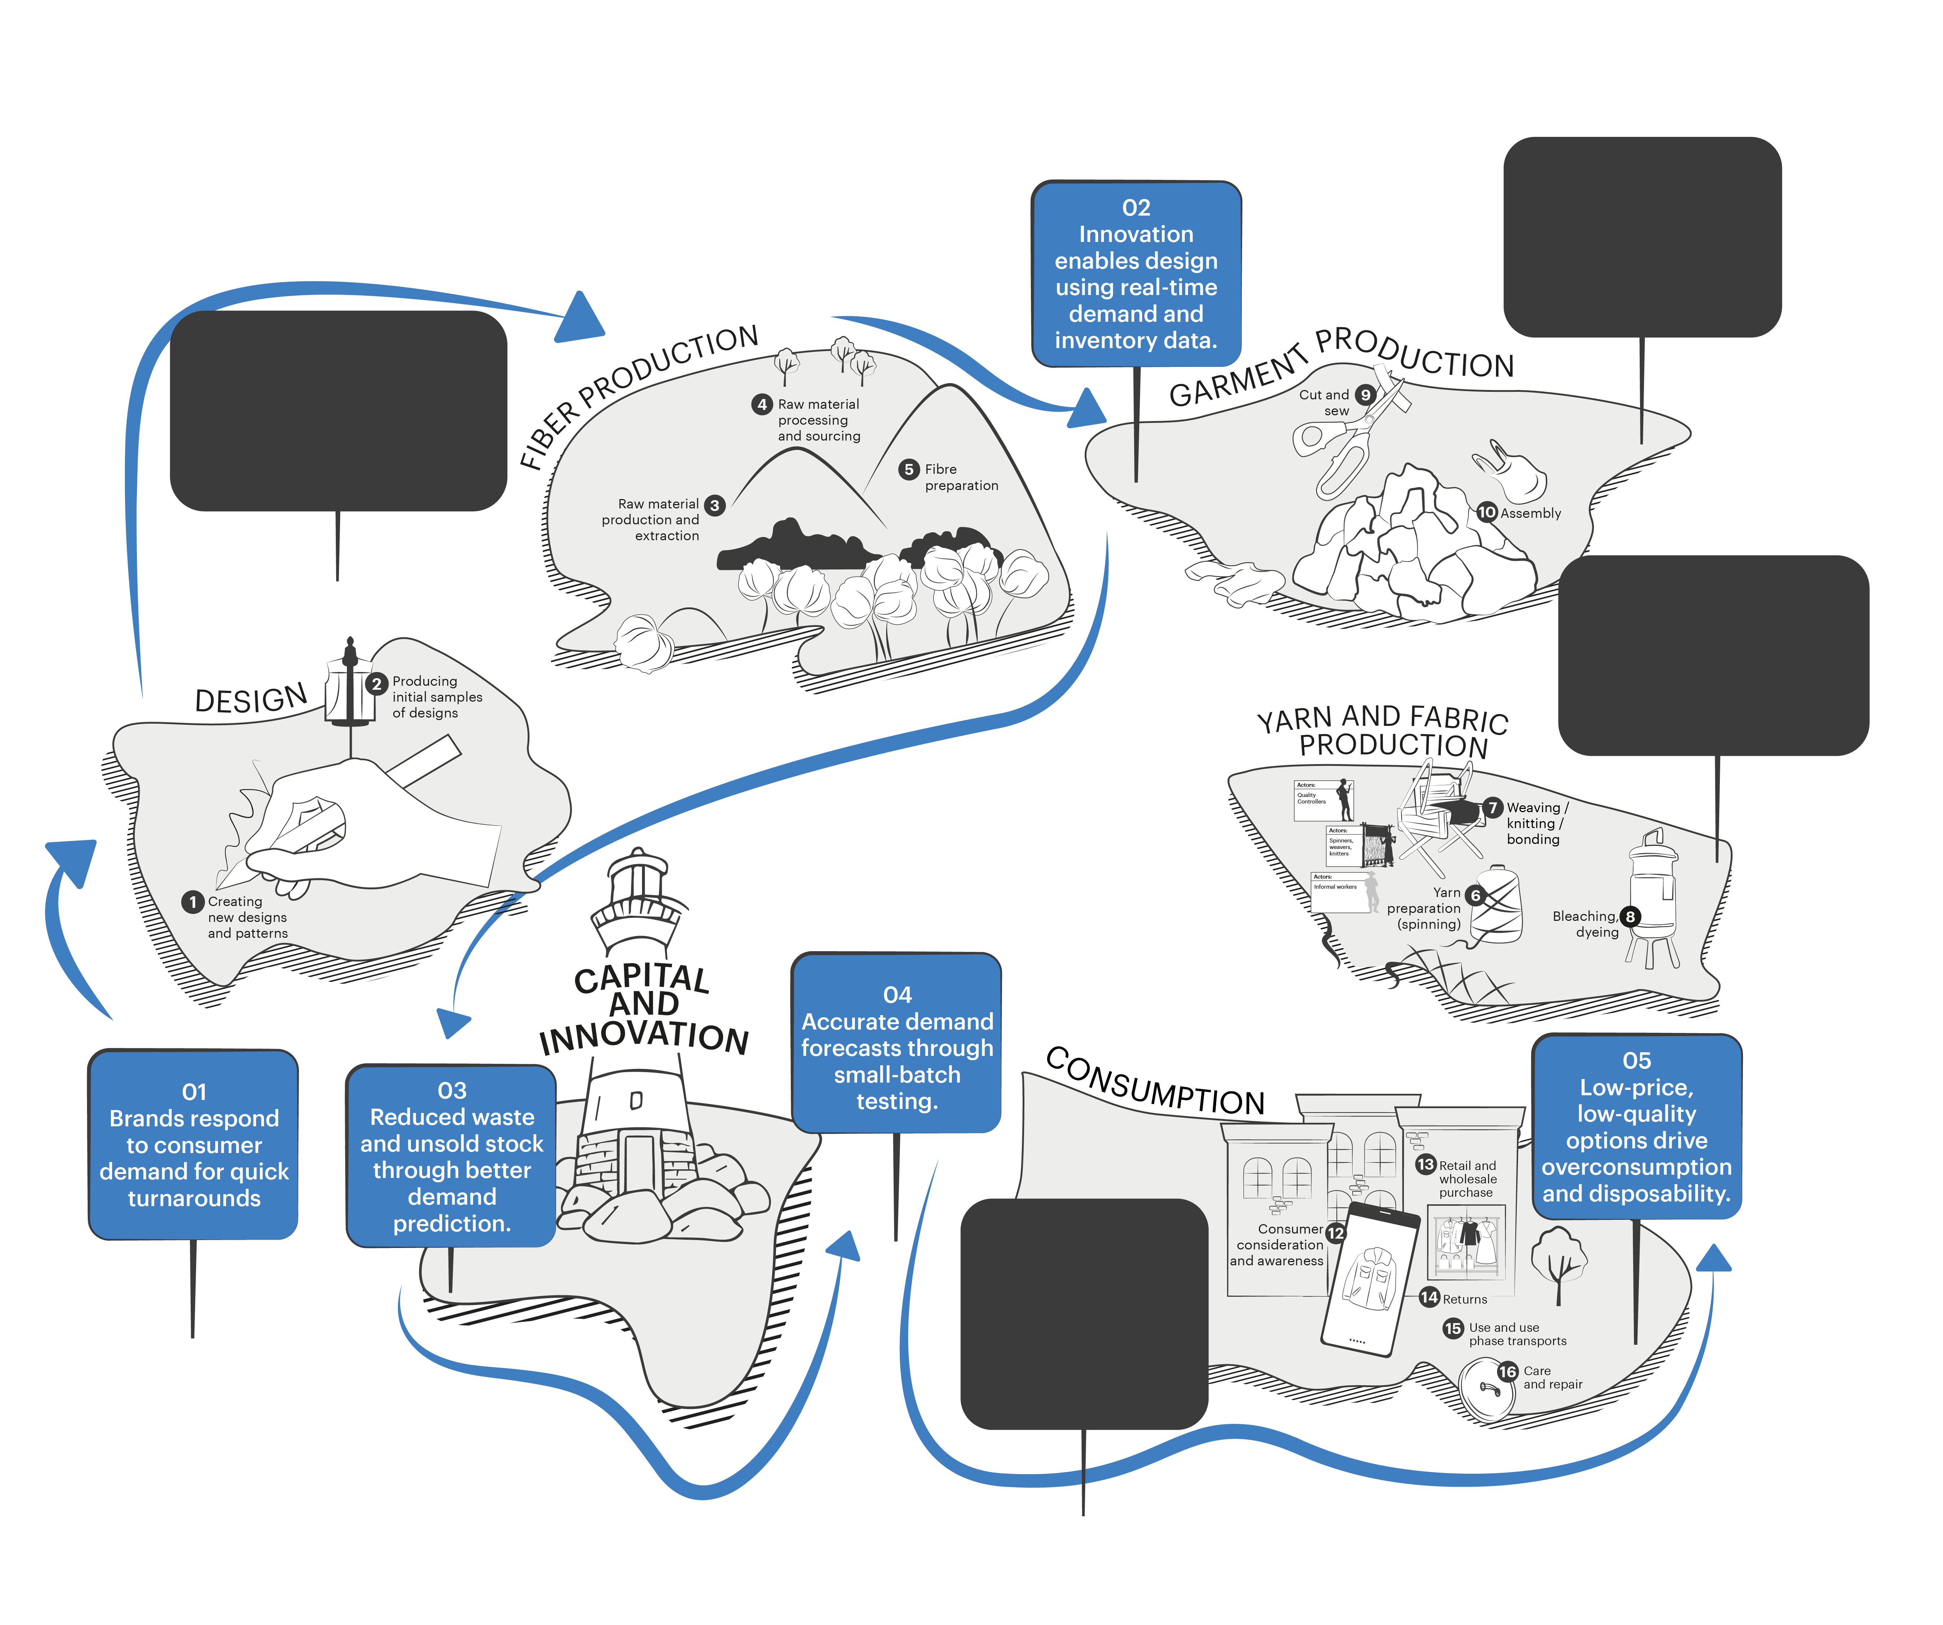
Compliance
Innovation
Let's look at how innovation shapes the system
Small-batch manufacturing
The innovation of on-demand production uses small test runs and real-time data on trends and inventory to decide what to scale, shortening lead times and reducing unsold stock.
Only natural or recycled raw materials are used
Ethical labour standards are followed and rewarded
Change drivers
Integrating real-time data into design and demand planning
Reconfiguring production to enable quick, flexible batches
Improving efficiency and reducing unsold inventory
Expanding choice at lower prices – which can increase consumption
and disposability
High-quality production ensures longevity and reduces the need for replacement.
Takeaway: Innovation requires clear guardrails, otherwise efficiency gains risk driving even more consumption and emissions.
Pride in high-quality, ethically made products reduces disposability.
Bus stops
Changes

Slide 19
04
Final word

Slide 20
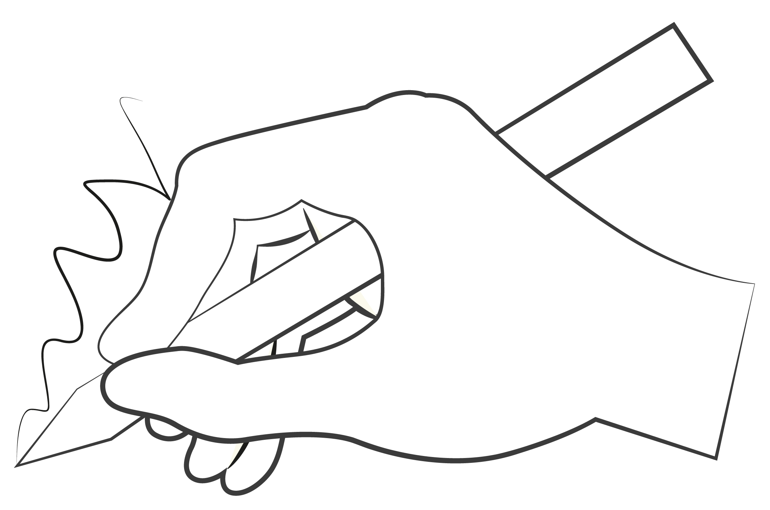
It’s your turn to reimagine the system
The map gives everyone
a common language and a neutral canvas for designing what needs to change next.
No single actor can transform fashion alone, but when many players move in the same direction, small actions can add up to bold,
system-level change.
Mapping roles and interdependencies
help us see where collaboration
and targeted interventions can most effectively accelerate impact while ensuring just transition.
Take the map, pick up a pen and don’t be afraid to reimagine.
Change starts with understanding the system and the role you play in it. The System Map helps you see where you sit, who you depend on, and where shifts in behaviour, investment or policy could make a real difference

Slide 21
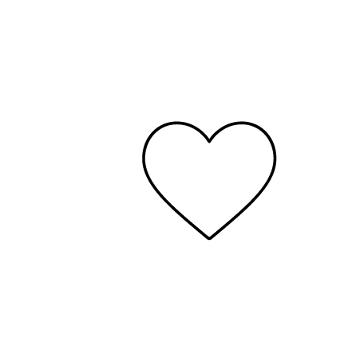
Thank you
Stay updated
hmfoundation.com
Contact us
info@hmfoundation.com
Follow us​
Instagram, Facebook, LinkedIn
and YouTube: @hmfoundation​
When you’re ready, feel free to continue with Workshop 1

