Slide 1
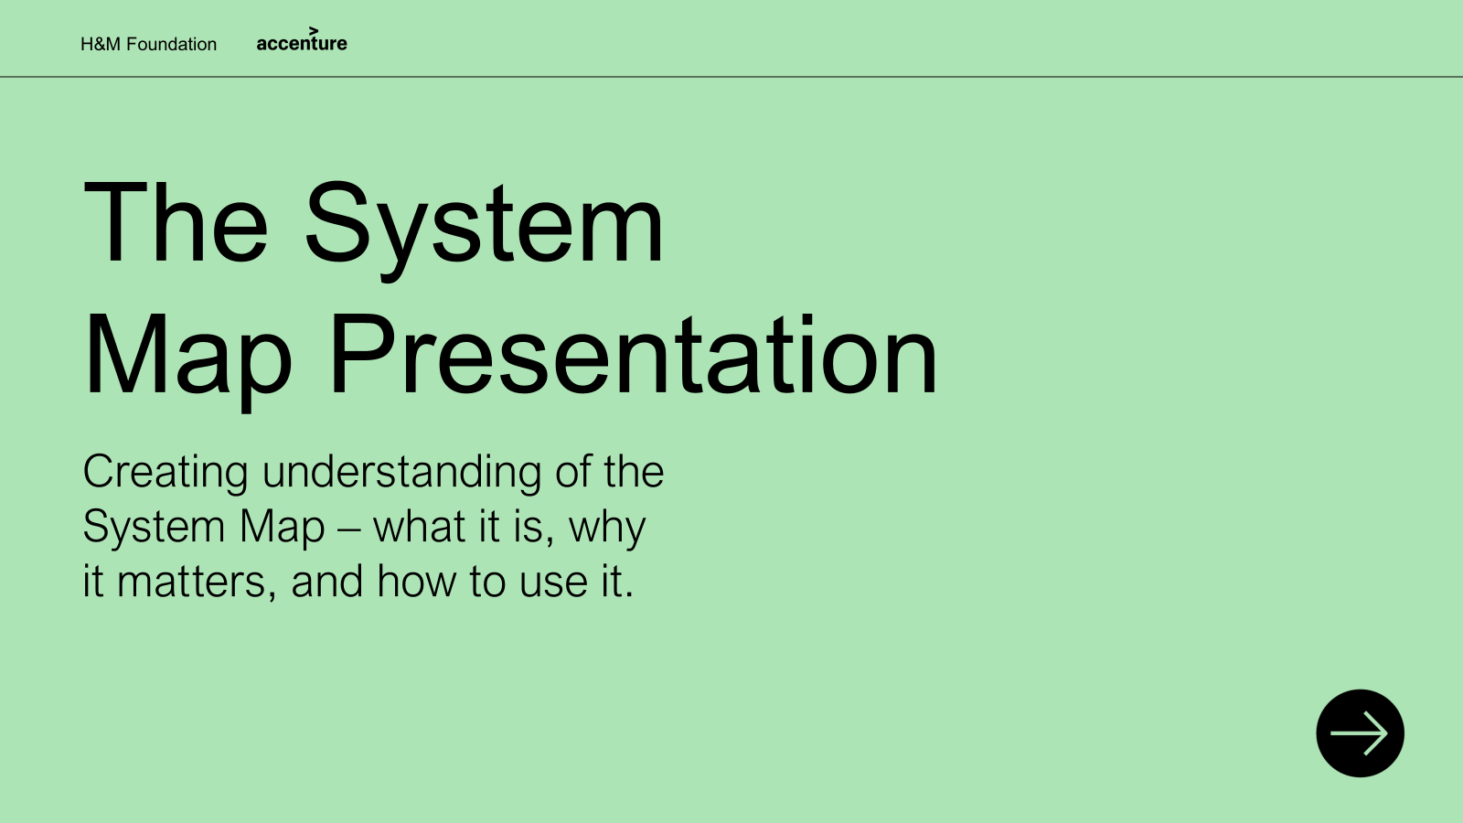
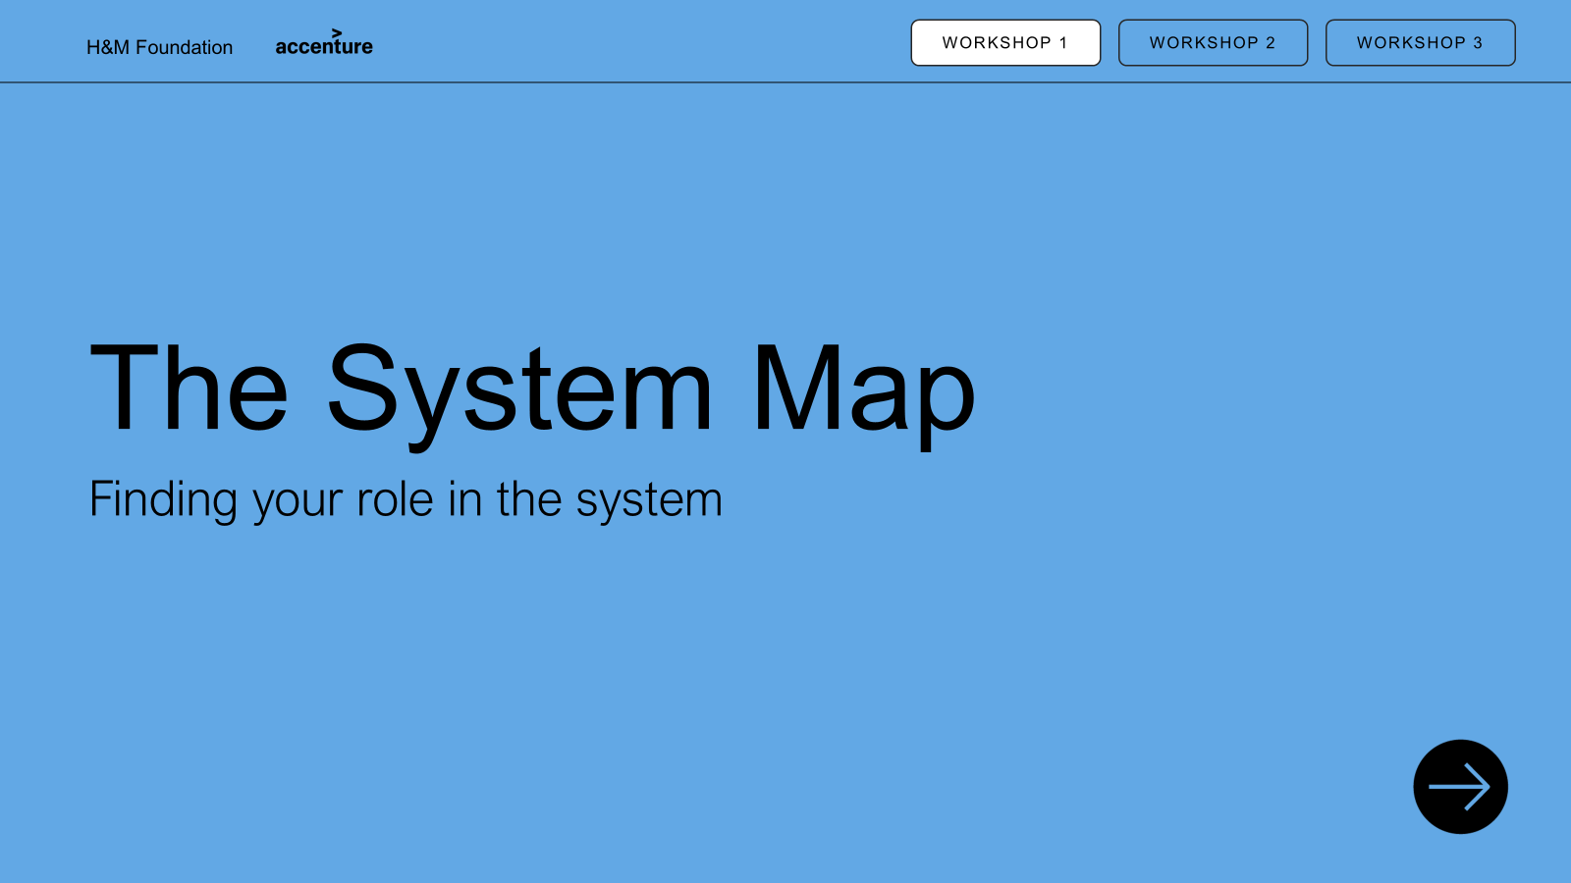
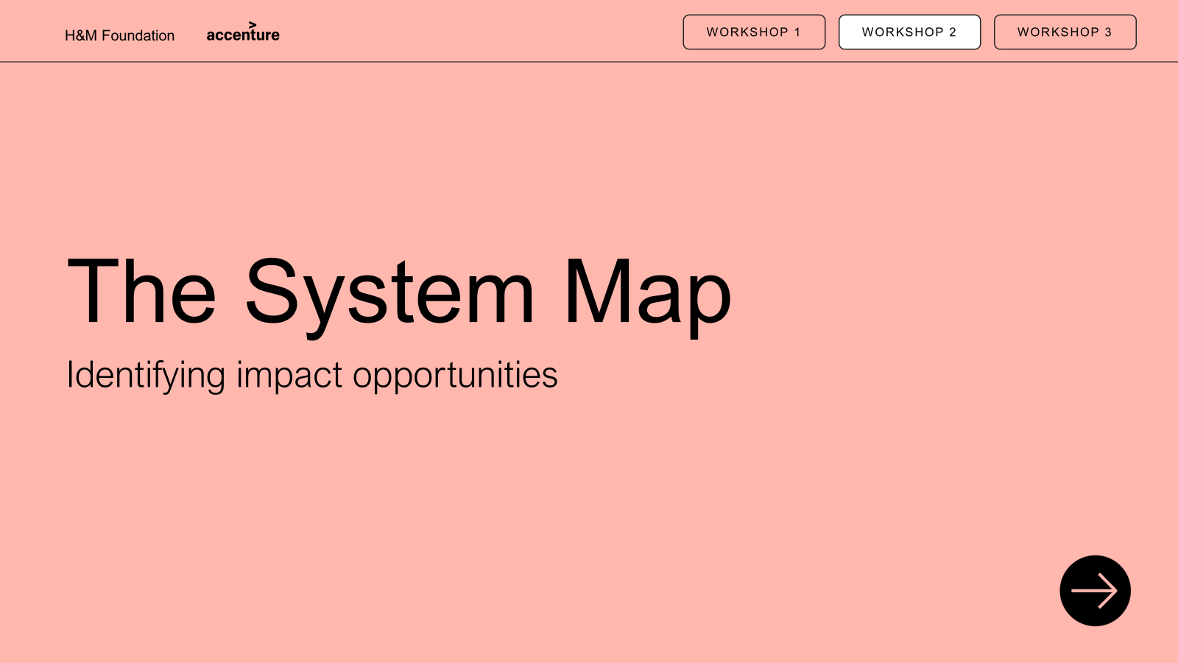
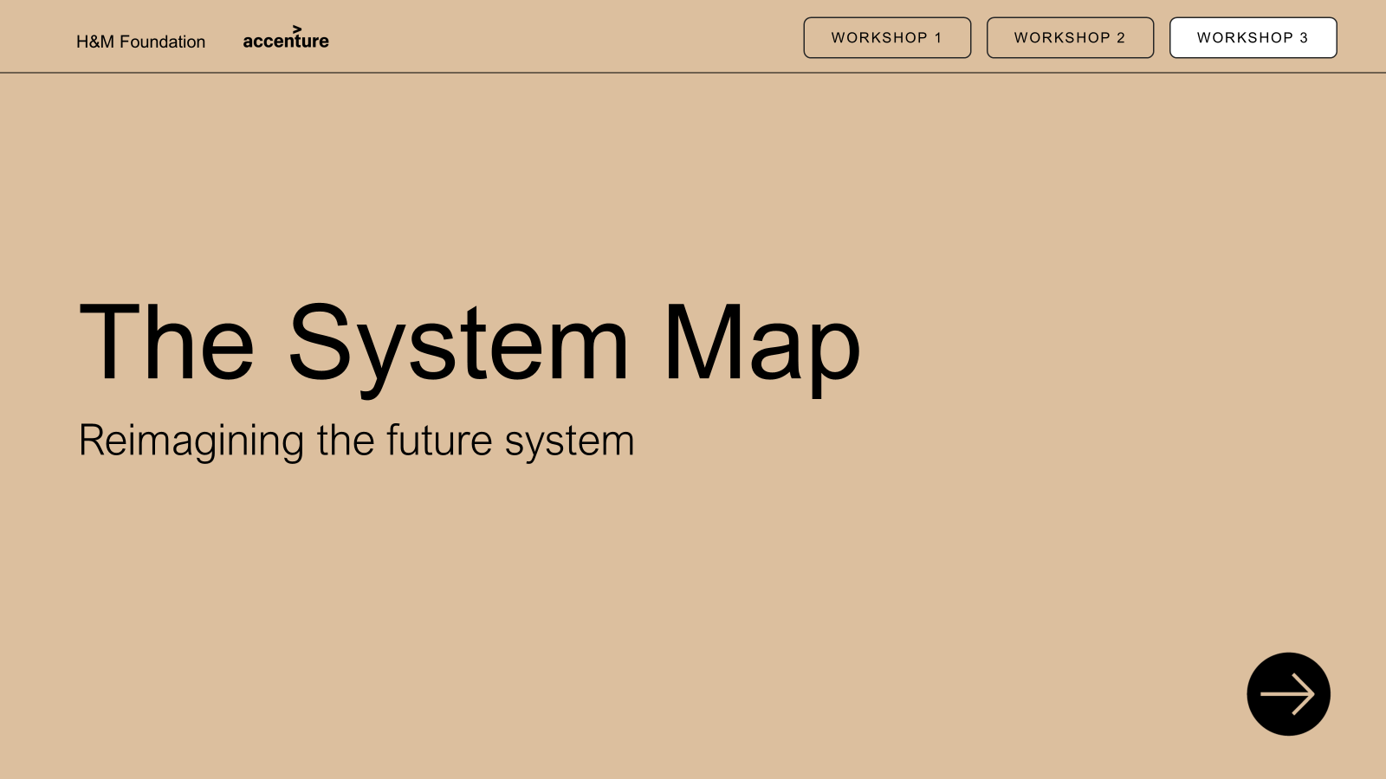
Executive summary: System Map presentation material
PRESENTATION
WORKSHOP 1
WORKSHOP 2
WORKSHOP 3
PURPOSE: This presentation material is developed to introduce the System Map and enable its practical use. The System Map is a flexible framework for making sense of the fashion system by bringing key stages, actors, and levers into one place. The following material introduces the map’s purpose, structure, and use, supporting users in understanding how the fashion system works and where change can be made. Optional workshops provide a deeper understanding of the fashion system, one’s position within it, opportunities for impact, and what a future system could look like to enable decarbonisation.
PARTICIPATION: This material is developed for all actors—whether you are actively working within the system or influencing it from the outside—from industry insiders and innovators to policymakers, investors, donors, researchers, and civil society. It is also designed to support new users engaging with the System Map for the first time.
PRESENTATION: It is optional how much of the material you choose to use—you may deliver only a keynote presentation or build it out with Workshops 1–3. Each workshop builds on the previous one, but the number of workshops you include and when you run them is entirely
up to you.
Content
Internal facilitator guide
Introduction: Trends shaping the industry of the future and purpose of visualizing the system
Read the map: Explain the map layers and elements (layers, flow actors)
Bring map to life: Brief examples of flows to relate to the map
Final: Inspire to start building on the map
Content
Internal facilitator guide
Introduction and purpose
Background
Exercise 1: Place yourself on the map
Exercise 2: Map relationships and influences
Exercise 3: Reflect on opportunities for collaboration
Wrap-up and group synthesis
System Map
30 min: Keynote presentation
Workshop 1
60 min: Finding your role in the system
Creating understanding of the System Map – what it is, why it matters, and how to use it
Opening discussion to familiarise with the map and identifying roles in the system
Content
Internal facilitator guide
Introduction and purpose
Background
Exercise 1: Find what impacts the system
Exercise 2: Place forces on the map
Exercise 3: Turn challenges into opportunities
Exercise 4: Reflect on opportunities for change
Wrap-up and group synthesis
Optional printable content
Content
Internal facilitator guide
Introduction and purpose
Background
Exercise 1: Start finding changes to the map
Exercise 2: Reimagine the System Map
Exercise 3: Start moving the needle
Wrap-up and group synthesis
Optional printable content
Workshop 2
90 min: Identifying impact opportunities
Workshop 3
120 min: Reimagining the future system
Identifying key impacting forces in the system and identifying opportunities to act
Developing the system to achieve decarbonisation though greater, and just impact
Contact Details: We are excited for you to use this material and spread the impact. While the material is public, we ask that it be used with care and credit to support thoughtful, respectful dialogue and action. For any questions or clarification, we ask you to reach out to info@hmfoundation.com. You can credit us in any preferred way, but here is a suggestion hmfoundation.com/system-map-toolkit-and-guiding-material/

Slide 2
Internal facilitator guide: Overview presentation approach
PRESENTATION
WORKSHOP 1
WORKSHOP 2
WORKSHOP 3
Background
Preparation
Follow-up
PURPOSE: The workshop builds a shared understanding of the fashion system by introducing the System Map and how to navigate it. It helps participants see their own role and influence, understand how different actors are connected, and reflect on how these relationships shape decisions and outcomes across the value chain.
By clarifying roles and dependencies, the workshop helps people and organisations identify where they can most effectively influence change and collaborate with others.
PARTICIPANTS:
No limit to number of participants but recommend 12-24 participants for easier facilitation, physical or digital
Groups of 2-4 people for exercises
Any type of participants can take part in the presentation e.g. brands, manufacturers, customers, policy makers
PRESENTATION: Start to familiarise and prepare by
Understand the System Map well enough to guide, not explain everything — especially roles, connections, and influence
Be clear on the purpose of each exercise and what participants should reflect on or discover
Prepare simple prompts and follow-up questions to help groups if they get stuck
Check technical setup in advance — screen sharing, sound, digital or printed maps, and personalized key notes
Plan time management and transitions between exercises to keep energy and focus
Set and protect the tone – no right or wrong answers
MATERIALS AND TOOLS:
No tools – The workshop can be performed without material, displaying the image of the map in the presentation material.
With tools – for a more immersive workshop, it is suggested to print out the map (physical) or use PPT version (digital) to drag and drop, for participants to easier navigate their location and draw the relationships.
DOCUMENTATION:
Collect and save the material if you utilize material in the workshop to summarize participants reflections
Capture interesting discussions and perspectives sparked by the material to identify what could be developed further
Note any concrete feedback from participants on the presentation or suggested next steps
Document where questions, confusion, or misunderstandings arose to refine content, exercises, or facilitation
REALISING OUTCOMES:
Understand the core elements of the
System Map
Know where key actors are positioned and how they relate to one another
Feel confident identifying patterns of influence and power across the map

Slide 3
Internal facilitator guide: Overview of workshop agenda
PRESENTATION
WORKSHOP 1
WORKSHOP 2
WORKSHOP 3
Agenda | Time | Slide | Instructions | Key Takeaway | Tips
1. Introduction | 10min | 4-8 | Welcome participants and state the purpose Explain the map is a tool for exploration Set workshop principles and safety | Shared space to explore roles, influence, and connections | Keep tone open and simple with no right or wrong answers. Encourage curiosity.
2. Background | 10min | 9-10 | Explain what the System Map shows Introduce the layers at a high level Explain how it will be used | The map makes complexity visible and navigable | Don’t over-explain and leverage the visuals instead of explaining every detail
3. Exercise 1 | 10min | 11-12 | Present the exercise thoroughly and make sure everyone understands Divide people into small groups of 2-4 Be clear on the time, 10 minutes includes presenting the exercise, talking in groups and optionally a short minute recap before moving to the next exercise Display the map on the screen or print it out for discussion | Participants start understanding the map and define their role | Give clear examples e.g. different places, what type of impact. It is an open question rather than just pointing to the map
4. Exercise 2 | 15min | 13-14 | Now building on the first exercise, present the next activity Allocate 15 minutes to present, discuss and conclude Invite the same groups of 2-4 people to keep the discussion Show the map and encourage to draw or write down connections Circulate support of the dialogue and questions if needed | Participants start understanding their dynamics on the map | Prepare examples if possible or share your own reflection before starting the exercise, it helps participants open their thought process
5. Exercise 3 | 10min | 15 | Share your reflection on the previous exercises You will reflect on the discussions Allocate 10 minutes for an open discussion and conclusion Make sure each group shares reflections so everyone is open to contribute | Participants leave with new perspectives on their role and clearer ideas about where collaboration is possible | Start by sharing your own reflections and why you found the exercises helpful. Bring up the map again if you want visual support
6. Wrap-up | 5min | 16 | Invite reflections from groups Summarize key themes Explain next steps | Clarity on roles and relationships enables action | Reflect patterns and focus on insights. Make sure to get their insights on the outcomes of the workshop.

Slide 4


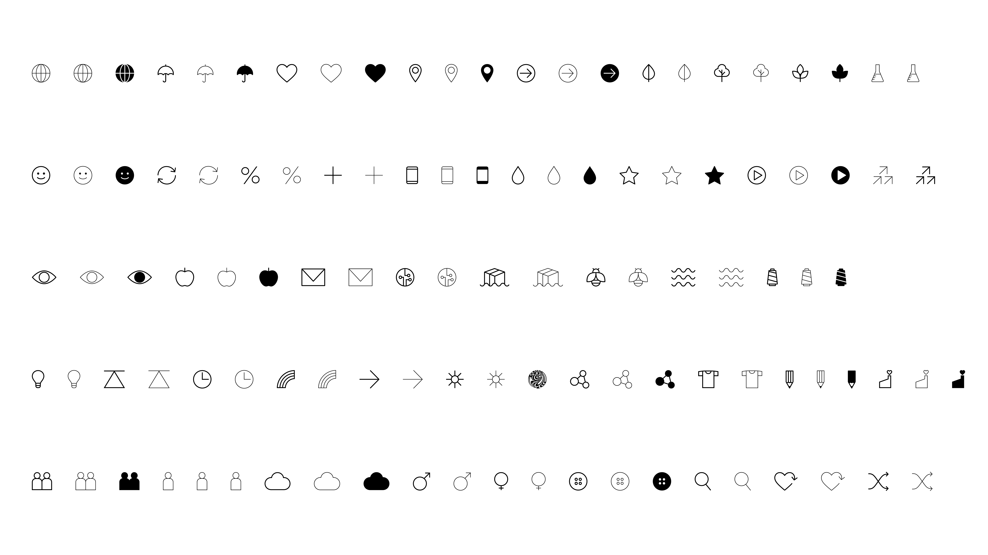
WORKSHOP 1
WORKSHOP 2
WORKSHOP 3
The System Map
Finding your role in the system

Slide 5
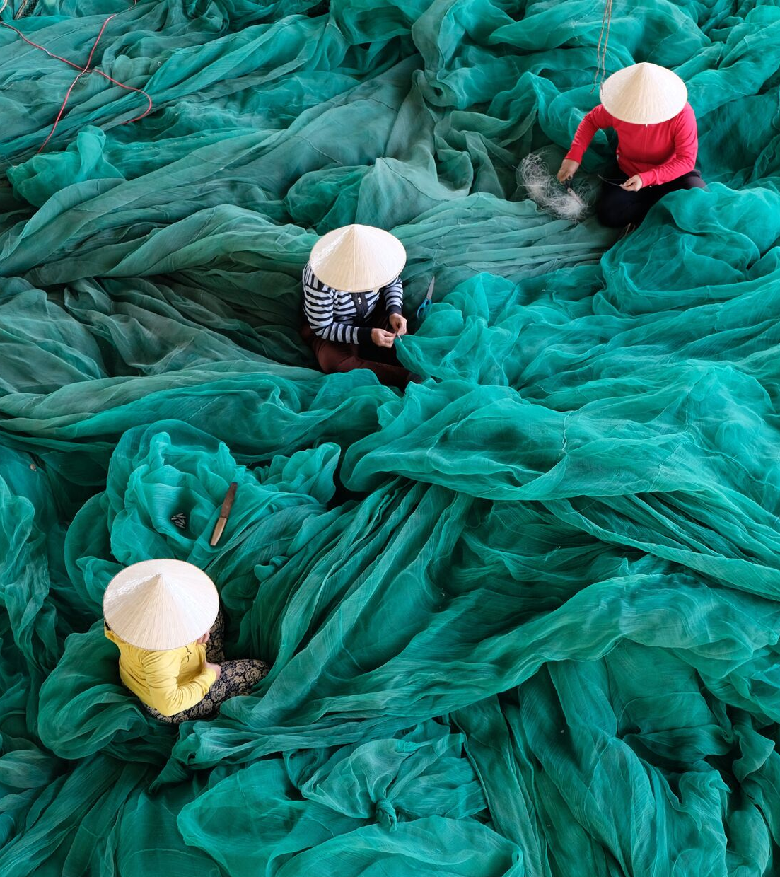
Agenda
1 hour
01
Introduction and purpose
Background
Exercise 1: Place yourself
on the map
Exercise 2: Map relationships
and influences
Exercise 3: Reflect on opportunities
for collaboration
Wrap-up and group synthesis
02
03
04
05
06

Slide 6
Now that we have gone through the map, get more familiar with it and with your place in the system
INTRODUCTION
BACKGROUND
EXERCISE 1
EXERCISE 2
EXERCISE 3
WRAP UP
WORKSHOP 1
WORKSHOP 2
WORKSHOP 3
Finding your role in the system: Understand your role in the system by mapping your position, understanding dependencies, and identifying key sources of influence.
Identifying impact opportunities
Reimagining the
future system
Exercise 1: Place
yourself on the map
Exercise 2: Map relationships and influences
Exercise 3: Reflect
on opportunities for collaboration

Slide 7

The purpose of this session is to build your understanding of the map
INTRODUCTION
BACKGROUND
EXERCISE 1
EXERCISE 2
EXERCISE 3
WRAP UP
WORKSHOP 1
Develop understanding and confidence in navigating the System Map
Recognize your position on the map and the role you have in the fashion & textile value chain
Gain clarity on where other actors sit on the map, and how those influences shape potential relationships

Slide 8
Principles for the workshop
INTRODUCTION
BACKGROUND
EXERCISE 1
EXERCISE 2
EXERCISE 3
WRAP UP
WORKSHOP 1
There are no right or wrong answers –
only possibilities.
Think interconnection rather than isolation –
utilize all perspectives and insights in this room!
Leave ‘business as usual’ at the door.
Be open to finding ‘blind spots’ and questioning biases – this is a safe space.
Some conversations
may lead you to places that feel uncomfortable,
and that’s OK.
If you find yourself ‘stuck’ on an activity, speaking to a facilitator might help.

Slide 9
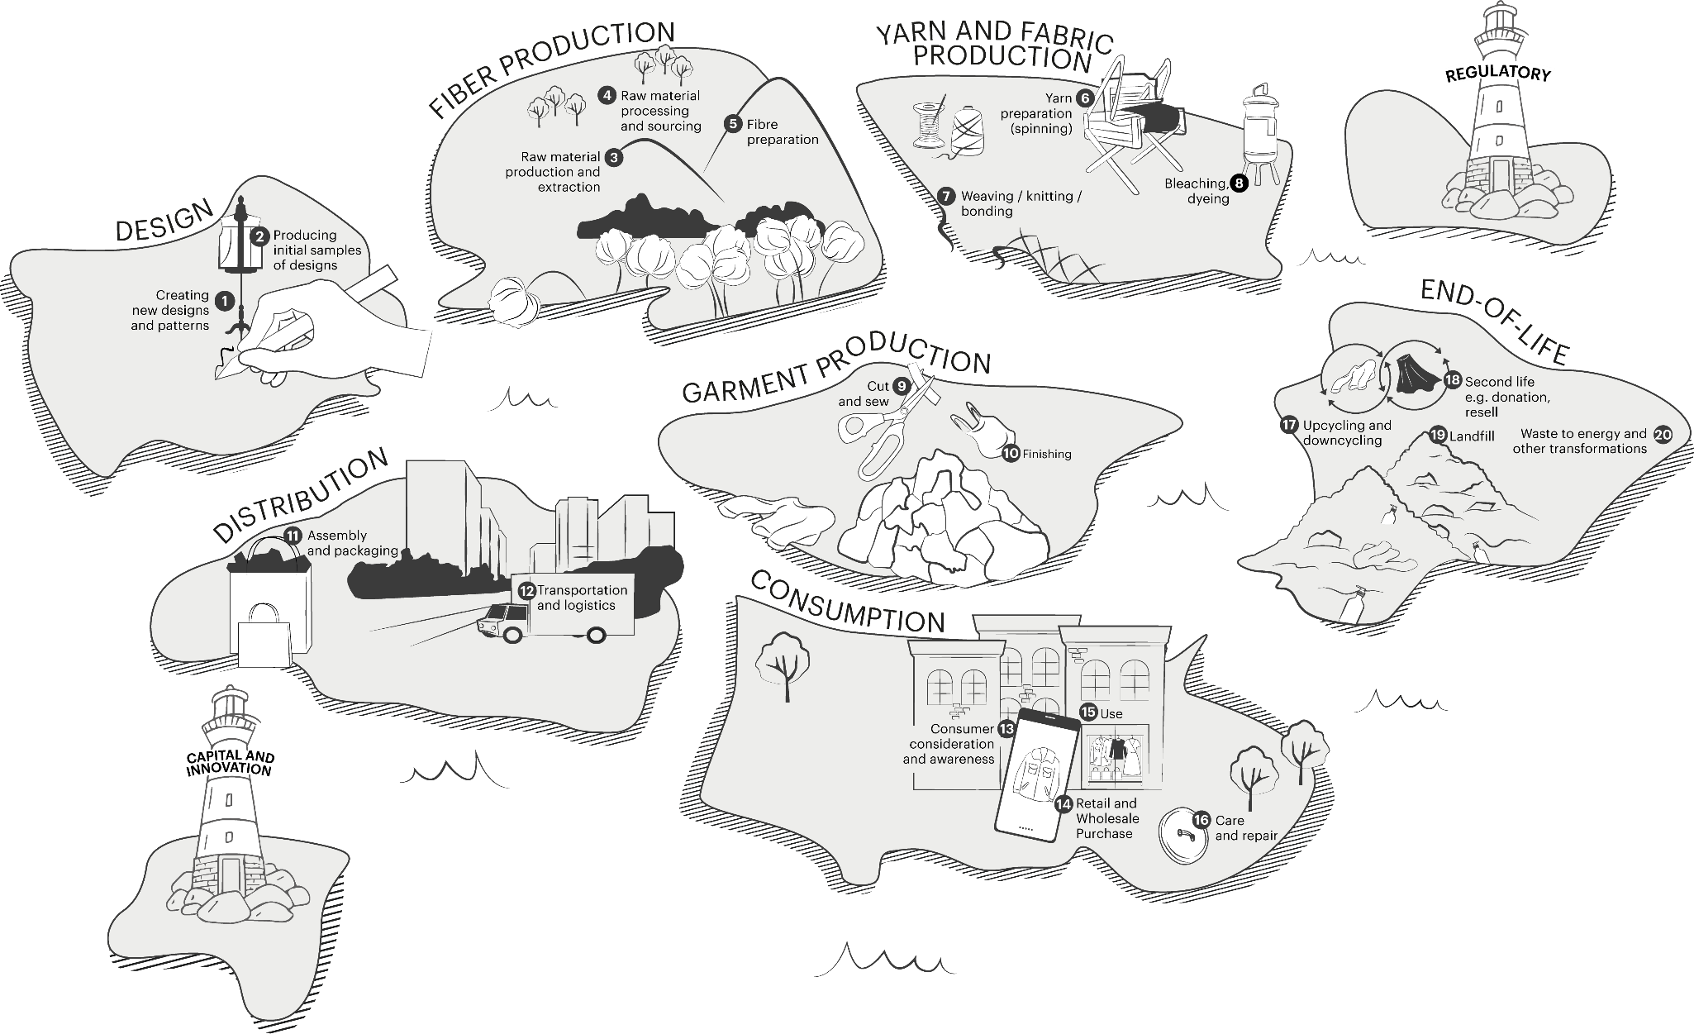
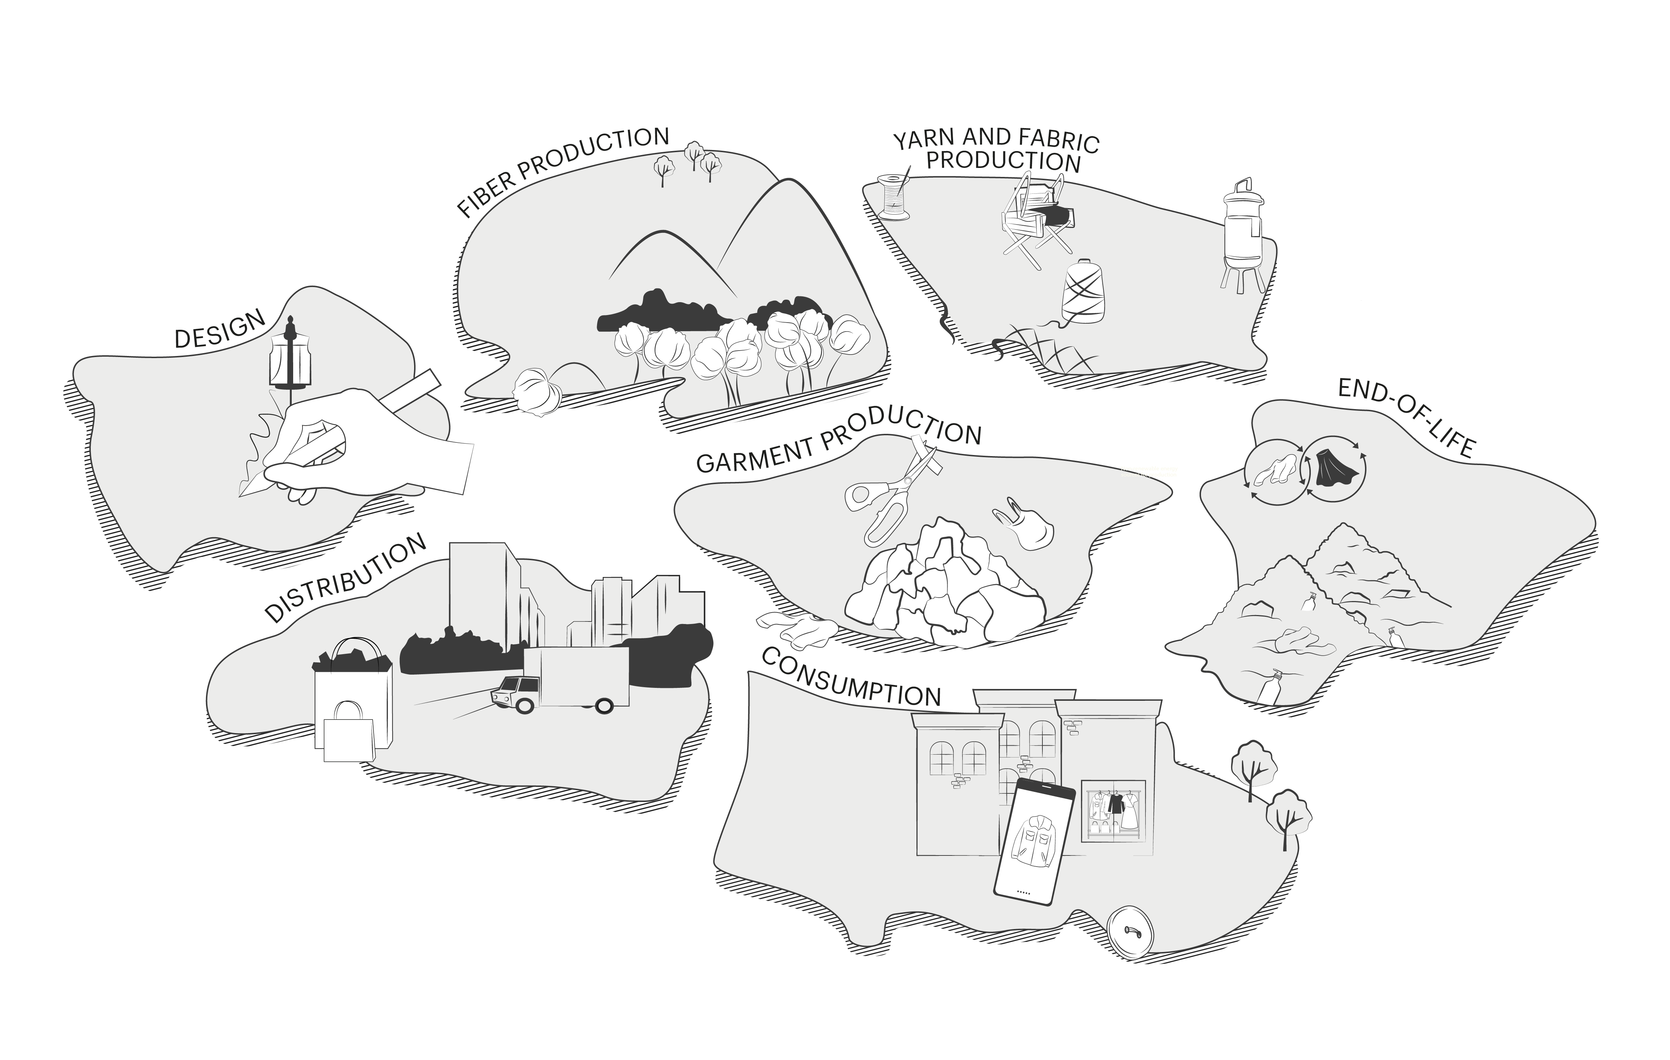
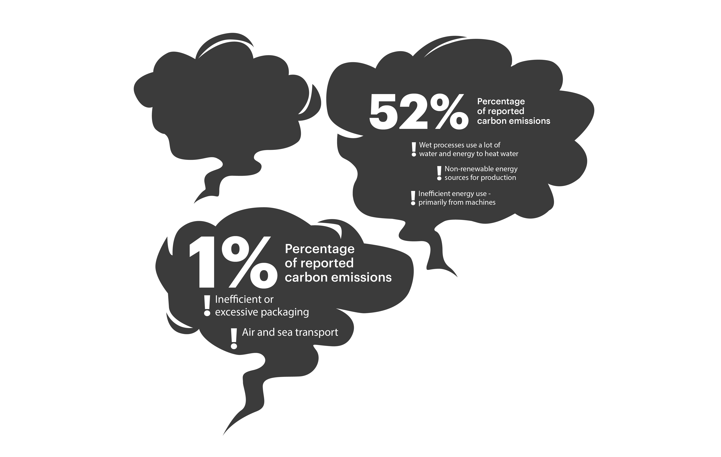
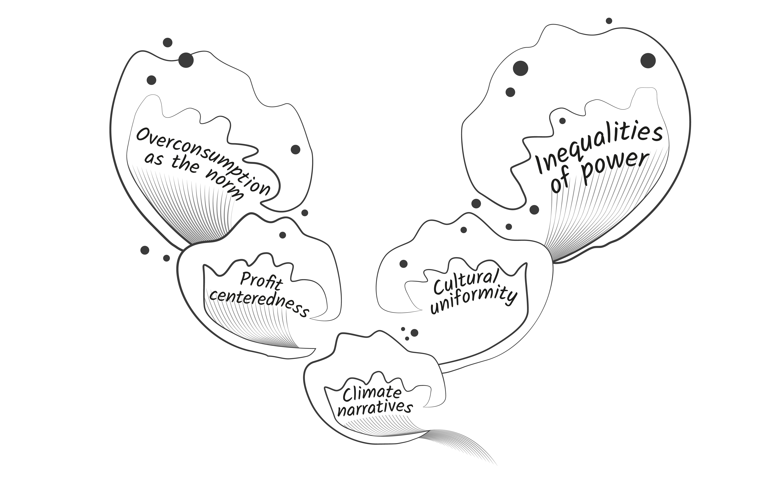
INTRODUCTION
BACKGROUND
EXERCISE 1
EXERCISE 2
EXERCISE 3
WRAP UP
WORKSHOP 1
The map creates
a starting point to navigate the system
We will start with a simplified map focusing on the first
of the three layers – the
value chain.
The fashion system is complex and interconnected – every decision ripples across the value chain.
Understanding your role
and where you can create leverage is the first step toward systemic change.
Layer 1: The value chain
Stages of the fashion value chain
Layer 2: Carbon
Share of emissions for each island
Layer 3:
Systemic forces
Macro forces influencing how
the system works

Slide 10
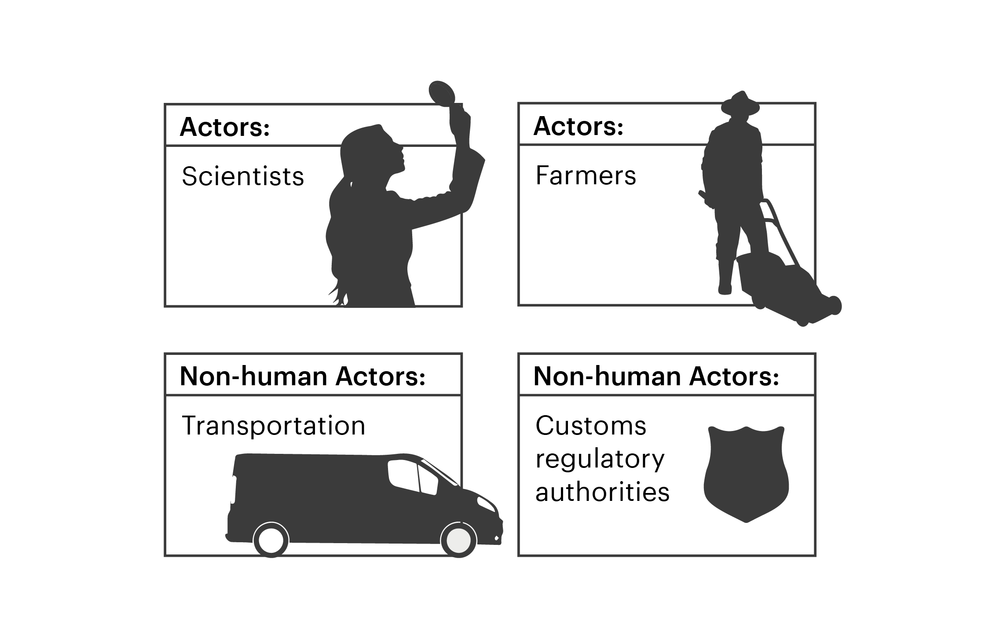
INTRODUCTION
BACKGROUND
EXERCISE 1
EXERCISE 2
EXERCISE 3
WRAP UP
WORKSHOP 1
Your placement on the map goes beyond one spot or location
For example, decisions in product development can influence impact across the value chain by:
As an actor in the value chain, thinking about your own role can be the first step in navigating the system map.
Your role and influence goes beyond one place where you may spend most of your time - the islands are interconnected, and decisions have a ripple effect.
Even though different parts of the value chain may feel like separate “islands”, your role helps connect them—often earlier and further downstream than
you might expect
Bringing people together: Aligning design, sourcing, manufacturing, sustainability, and suppliers around shared goals.
Shaping sourcing practices: Defining material requirements that drive supplier choice, sourcing locations, and ethical outcomes.
Creating operational impact: Making design decisions that influence cost, timelines, and workforce stability across the supply chain.
Building long-term value: Designing for durability and repairability to reduce waste and support resilient operations.

Slide 11
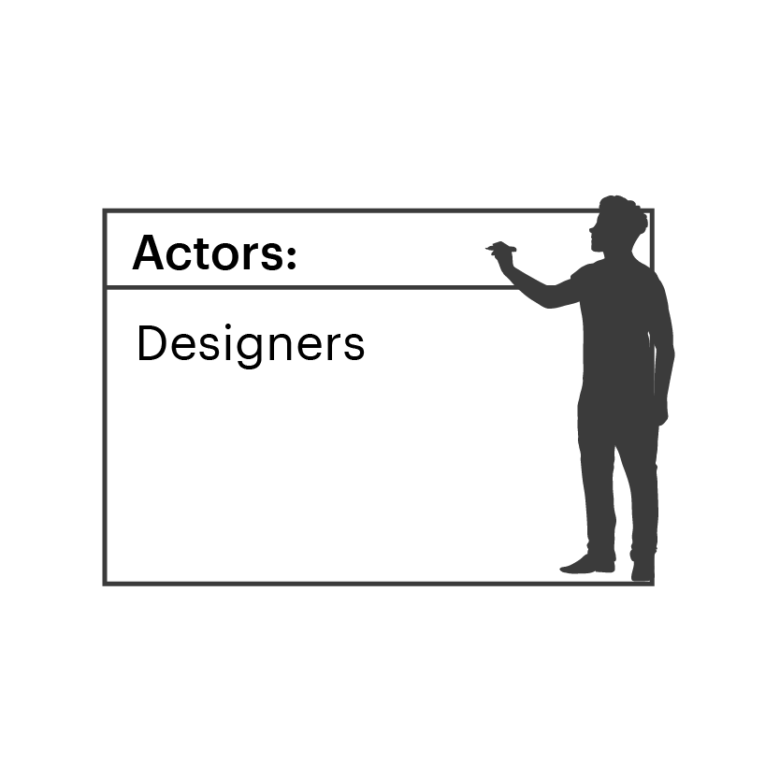
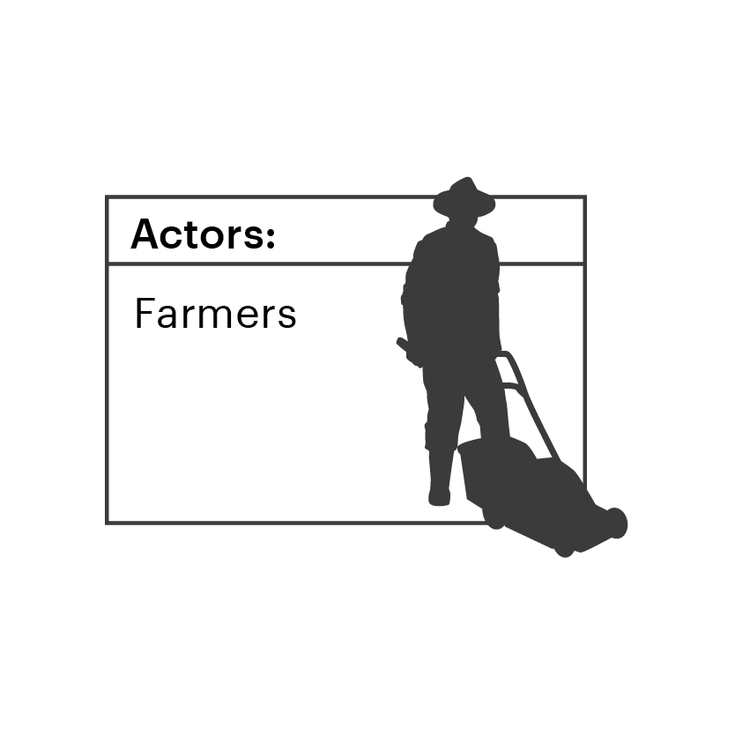
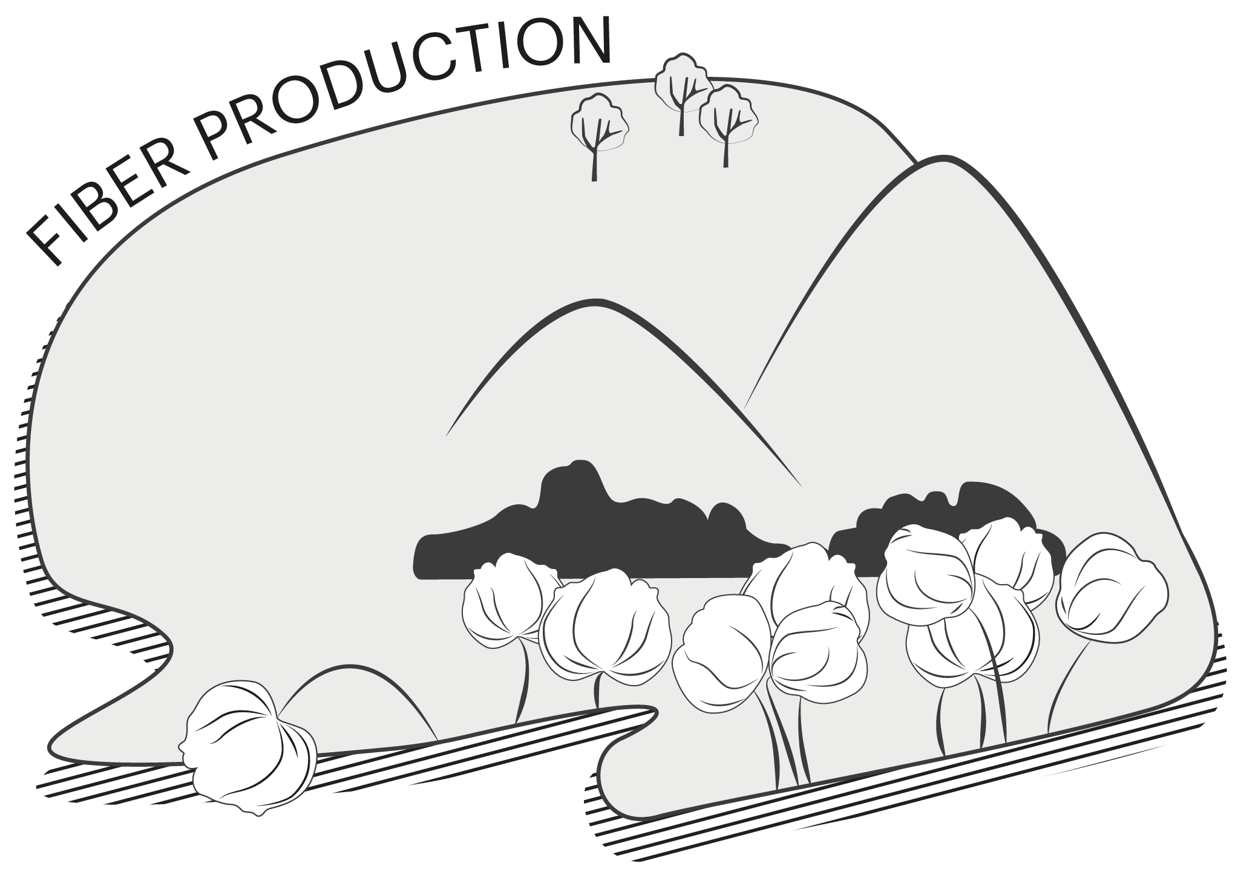
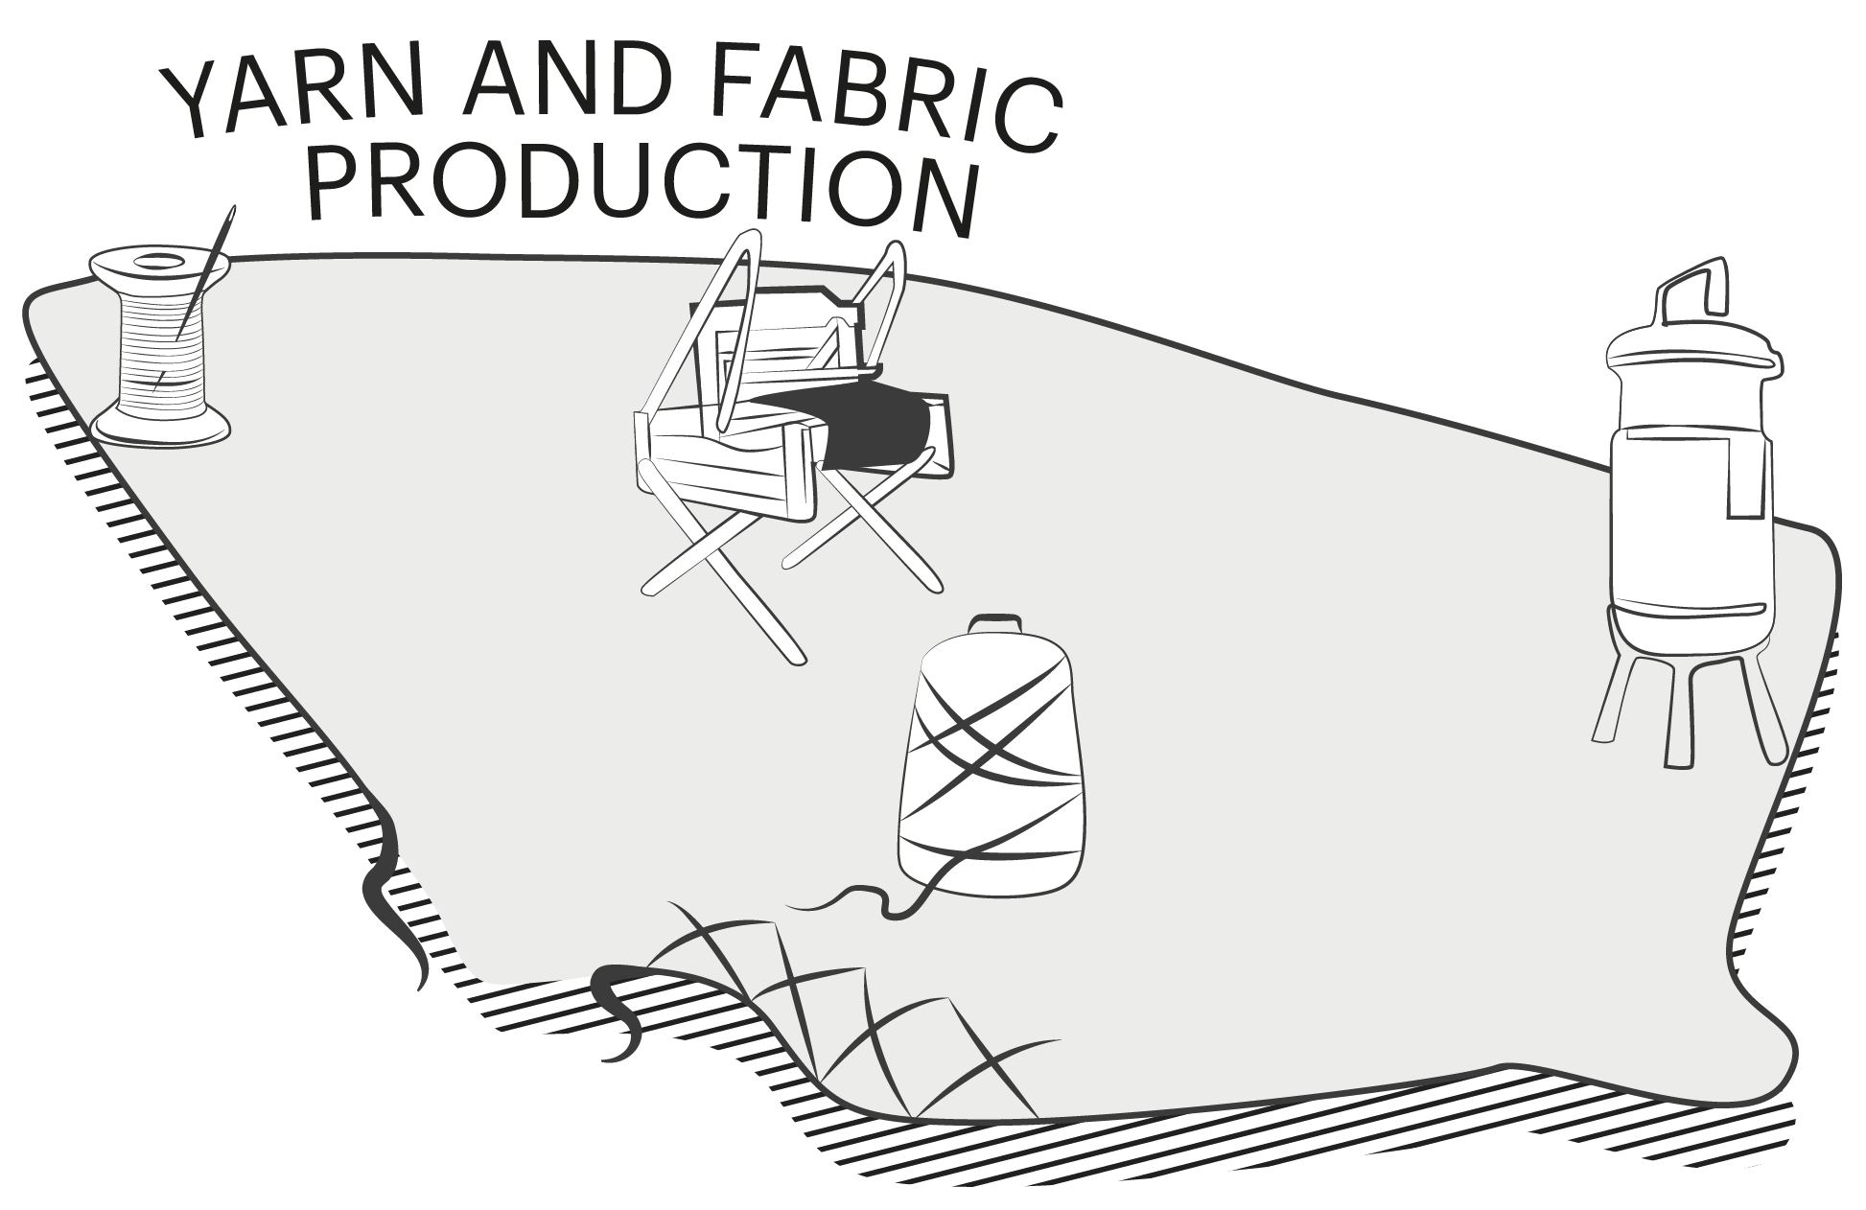
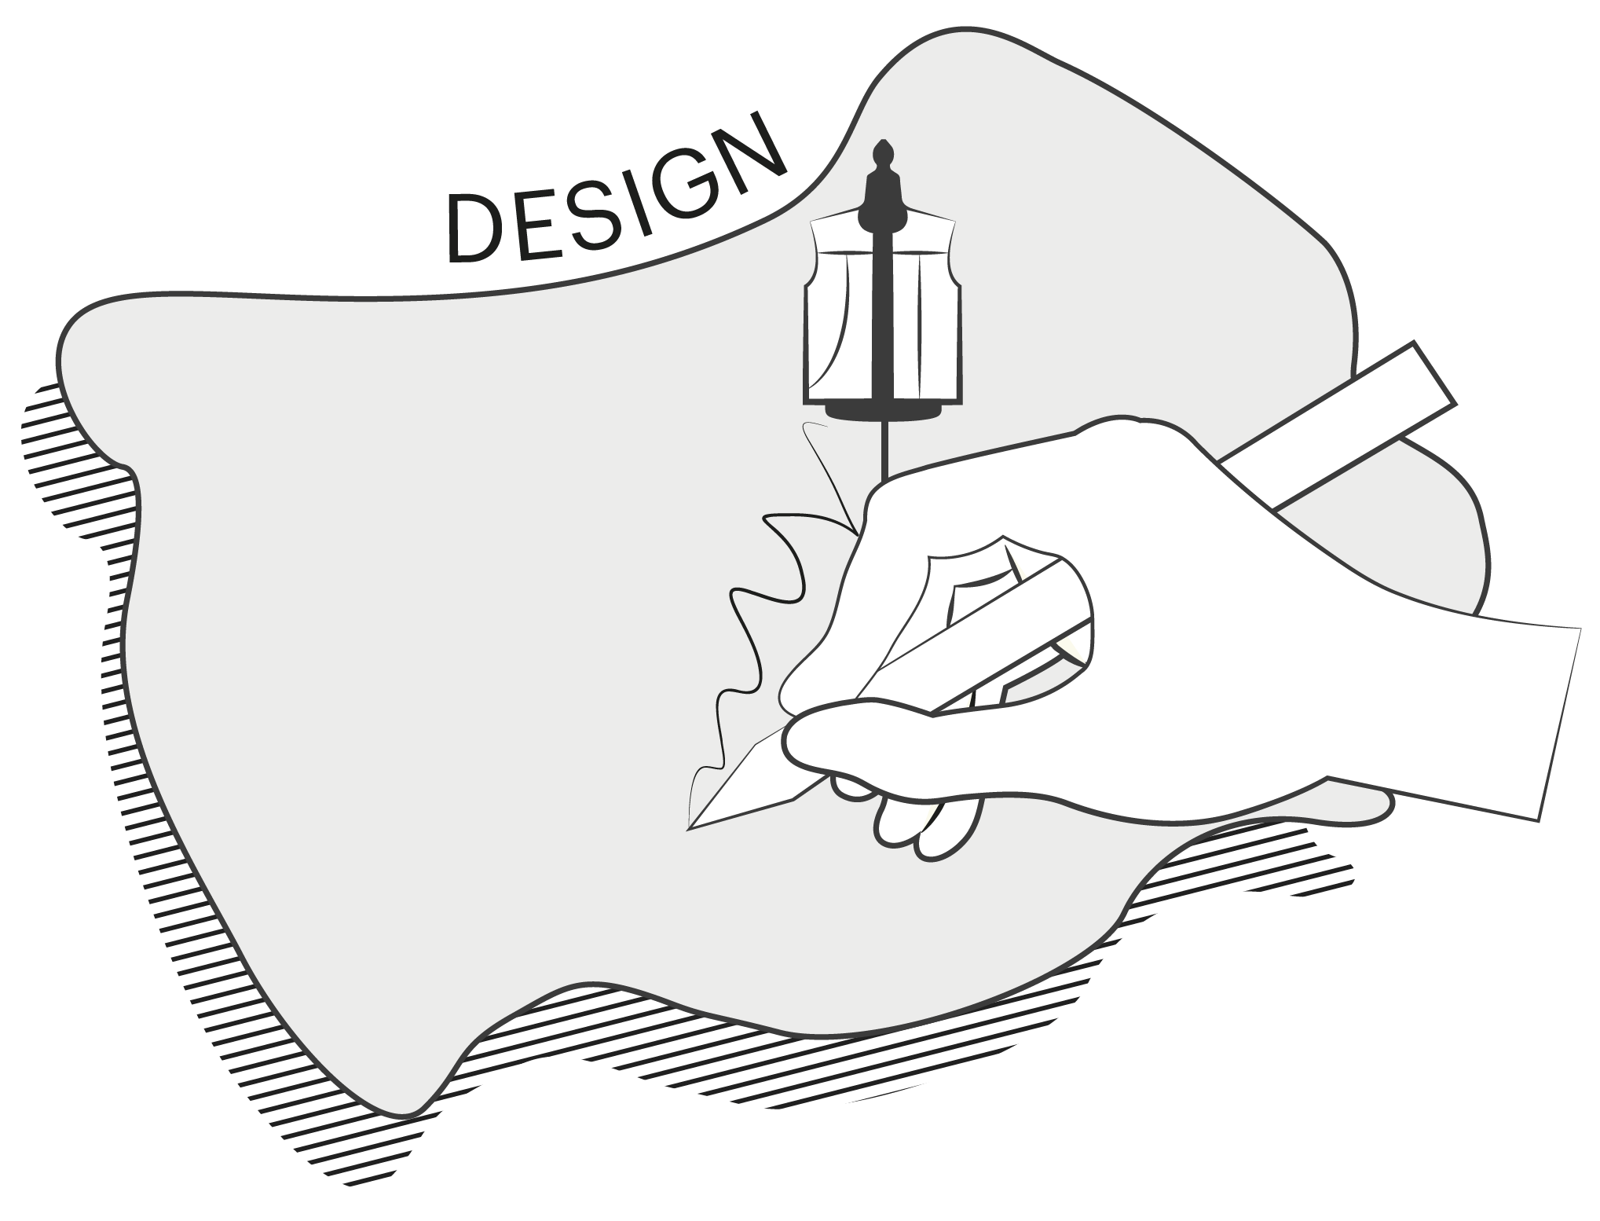
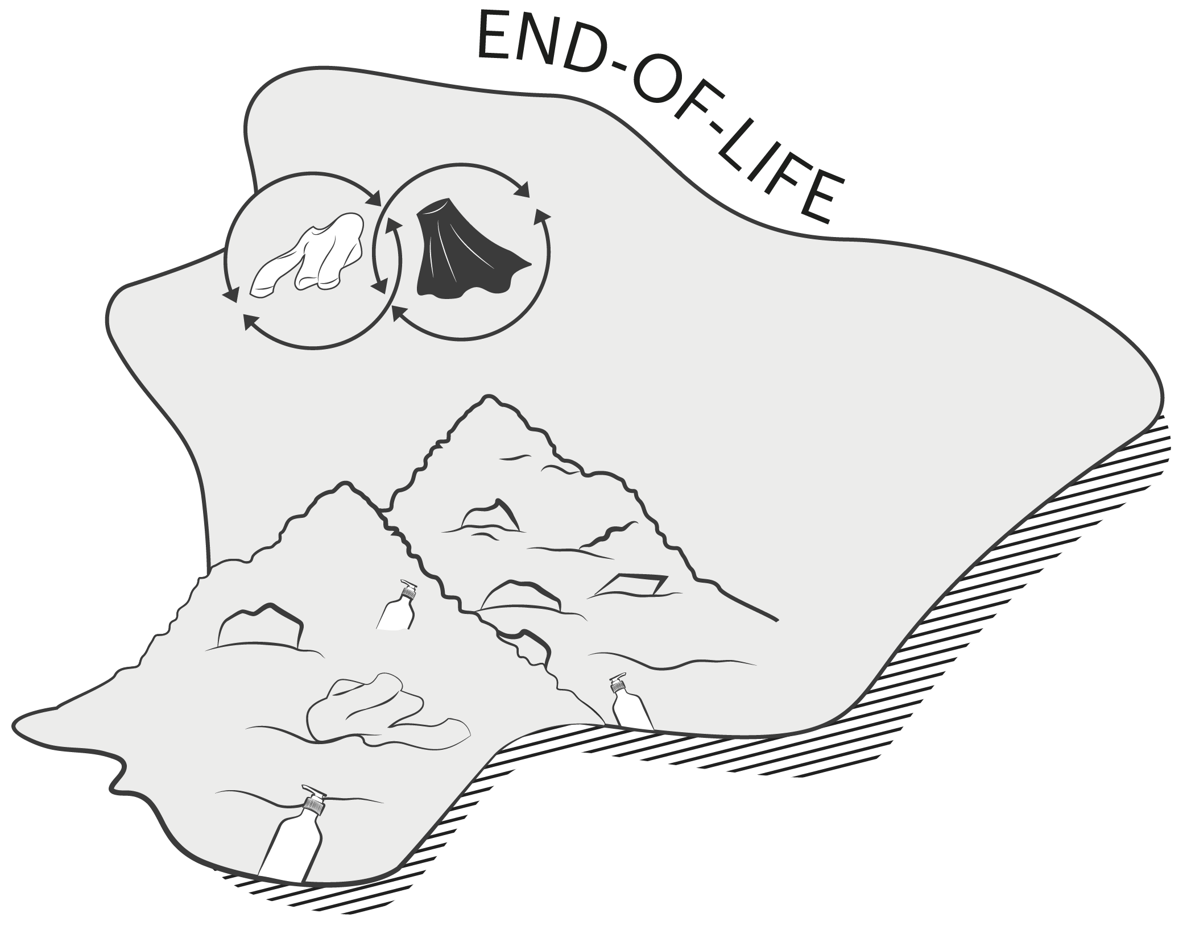
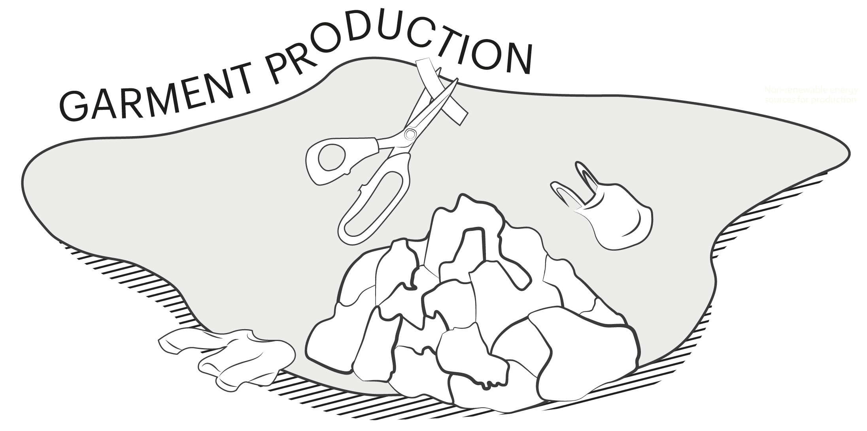
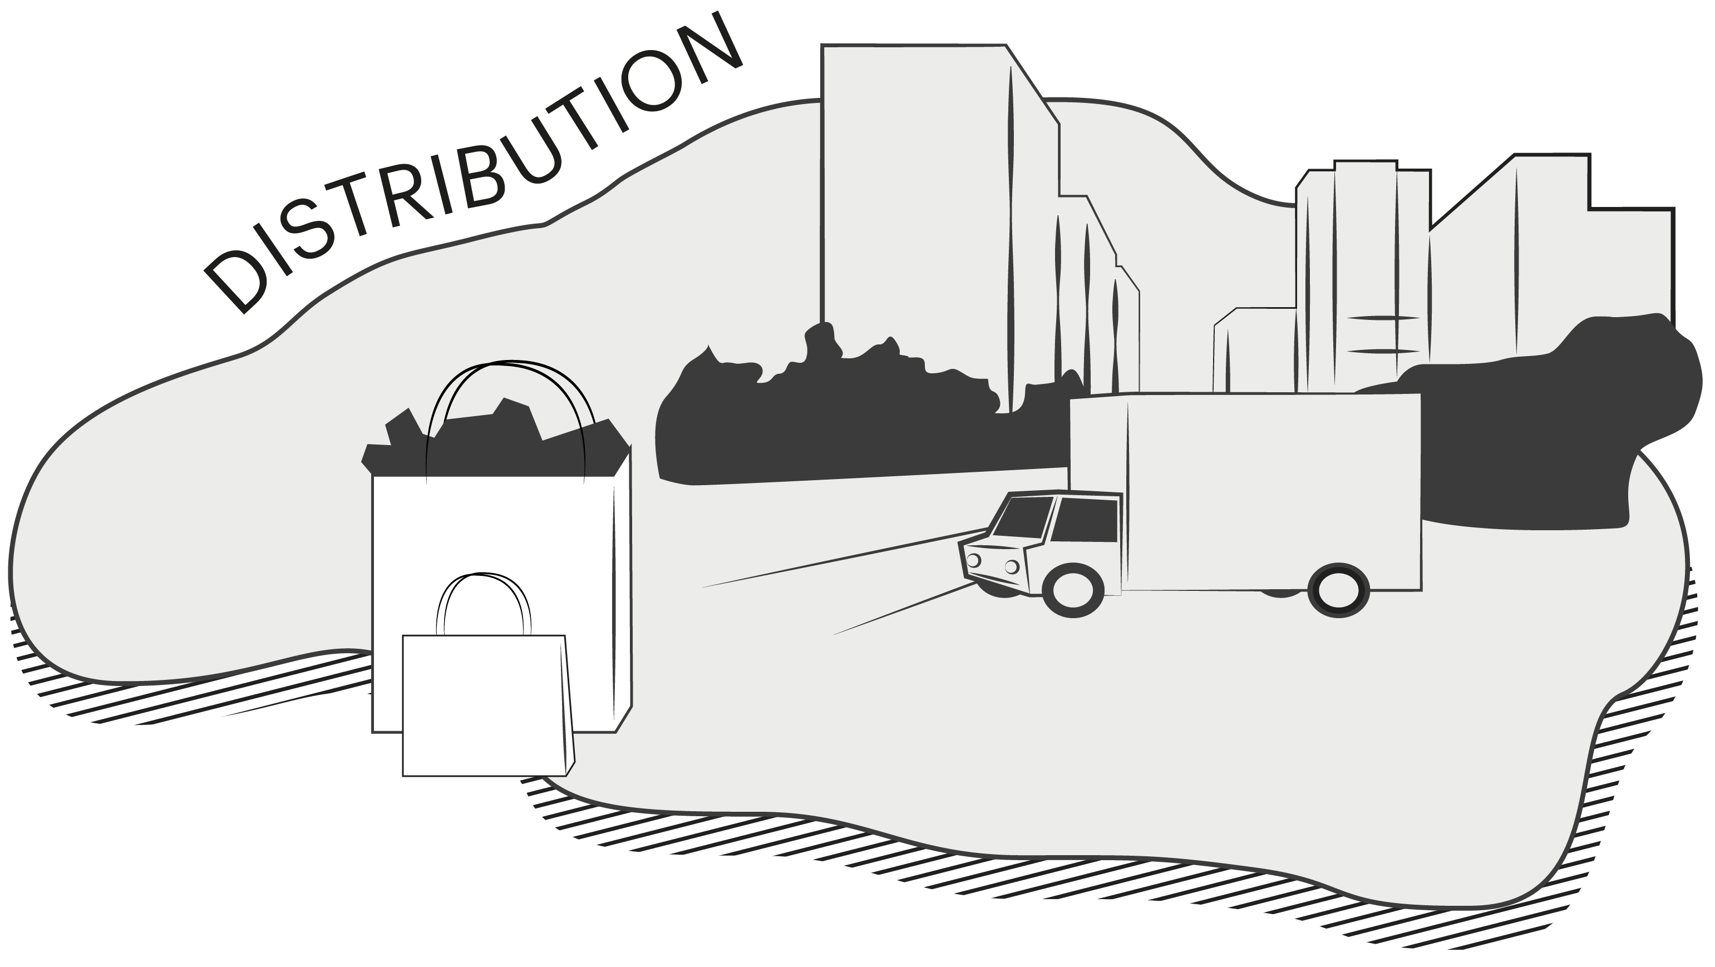
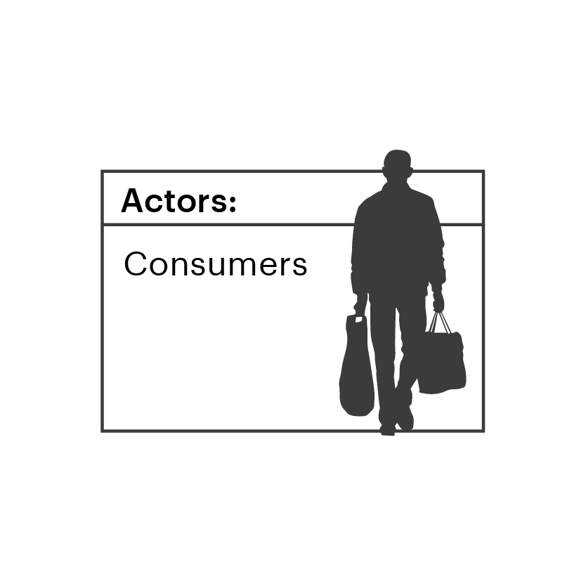
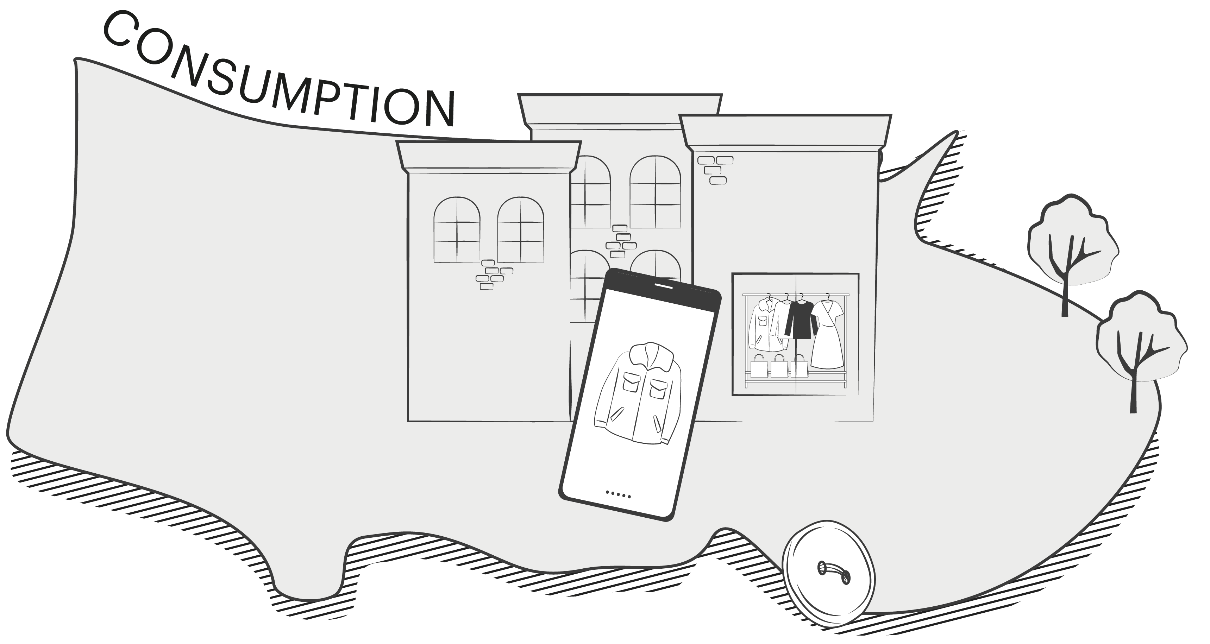
INTRODUCTION
BACKGROUND
EXERCISE 1
EXERCISE 2
EXERCISE 3
WRAP UP
WORKSHOP 1
Place yourself
on the map
Pinpoint where you sit on the map
and describe your role and impact in
the system.
Do you sit in one place or multiple places on the map?
What type of impact do you have?
E.g. Do you bring other people together, or are you providing
new innovative solutions?
Reminders:
10 minutes
Reflect and discuss
in groups of 2-4 people
Use the map as a navigator for discussion

Slide 12
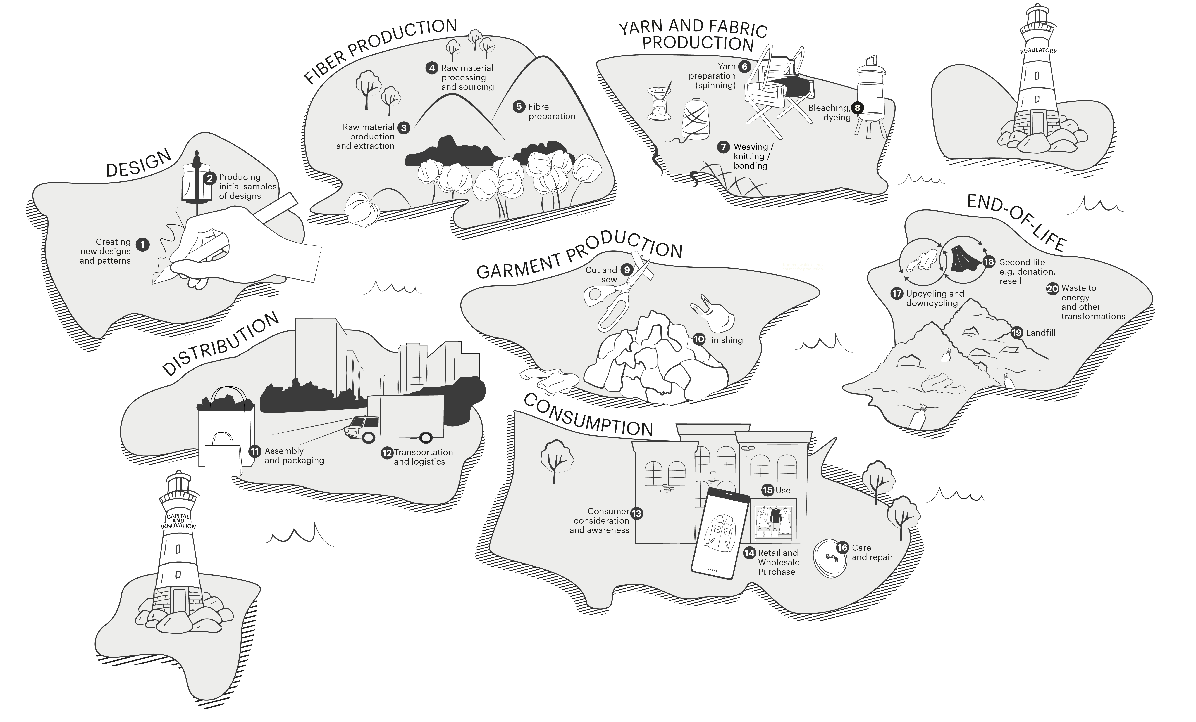
INTRODUCTION
BACKGROUND
EXERCISE 1
EXERCISE 2
EXERCISE 3
WRAP UP
WORKSHOP 1
Optional: You can use the pins
to mark where you sit on the map.
If you’re using a printout, feel free to draw directly on the map.
Drag & Drop

Slide 13
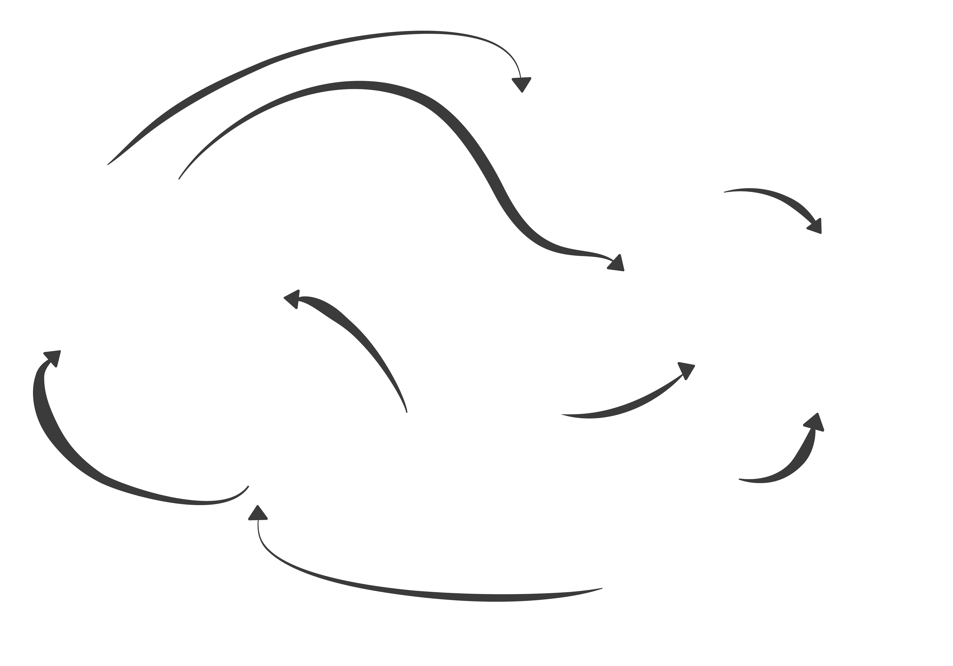
INTRODUCTION
BACKGROUND
EXERCISE 1
EXERCISE 2
EXERCISE 3
WRAP UP
WORKSHOP 1
Map relationships
and influence
From where you sit on the map, explore and discuss the relationships with different parts
of the map:
Discuss the parts of the map that you influence
Discuss who else on the map has influence on you and the impact they have
Reminders:
10 minutes
Reflect and discuss
in groups of 2-4 people
Use the map to help
you with the discussion

Slide 14
INTRODUCTION
BACKGROUND
EXERCISE 1
EXERCISE 2
EXERCISE 3
WRAP UP
WORKSHOP 1
Optional: You can use the arrows
to mark relationships and influence.
If you’re using a printout, feel free to draw directly on the map.
Drag & Drop

Slide 15

INTRODUCTION
BACKGROUND
EXERCISE 1
EXERCISE 2
EXERCISE 3
WRAP UP
WORKSHOP 1
Reflect on opportunities
What does the map make you realise about your role in the fashion industry?
Do you notice any key areas
of challenge or opportunity for collaboration?
How has the map helped gain new perspective on the fashion system?
Reminders:
10 minutes
Open discussion
Use the map as a
navigator for discussion

Slide 16
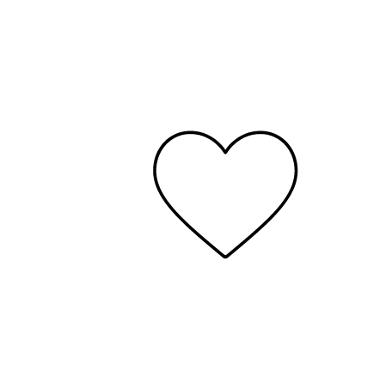
Thank you
Stay updated
hmfoundation.com
Contact us
info@hmfoundation.com
Follow us​
Instagram, LinkedIn and YouTube: @hmfoundation​
When you’re ready, feel free to continue with Workshop 2

