Slide 1

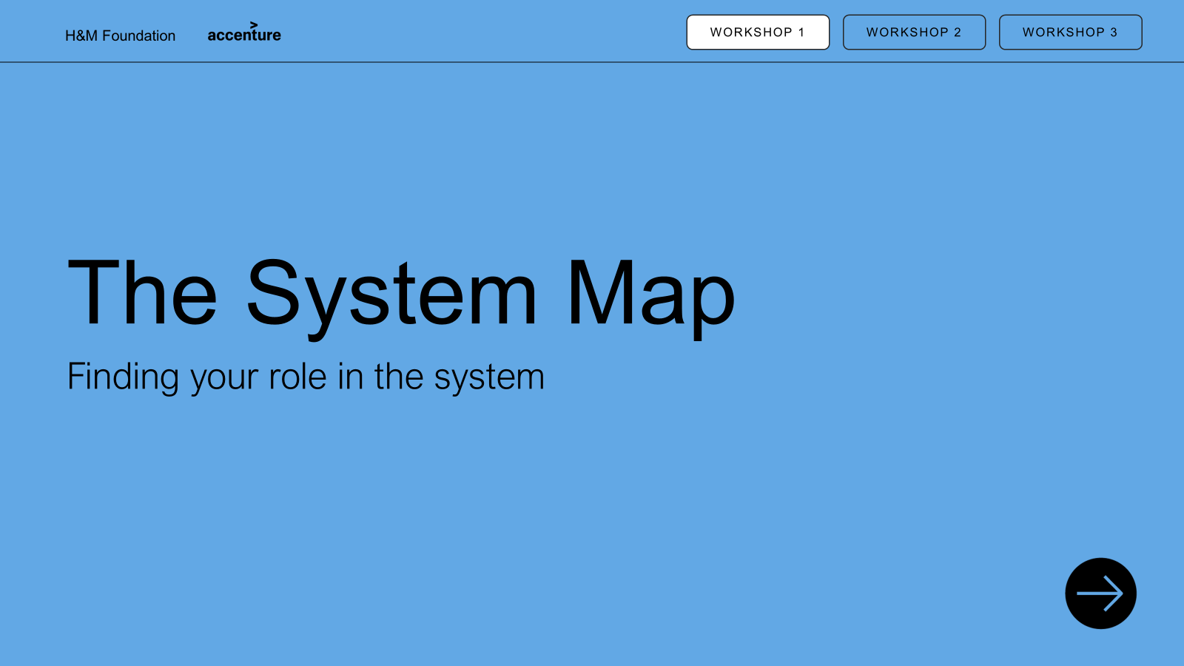
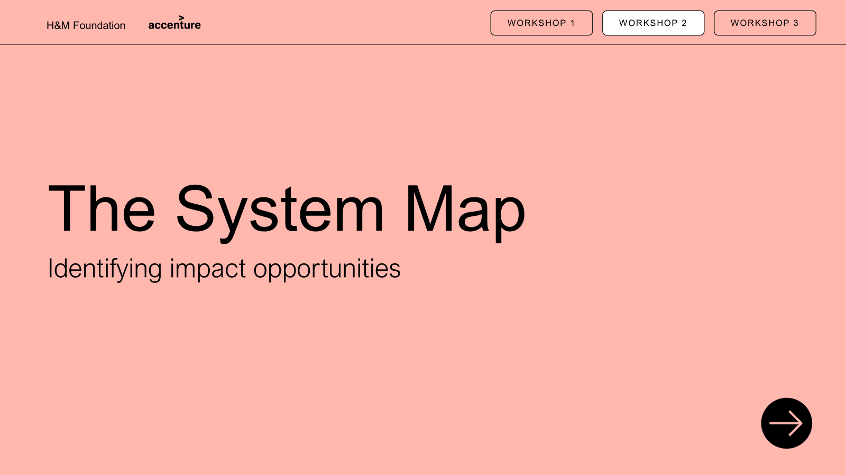
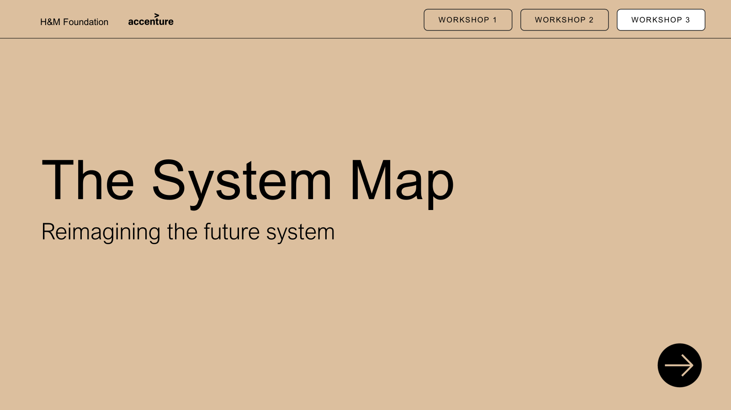
Executive summary: System Map presentation material
PRESENTATION
WORKSHOP 1
WORKSHOP 2
WORKSHOP 3
PURPOSE: This presentation material is developed to introduce the System Map and enable its practical use. The System Map is a flexible framework for making sense of the fashion system by bringing key stages, actors, and levers into one place. The following material introduces the map’s purpose, structure, and use, supporting users in understanding how the fashion system works and where change can be made. Optional workshops provide a deeper understanding of the fashion system, one’s position within it, opportunities for impact, and what a future system could look like to enable decarbonisation.
PARTICIPATION: This material is developed for all actors—whether you are actively working within the system or influencing it from the outside—from industry insiders and innovators to policymakers, investors, donors, researchers, and civil society. It is also designed to support new users engaging with the System Map for the first time.
PRESENTATION: It is optional how much of the material you choose to use—you may deliver only a keynote presentation or build it out with Workshops 1–3. Each workshop builds on the previous one, but the number of workshops you include and when you run them is entirely up to you.
Content
Internal facilitator guide
Introduction: Trends shaping the industry of the future and purpose of visualizing the system
Read the map: Explain the map layers and elements (layers, flow actors)
Bring map to life: Brief examples of flows to relate to the map
Final: Inspire to start building on the map
Content
Internal facilitator guide
Introduction and purpose
Background
Exercise 1: Place yourself on the map
Exercise 2: Map relationships and influences
Exercise 3: Reflect on opportunities for collaboration
Wrap-up and group synthesis
System Map
30 min: Keynote presentation
Workshop 1
60 min: Finding your role in the system
Creating understanding of the System Map – what it is, why it matters, and how to use it
Opening discussion to familiarise with the map and identifying roles in the system
Content
Internal facilitator guide
Introduction and purpose
Background
Exercise 1: Find what impacts the system
Exercise 2: Place forces on the map
Exercise 3: Turn challenges into opportunities
Exercise 4: Reflect on opportunities for change
Wrap-up and group synthesis
Optional printable content
Content
Internal facilitator guide
Introduction and purpose
Background
Exercise 1: Start finding changes to the map
Exercise 2: Reimagine the System Map
Exercise 3: Start moving the needle
Wrap-up and group synthesis
Optional printable content
Workshop 2
90 min: Identifying impact opportunities
Workshop 3
120 min: Reimagining the future system
Identifying key impacting forces in the system and identifying opportunities to act
Developing the system to achieve decarbonisation though greater, and just impact
Contact Details: We are excited for you to use this material and spread the impact. While the material is public, we ask that it be used with care and credit to support thoughtful, respectful dialogue and action. For any questions or clarification, we ask you to reach out to info@hmfoundation.com. You can credit us in any preferred way, but here is a suggestion hmfoundation.com/system-map-toolkit-and-guiding-material/

Slide 2
Internal facilitator guide: Overview presentation approach
PRESENTATION
WORKSHOP 1
WORKSHOP 2
WORKSHOP 3
Background
Preparation
Follow-up
PURPOSE: This workshop helps participants understand the systemic forces shaping the fashion system and how they influence decarbonisation efforts. By mapping these forces, participants identify where power, pressure, and opportunities for change sit across the system.
The outcome is a shared set of concrete, addressable impact opportunities that participants can act on within their own roles and organisations.
PARTICIPANTS:
No limit to number of participants but recommend 12-24 participants for easier facilitation, physical or digital
Groups of 2-4 people for exercises
Any type of participants can take part in the presentation e.g. brands, manufacturers, customers, policy makers
PRESENTATION: Start to familiarise and
prepare by
Understand the System Map — how outer forces shape behaviour, power, and outcomes across the map
Be clear on the purpose of each exercise — impacts of forces, where they land on the map, and which challenges are addressable
Prepare prompts that help groups move from observation to opportunity
Technical and material check in advance — map, force cards, post-its, screen sharing, sound, and facilitator notes
Plan time management and transitions carefully, allowing space for reflection while keeping momentum
Set and protect the tone — no right or wrong answers
MATERIALS AND TOOLS:
No tools – The workshop can be performed without printed material, using post-its for interactive exercises and displaying the map included in the presentation for guidance.
With tools – for a more immersive workshop, it is suggested to print out the map, forces and cards (physical) or use PPT version (digital) to drag and drop, for improved engagement and clear outcomes.
DOCUMENTATION:
Collect and save the material if you utilize material in the workshop to summarize participants reflections
Capture interesting discussions and perspectives sparked by the material to identify what could be developed further
Note any concrete feedback from participants on the presentation or suggested next steps
Document where questions, confusion, or misunderstandings arose to refine content, exercises, or facilitation
REALISING OUTCOMES:
Shared clarity on key systemic forces, leverage points, and power dynamics shaping the system
Concrete, role-relevant impact opportunities participants can realistically act on

Slide 3
Internal facilitator guide: Overview of workshop agenda
PRESENTATION
WORKSHOP 1
WORKSHOP 2
WORKSHOP 3
Agenda | Time | Slide | Instructions | Key Takeaway | Tips
1. Introduction | 5min | 4-8 | Set the purpose: understanding systemic forces shaping the fashion system Explain how this builds on Workshop 1, from roles to forces, adding map layers Outline the flow of exercises and expected outcomes | Systemic forces explain why challenges persist and where leverage for change exists. | Keep this section short and energising. Reinforce that there are no right or wrong answers.
2. Background | 10min | 9-11 | Introduce the extended System Map and the systemic forces layer Explain what systemic forces are, using one concrete example Clarify how forces shape power, behaviour, and outcomes | Gain further understanding of the system map and the impact of each force. | Avoid over-explaining the map or theory. Use one relatable example to initiate discussion.
3. Exercise 1 | 15min | 12 | Make sure your present the forces to build basic understanding. Ask if there are any questions regarding the forces and their meaning Describe the exercise, clarify that not all forces need to be included Divide people into small groups of 2-4 Briefly explain the cards Allocate time for 15 minutes, includes presenting the exercise, talking in groups and optionally a short minute recap before moving to the next exercise Prepare the cards beforehand so that they are allocated when starting the exercise | Participants start understanding the systematic forces and how they influence the system and decarbonization. | Make sure to explain the connection to decarbonization. You can choose to focus on specific forces if you want or let the participants chose depending on the output you value.
4. Exercise 2 | 15min | 13-14 | Present the next exercise Allocate 15 minutes to present, discuss and conclude the exercise Start with short individual reflection (1-2 minutes) to discuss in full group Prepare the map to be able to place out the cards on the table/board | Participants gain perspective of how forces impact other parts of the system. | Prepare examples if possible or share your own reflection before starting the exercise, it helps open their thought process.
5. Exercise 3 | 20min | 16 | Go through the exercise and make sure everyone understands Allocate 20minutes – half of the time for exercise for step 1 and step 2. Signal to the group when it’s time for step 2 Start step 1 individually – discuss step 2 together in the same groups of 2-4 Prepare cards or post its on the table to write down challenges | Start understanding where participants could start to create opportunity for change. | Be practical in explaining the exercise. Make an example of step 1 and step 2 to clarify. You can even use the cards to demonstrate.
6. Exercise 4 | 15min | 17 | Reflect on the previous exercises and open up for discussion based on the questions Make sure you include all the groups in the discussion | Participants identify realistic impact opportunities for change. | Share your own reflections to open the discussion. Use the cards as base for discussion.
7. Wrap-up | 5min | 18 | Invite reflection on key insights and perspective shifts Highlight patterns, tensions, or leverage points that emerged Connect insights to future action and the next workshop | Participants leave with clearer, role-relevant impact opportunities. | Synthesize themes rather than summarising every group.

Slide 4


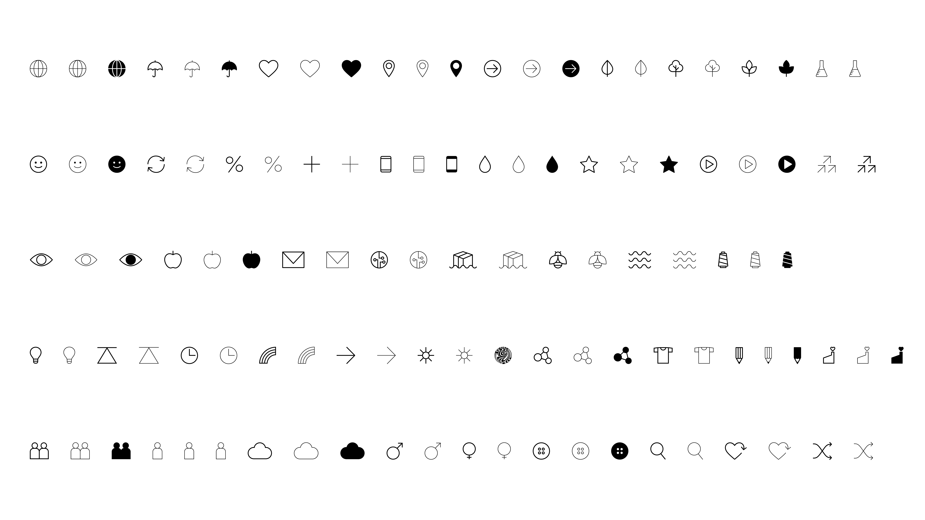
WORKSHOP 1
WORKSHOP 2
WORKSHOP 3
The System Map
Finding your role in the system

Slide 5

Agenda
1.5 hours
01
Introduction and purpose
Background
Exercise 1: Find what
impacts the system
Exercise 2: Place forces
on the map
Exercise 3: Make challenges
into opportunities
Exercise 4: Reflect on opportunities for change
Wrap up and group synthesis
02
03
04
05
06
07

Slide 6
Now that we have gone through the map, get more familiar with it and with your place in the system
INTRODUCTION
BACKGROUND
EXERCISE 1
EXERCISE 2
EXERCISE 3
EXERCISE 4
WRAP UP
WORKSHOP 1
WORKSHOP 2
WORKSHOP 3
Finding your role in the system
Identifying impact opportunities: Identify key levers and blockers along your route and explore how
to shift system flows.
Reimagining the
future system
Exercise 1: Find what impacts the system
Exercise 2: Place forces
on the map
Exercise 3: Turn challenges into opportunities
Exercise 4: Reflect on opportunities for change

Slide 7

The purpose of this session is to understand the systemic forces and opportunities for impact
INTRODUCTION
BACKGROUND
EXERCISE 1
EXERCISE 2
EXERCISE 3
EXERCISE 4
WRAP UP
WORKSHOP 2
Understand how key forces impact the fashion system and the role of your organization within it
Identify where opportunities lie for positive change and decarbonisation in the fashion system
Build confidence in how to create meaningful impact across the system

Slide 8
Principles for the workshop
INTRODUCTION
BACKGROUND
EXERCISE 1
EXERCISE 2
EXERCISE 3
EXERCISE 4
WRAP UP
WORKSHOP 2
There are no right or wrong answers –
only possibilities.
Think interconnection rather than isolation –
utilize all perspectives and insights in this room!
Leave ‘business as usual’ at the door.
Be open to finding ‘blind spots’ and questioning biases – this is a safe space.
Some conversations
may lead you to places that feel uncomfortable,
and that’s OK.
If you find yourself ‘stuck’ on an activity, speaking to a facilitator might help.

Slide 9
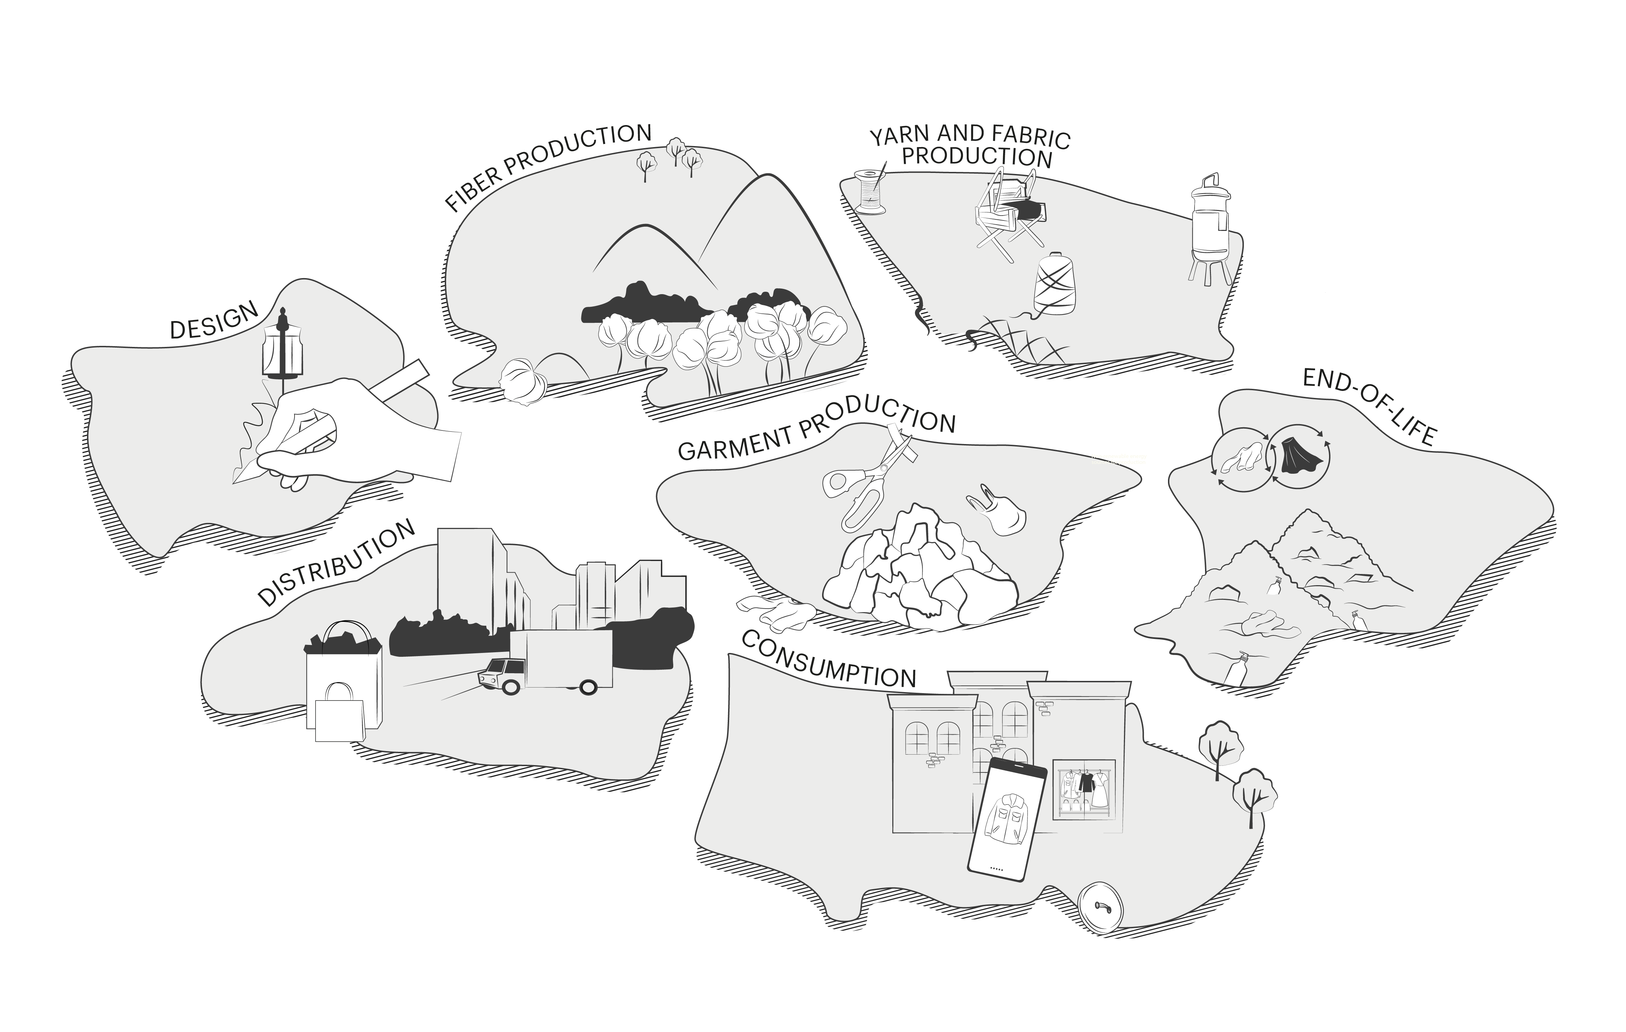
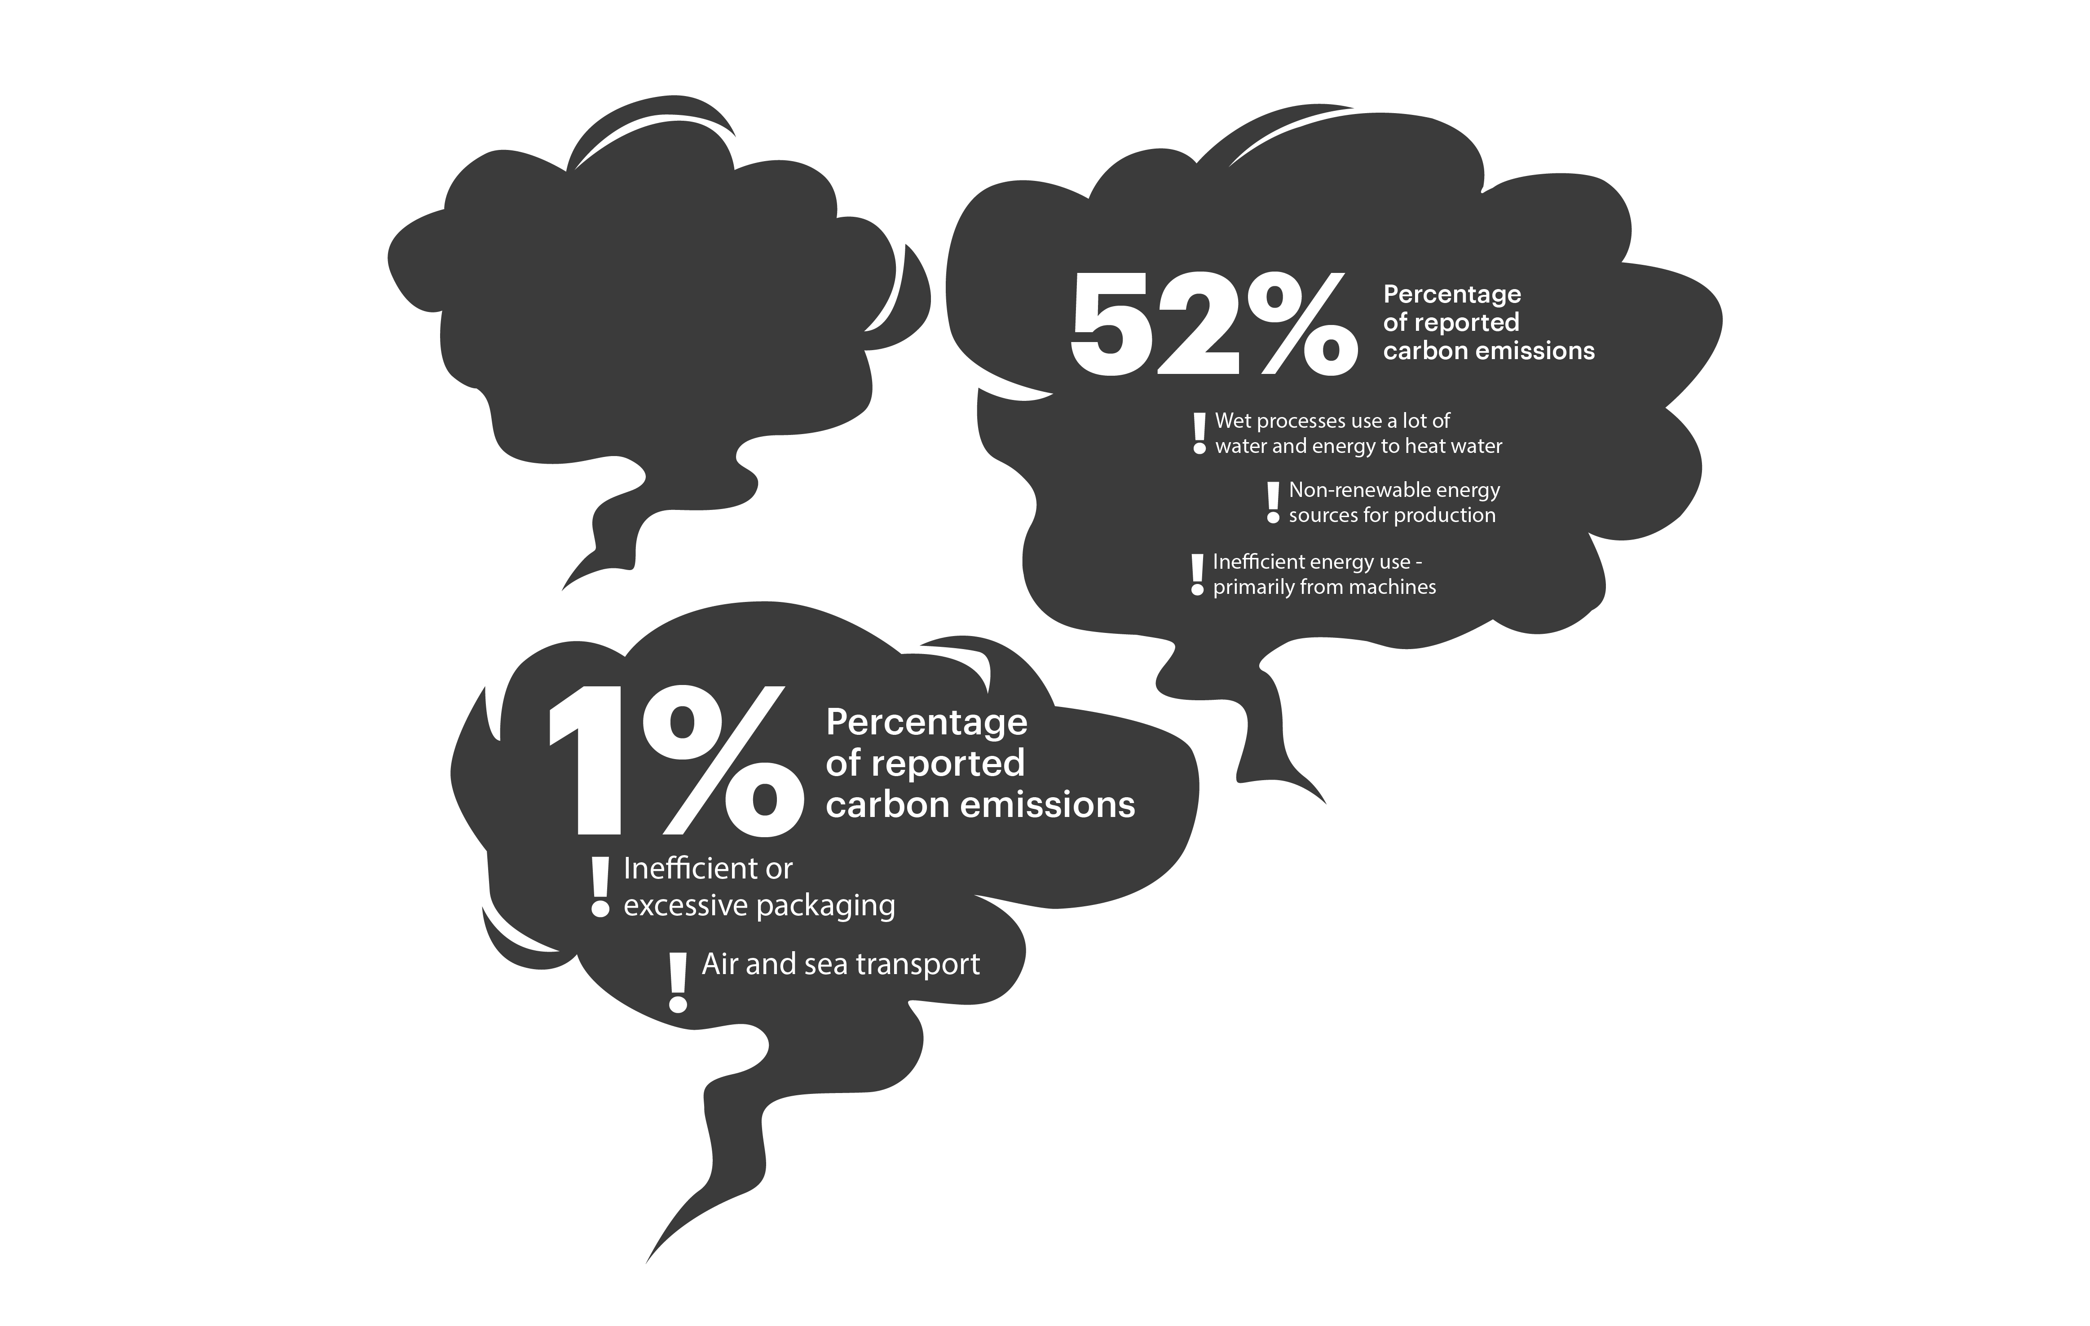
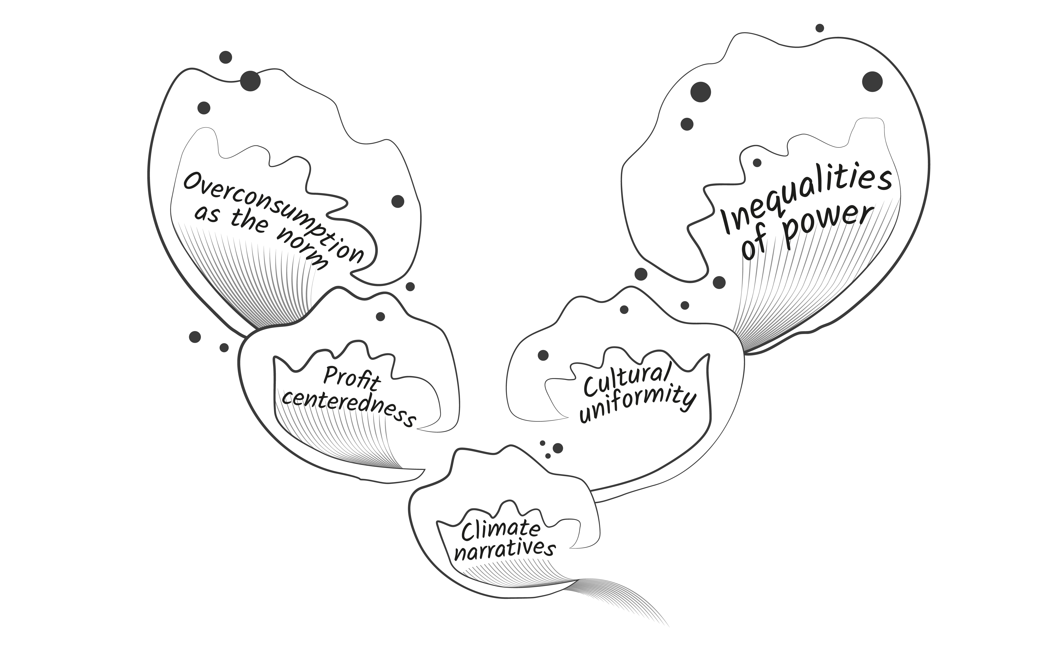
INTRODUCTION
BACKGROUND
EXERCISE 1
EXERCISE 2
EXERCISE 3
EXERCISE 4
WRAP UP
WORKSHOP 2
Extending the map to understand how the system works and is influenced
Now we will use an extended map focusing on the third of the three layers – systemic forces
The fashion system is subject to change as outer forces creates pressure
A systemic force is an invisible but powerful part of the system’s design that shapes behaviour and drives a certain outcome
Layer 1: The value chain
Stages of the fashion value chain
Layer 2: Carbon
Share of emissions for each island
Layer 3:
Systemic forces
Macro forces influencing how
the system works

Slide 10





INTRODUCTION
BACKGROUND
EXERCISE 1
EXERCISE 2
EXERCISE 3
EXERCISE 4
WRAP UP
WORKSHOP 2
Each force create impact on the fashion system
Systemic forces impact
Systemic forces matter because they help to reveal root causes
of challenges in the system and to inspire change that creates meaningful impact.
Some forces are very obvious - overconsumption as the norm, for example. Others are less visible - power imbalances,
for example.
Some forces are uncomfortable to talk about, but if we don’t name them, we can’t shift them.
Climate narratives
shape how people and organisations frame climate change—whether as a shared systemic challenge,
a compliance issue, or something distant and abstract.
Profit centredness drives the fashion system to prioritise short-term financial performance, shaping decisions on design, sourcing, speed, and scale.
Overconsumption as the norm has designed the fashion system around high volumes, low prices, and rapid change, increasing pressure on resources and people.
Cultural uniformity has shifted the fashion system away from local knowledge and practices toward standardised global approaches.
Inequalities of power has led to decision-making often favouring brands over manufacturers and suppliers while placing workers on the ground at a disadvantage.

Slide 11
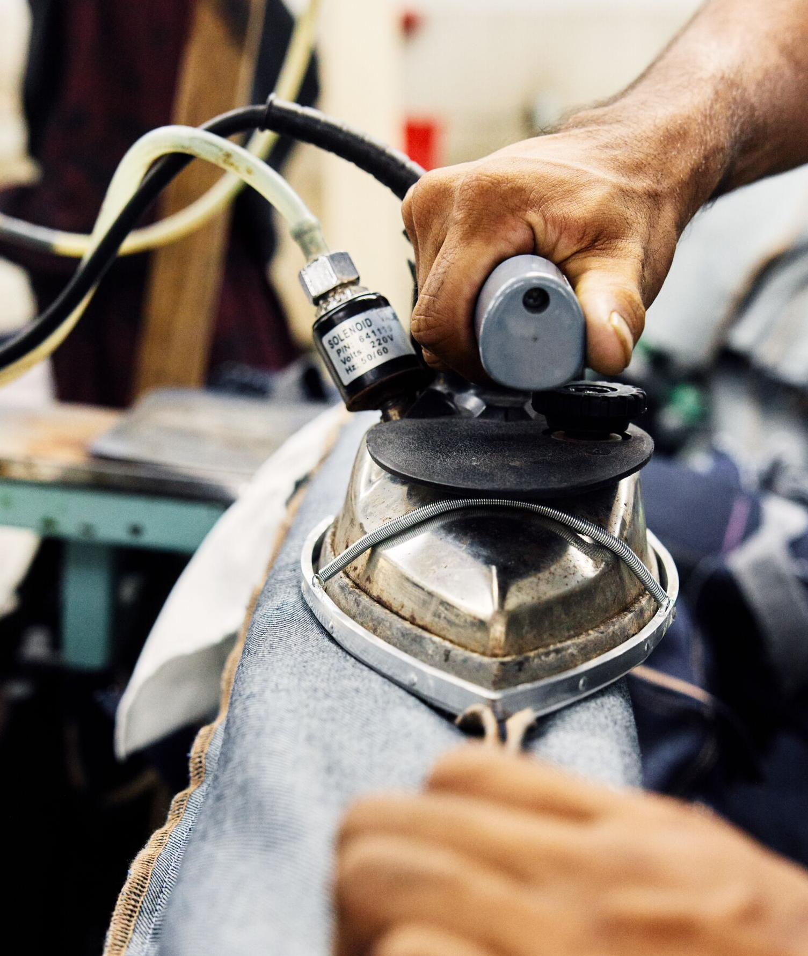
INTRODUCTION
BACKGROUND
EXERCISE 1
EXERCISE 2
EXERCISE 3
EXERCISE 4
WRAP UP
WORKSHOP 2
An example of how inequalities of power influence decisions and outcomes
What outcome does it create in the fashion system?
This power imbalance means brands can demand low prices and fast delivery, while factories and workers carry the pressure through longer hours, lower wages, and limited ability to push back or plan ahead
How does it impact decarbonization?
Decarbonisation regulations are often made centrally, and don’t take the whole system to account. e.g. target to reduce air conditioning in factories can lead to heat stroke, which is unworkable
What is the problem and opportunity?
When those expected to deliver lower emissions have the least |
power to make decisions, change stalls—creating an opportunity to rebalance power through shared investment, longer-term contracts, and involving suppliers and workers in decision-making to enable
just and lasting decarbonisation
Now it’s time for you to reflect on the forces from your perspective…

Slide 12
INTRODUCTION
BACKGROUND
EXERCISE 1
EXERCISE 2
EXERCISE 3
EXERCISE 4
WRAP UP
WORKSHOP 2
Find what impacts the system
From this list of systemic forces, discuss how they are impacting the decarbonisation of the fashion system today and in the future.
You don't have to choose all of the forces – you can choose 2-3 that feel particularly impactful for your work in the fashion system.
Prompts:
Which systemic forces feel most impactful for your work in the fashion system?
In what ways do these forces influence decarbonisation efforts, positively and negatively?
How do you see these forces changing over the next 1-2 years?
Systemic forces:
Reminders:
Overconsumption as the norm: The normalisation and accessibility of fast fashion.
Profit centredness: The role
of ROI and business metrics
in determining priorities and practices of organisations.
Climate narratives: the
way climate change is talked about in the media, and how this influences individuals,
organisations and policy.
Cultural uniformity: The move away from local context and practices as a result of globalisation.
Inequalities of power: The way power and decision making is distributed across the value chain.
15 minutes
Familiarise yourself with the systemic forces
Reflect and discuss the prompts in groups
of 2-4 people
Use examples of printed cards to answer

Slide 13
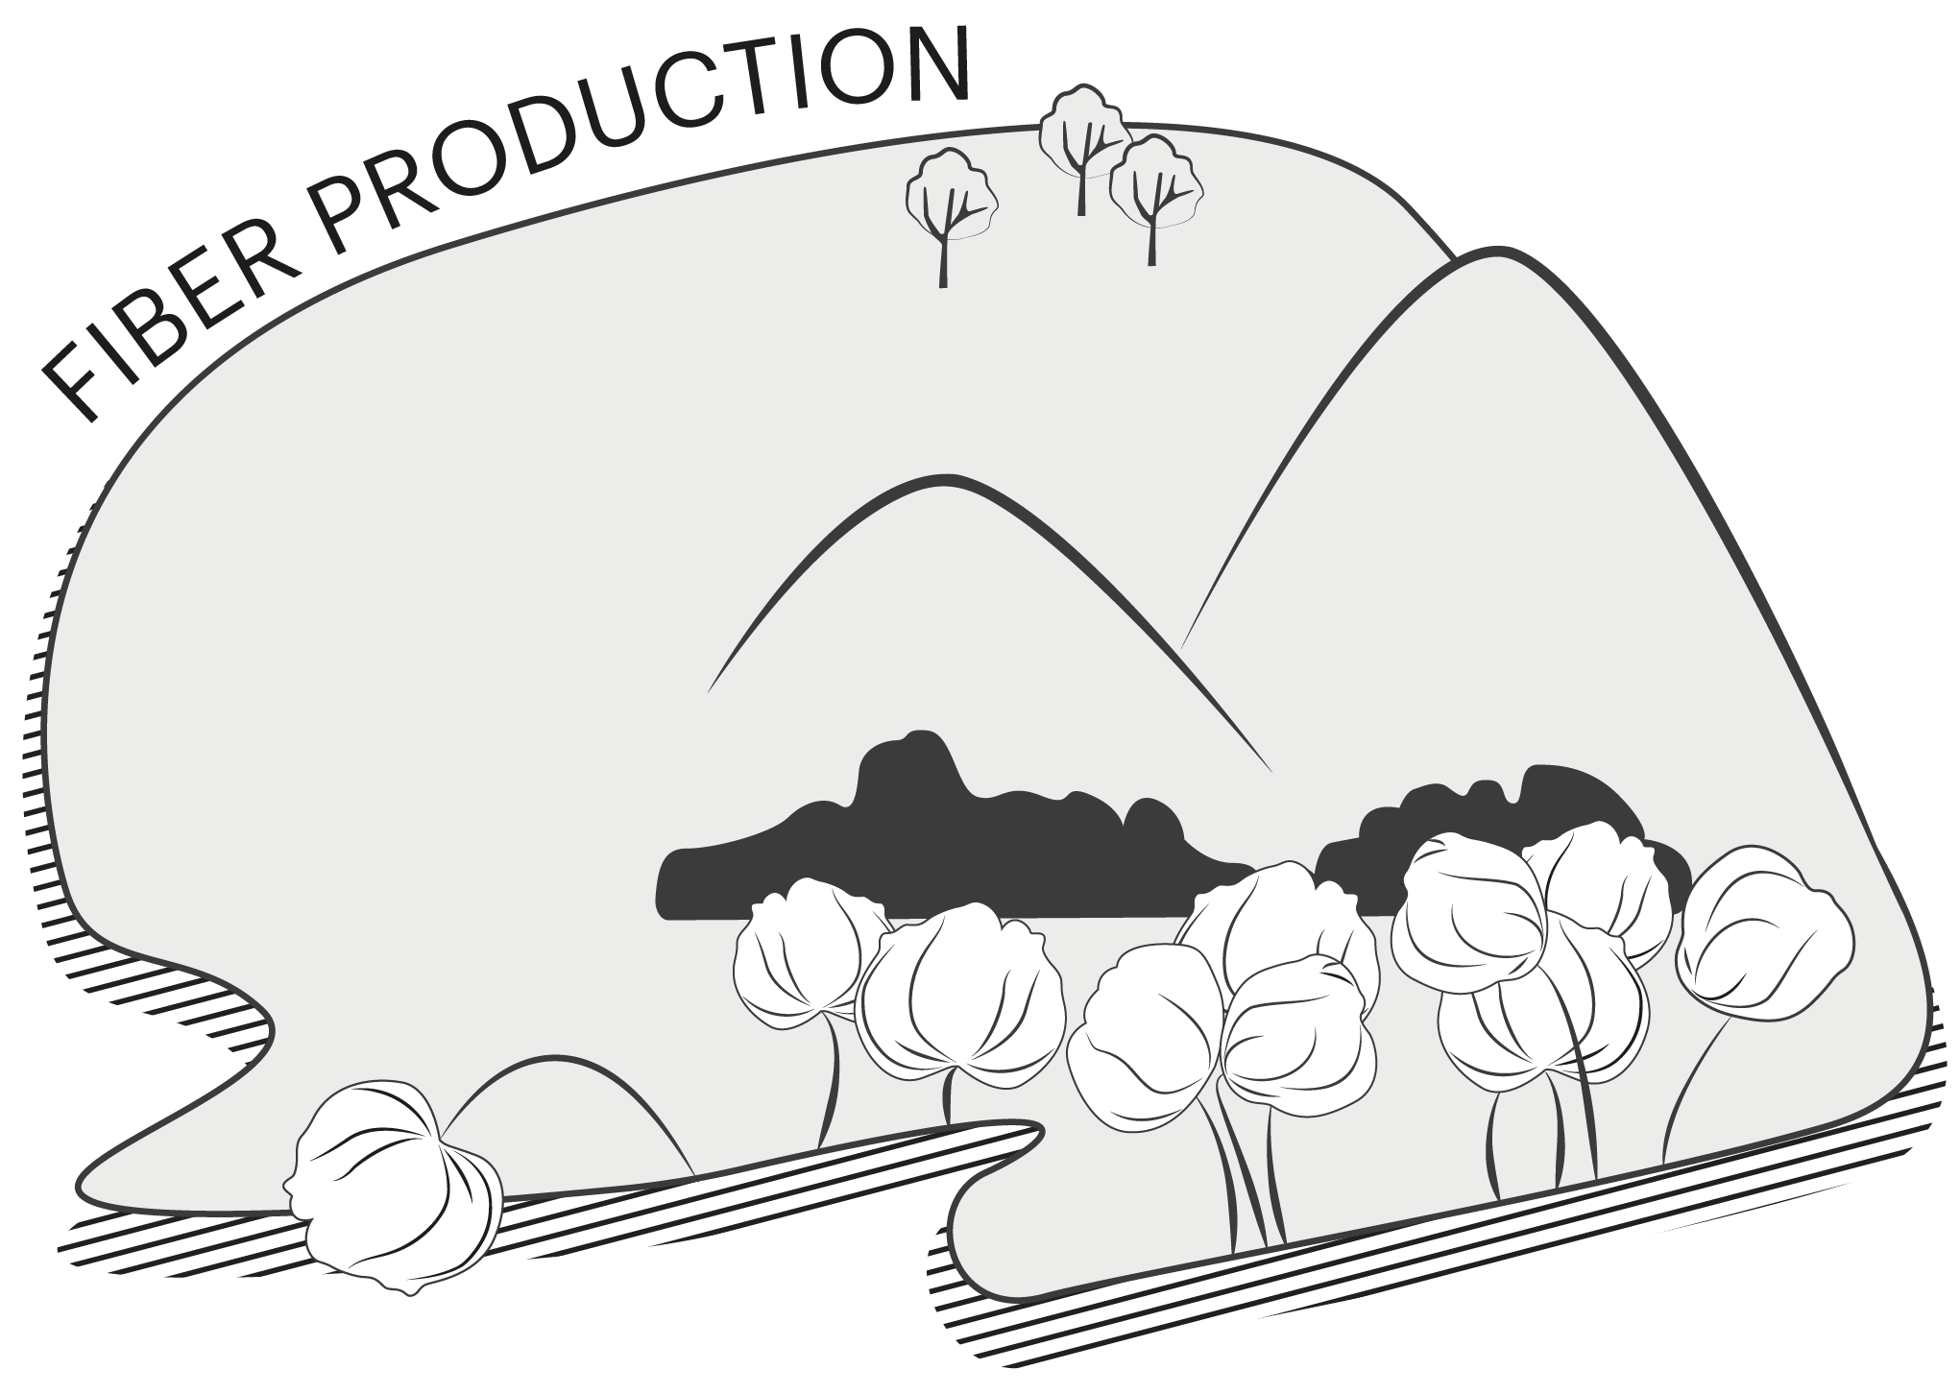
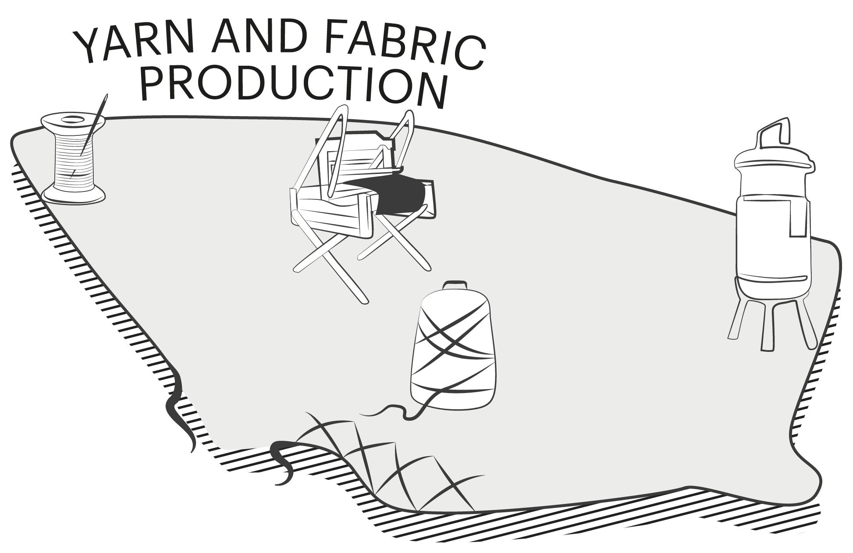
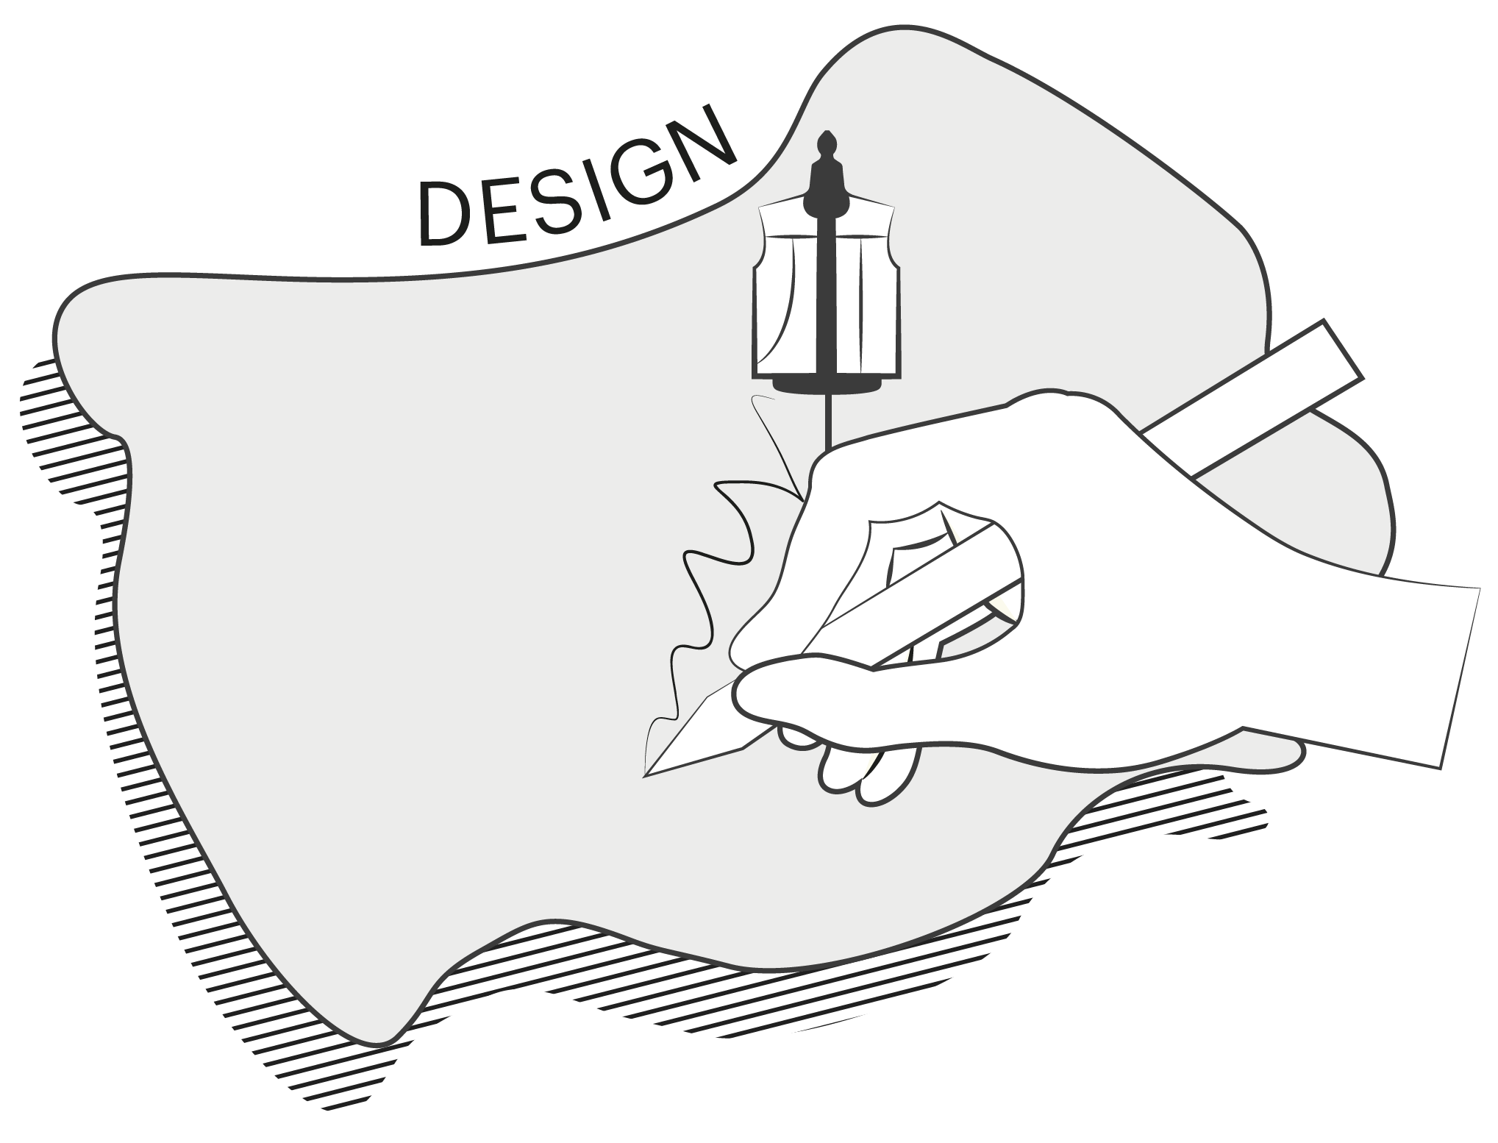
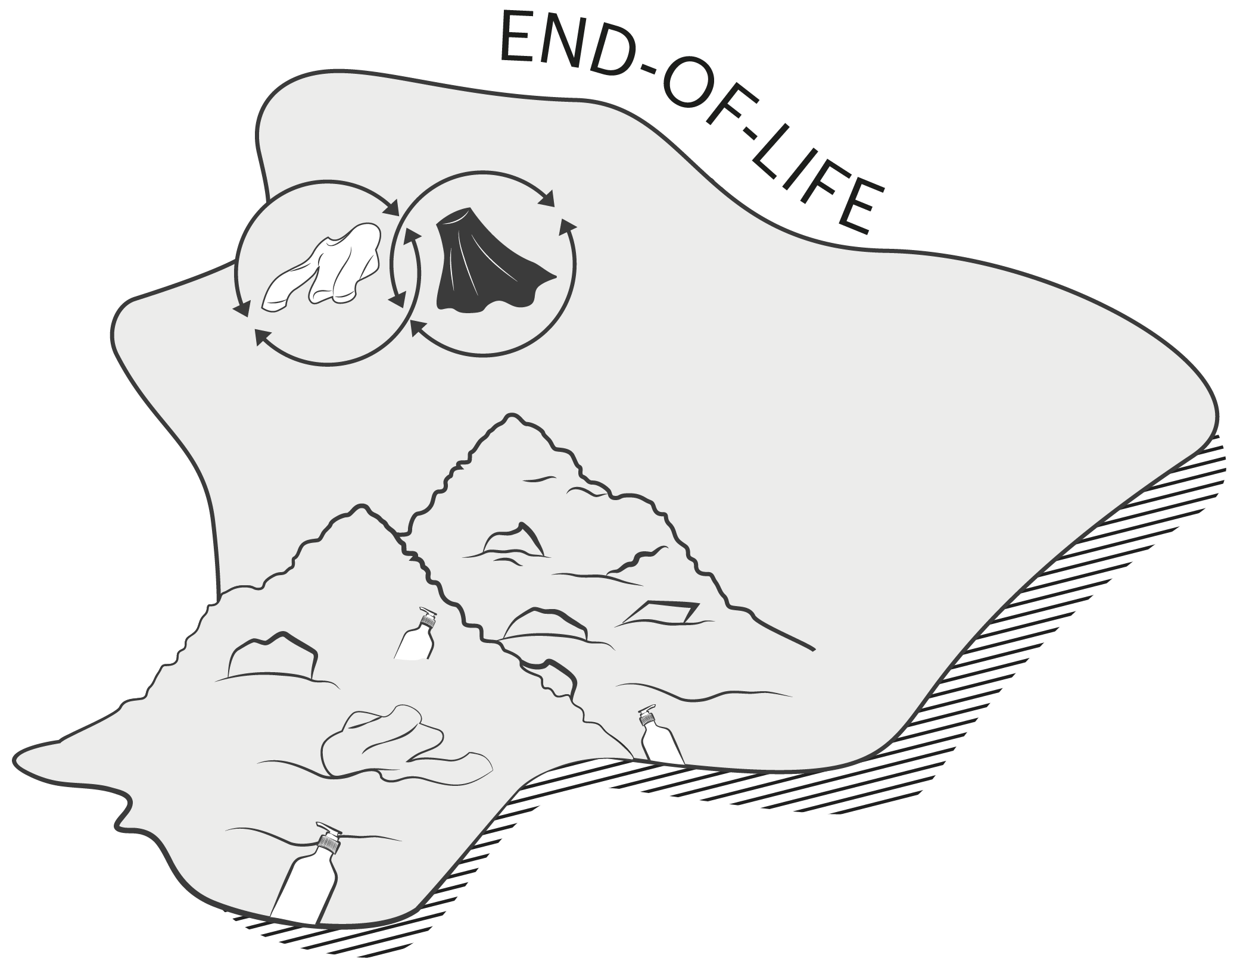
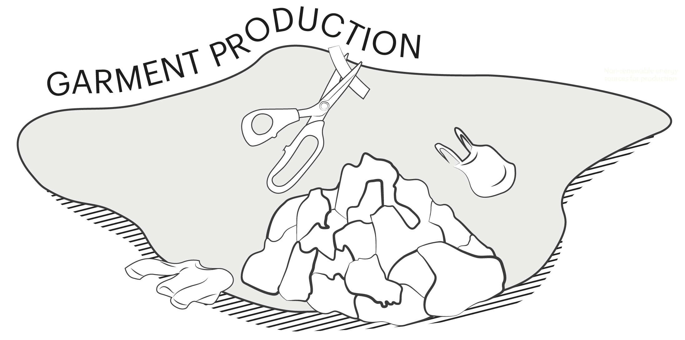
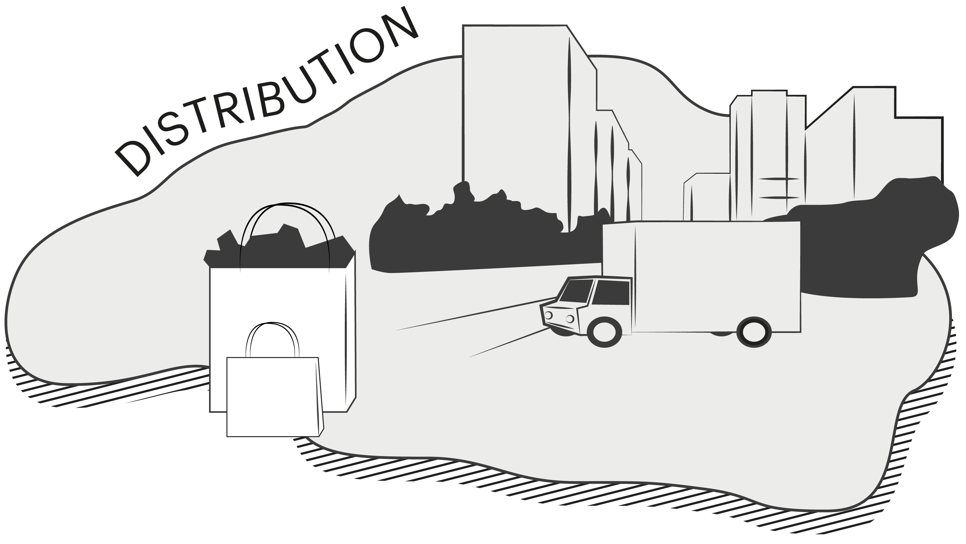
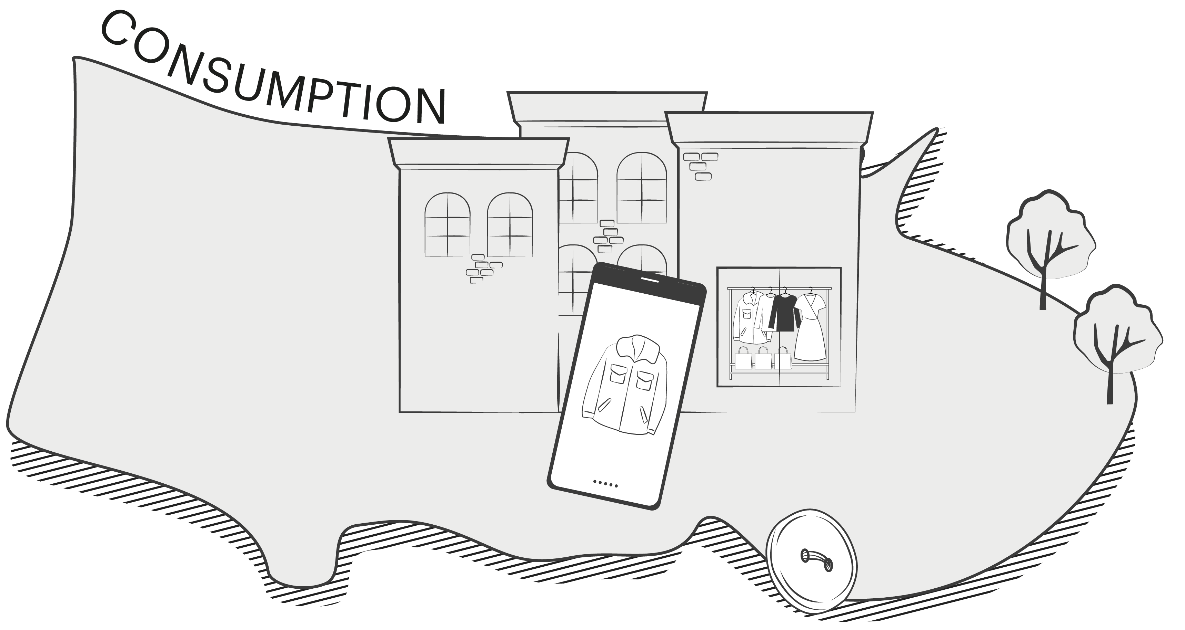
INTRODUCTION
BACKGROUND
EXERCISE 1
EXERCISE 2
EXERCISE 3
EXERCISE 4
WRAP UP
WORKSHOP 2
Place forces
on the map
Now that you've discussed the systemic forces, identify the places on the map where they have most impact.
Forces can impact multiple places
on the map.
Which points on the map do the systemic forces impact the most?
Who do the forces affect the most, and why?
Reminders:
15 minutes
Reflect and discuss
in open groups
Use the map on the next
page to plot the forces

Slide 14

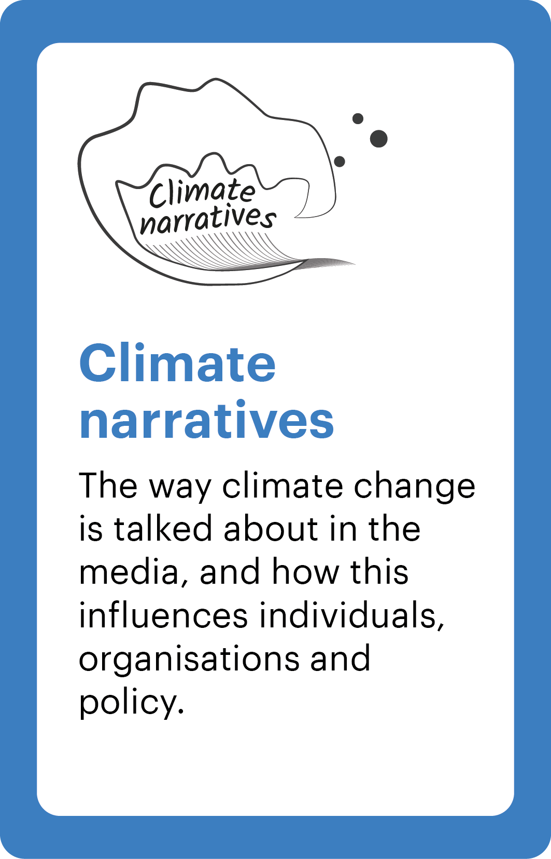

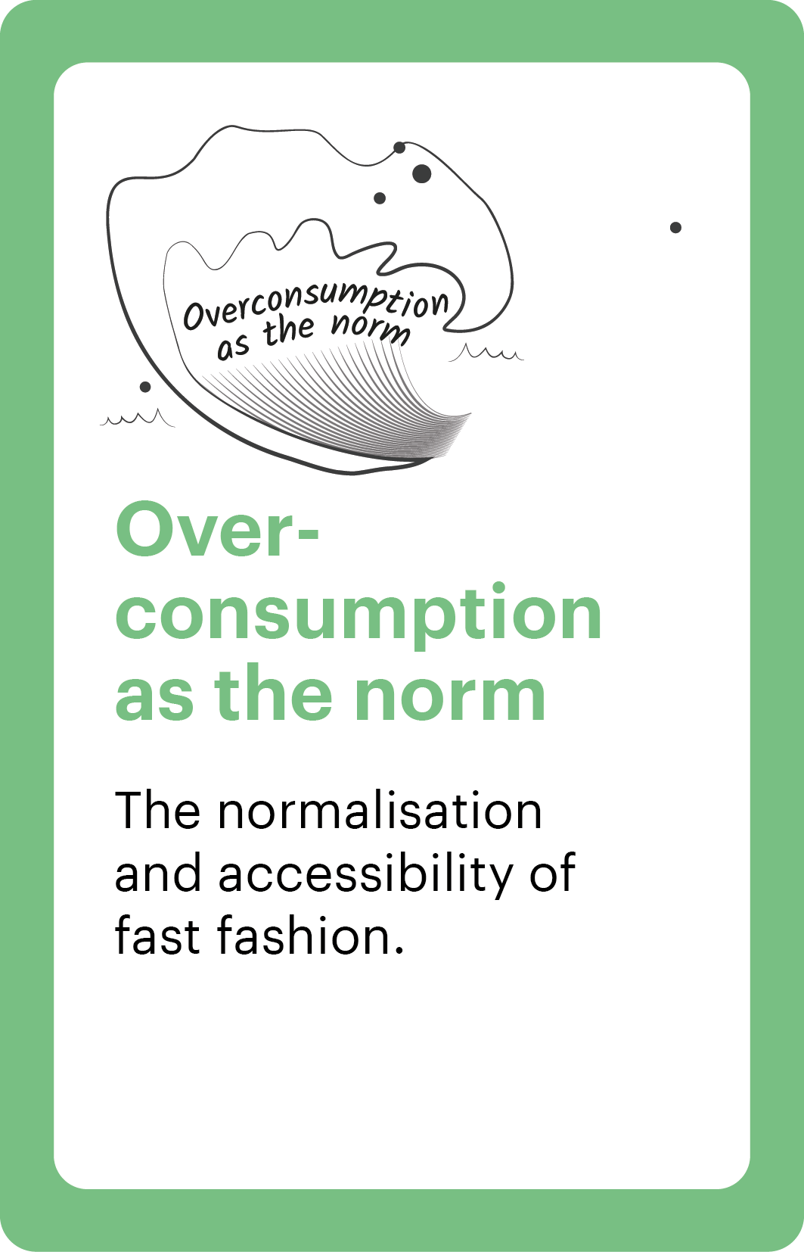

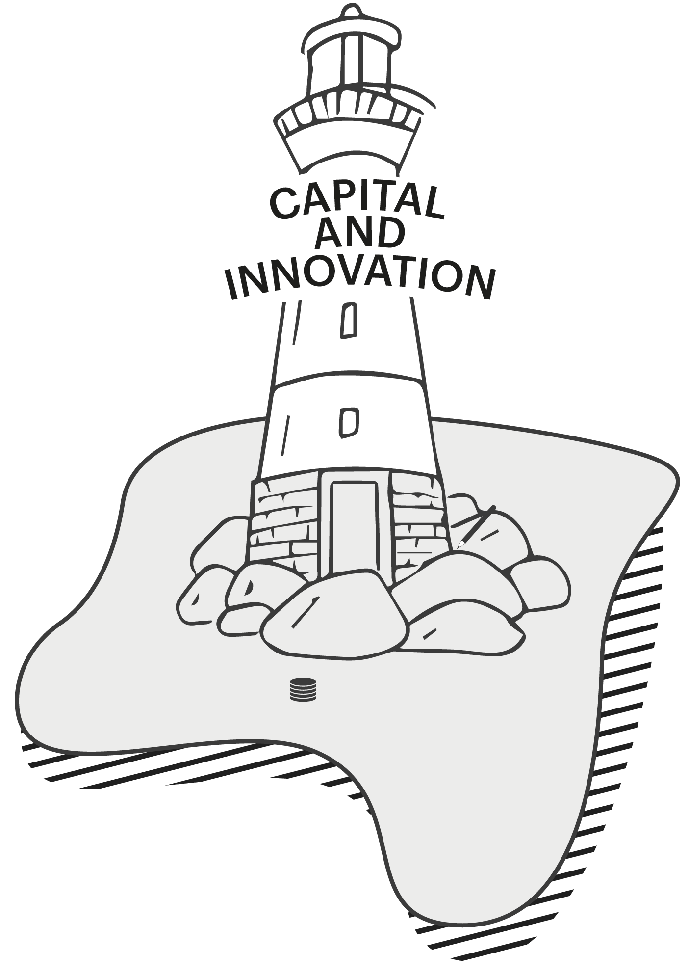

INTRODUCTION
BACKGROUND
EXERCISE 1
EXERCISE 2
EXERCISE 3
EXERCISE 4
WRAP UP
WORKSHOP 2
Use the system force cards to evaluate how impact is distributed in the system to enable just change.

Slide 15
WORKSHOP 2
Break time
10 minutes

Slide 16



INTRODUCTION
BACKGROUND
EXERCISE 1
EXERCISE 2
EXERCISE 3
EXERCISE 4
WRAP UP
WORKSHOP 2
Make challenges into opportunities
Step 1
Looking at the systemic forces that you've plotted on the map, write some problem statements that summarise the key challenge or pain point.
E.g. "Power imbalances mean that suppliers are not able to recommend regulation changes that are appropriate for their local context."
You can write as many challenge statements as you like.
Identify addressable challenges that provide opportunities for positive change in the fashion system.
Media stories about “sustainable fashion” focus on consumer choices, while the realities are faced by factory workers—such as heat and production pressure.
Repair or better materials would reduce impact, but the idea gets shelved because it won’t hit this quarter’s margin target.
Shoppers are trained to treat clothing as disposable—new drops every week and “20% off today” nudges.
Reminders:
20 minutes
Reflect and discuss
in the same groups
Use post-its or printed cards for writing
Rank the three most addressable
Step 2
Turn these challenges to opportunities by ranking the challenges based on how addressable they are within your organisation’s remit. Discuss your reasoning for the 2-3 highest ranked opportunities.
‘Most addressable’ means how much ability your organisation has to influence or solve the challenge.
1
2
3

Slide 17
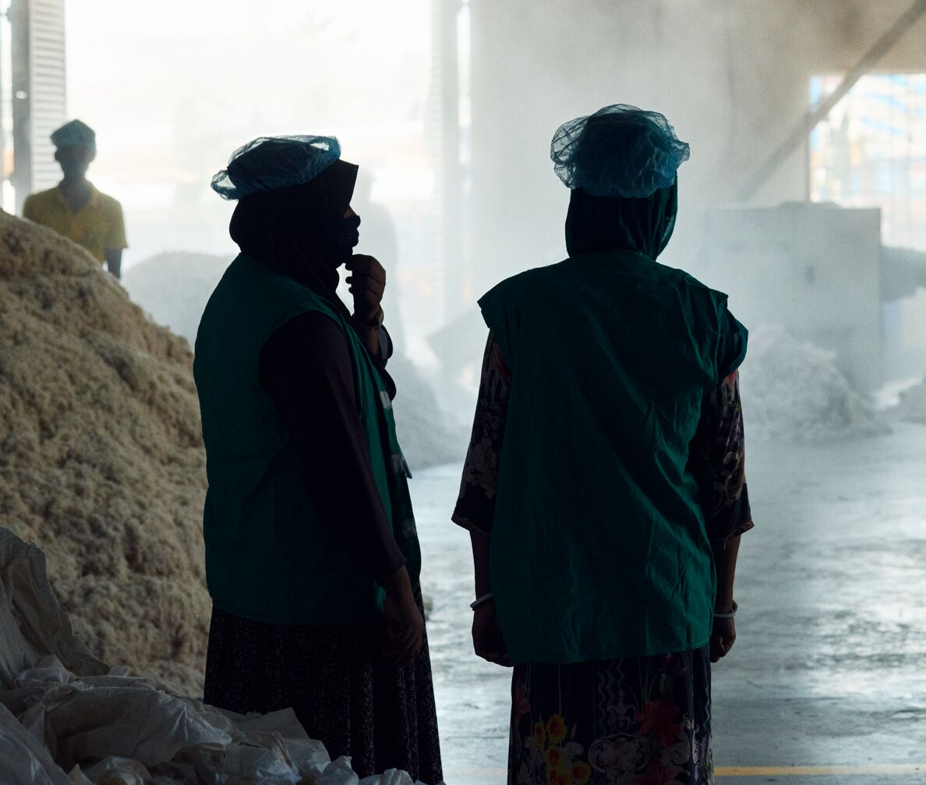
INTRODUCTION
BACKGROUND
EXERCISE 1
EXERCISE 2
EXERCISE 3
EXERCISE 4
WRAP UP
WORKSHOP 2
Reflect on opportunities
for change
Summarise and reflect on the key challenges and opportunities for change.
Have these exercises made you think differently about the challenges and opportunities to decarbonise the fashion system? In what ways?
What changes do you think are
needed most?
What might the one starting point
be for change?
Reminders:
10 minutes
Reflect and discuss
in open groups

Slide 18
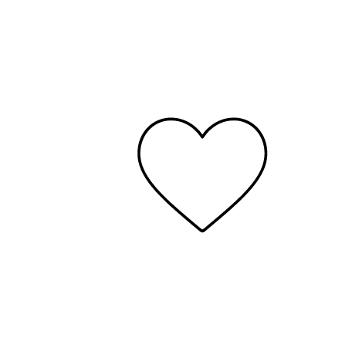
Thank you
Stay updated
hmfoundation.com
Contact us
info@hmfoundation.com
Follow us​
Instagram, LinkedIn and YouTube: @hmfoundation​
When you’re ready, feel free to continue with Workshop 3
18

Slide 19
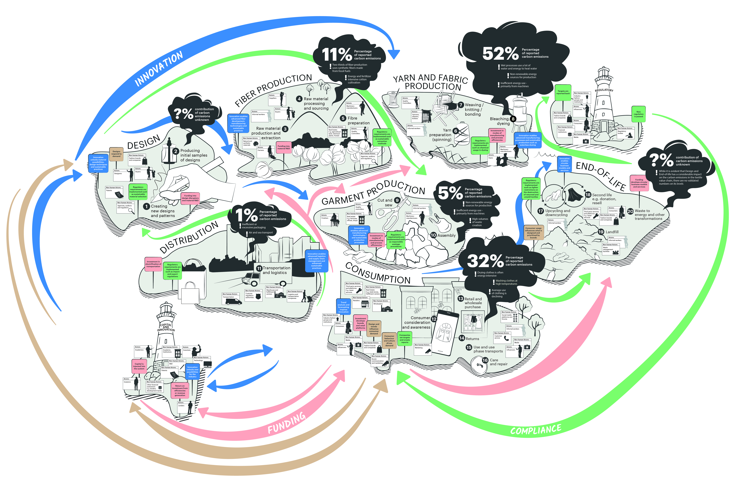
The System Map
WORKSHOP 2

Slide 20
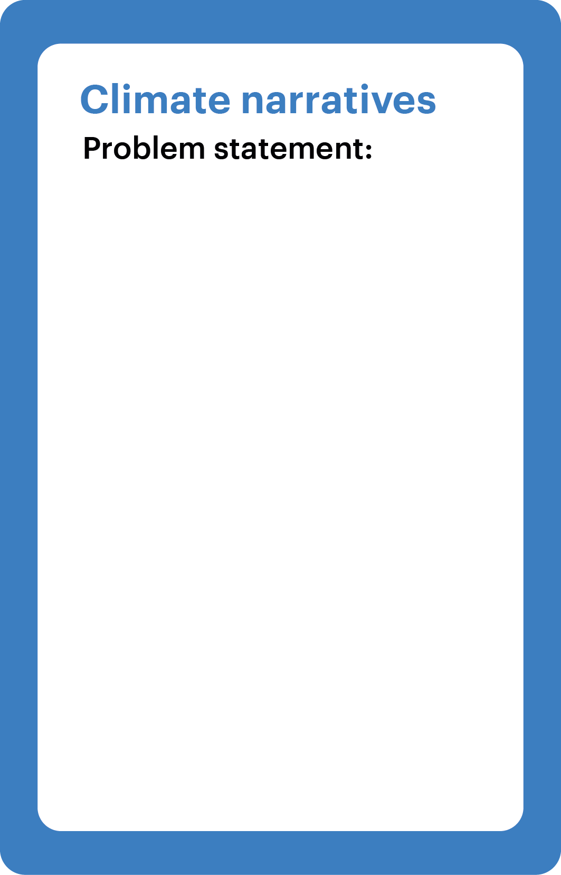
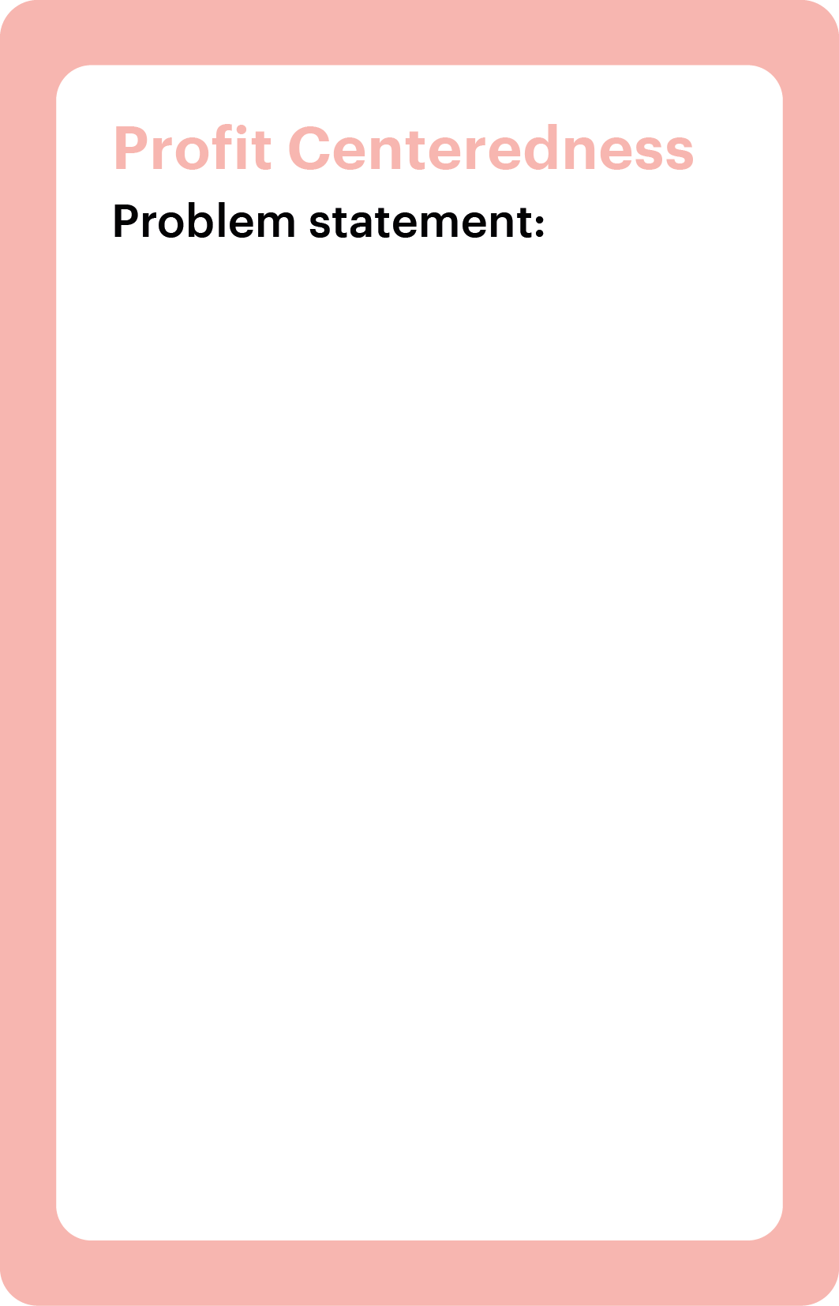
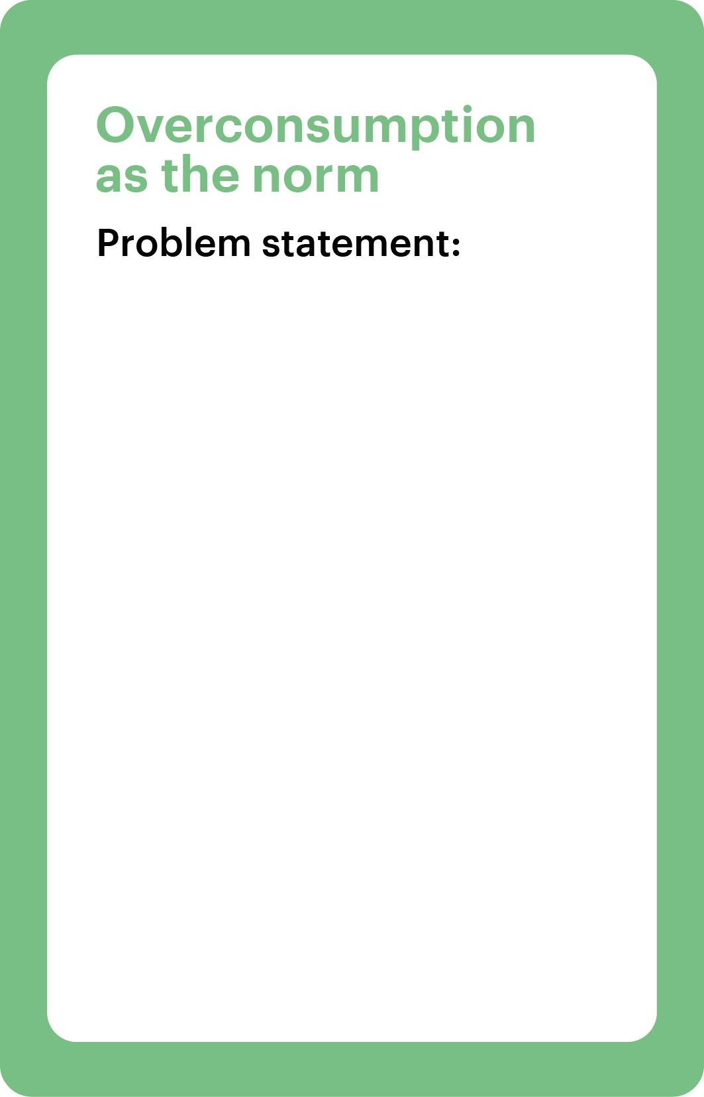


The System Map
WORKSHOP 2

Slide 21

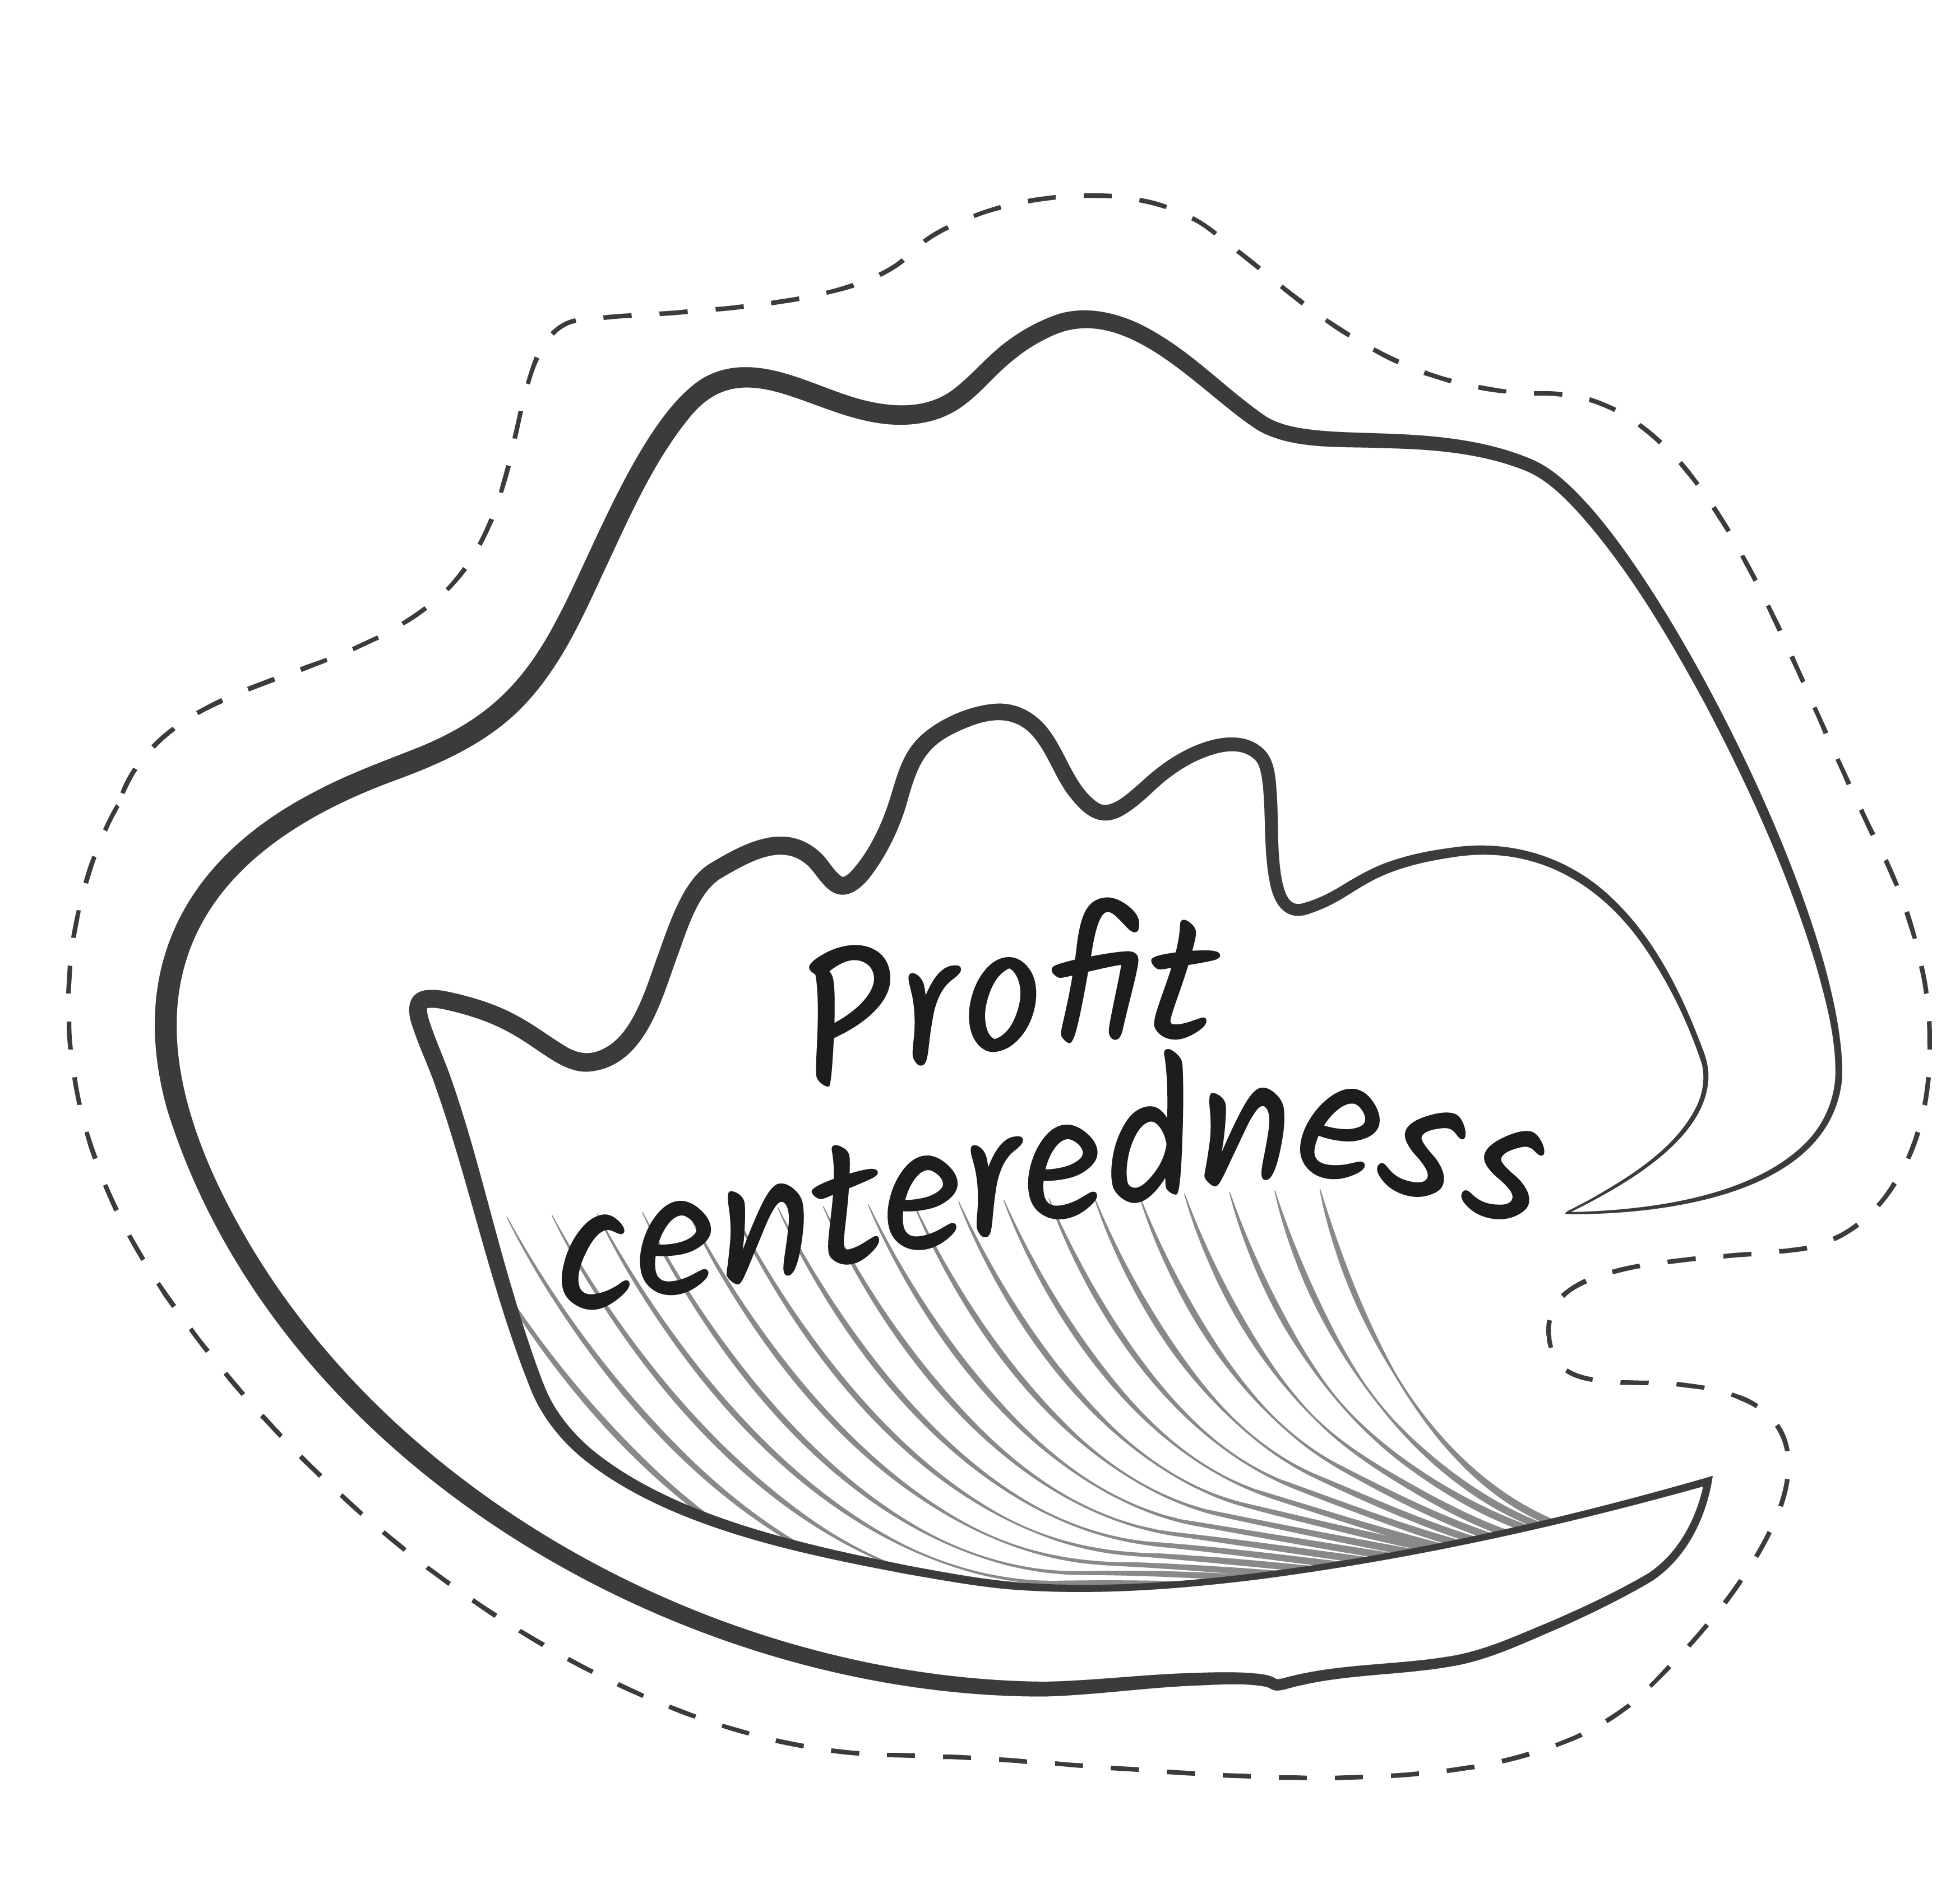

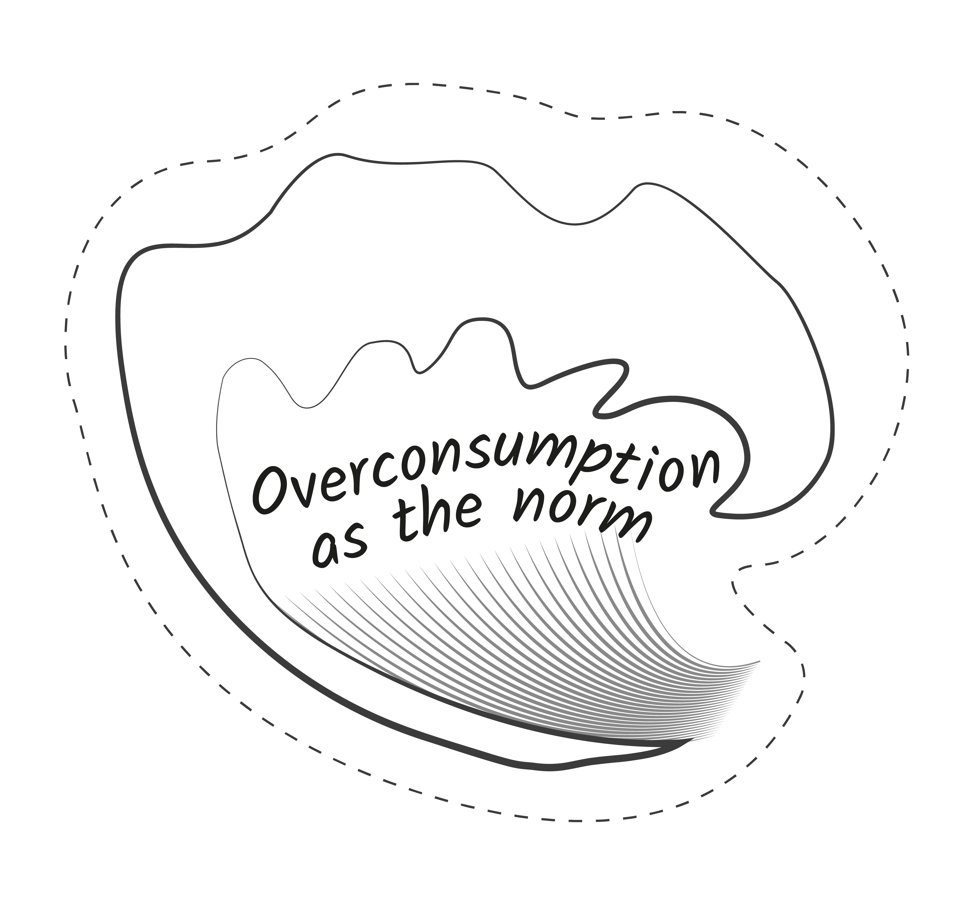

Perforated force cards for print
WORKSHOP 2

Slide 22
Digital force cards
WORKSHOP 2

