Slide 1
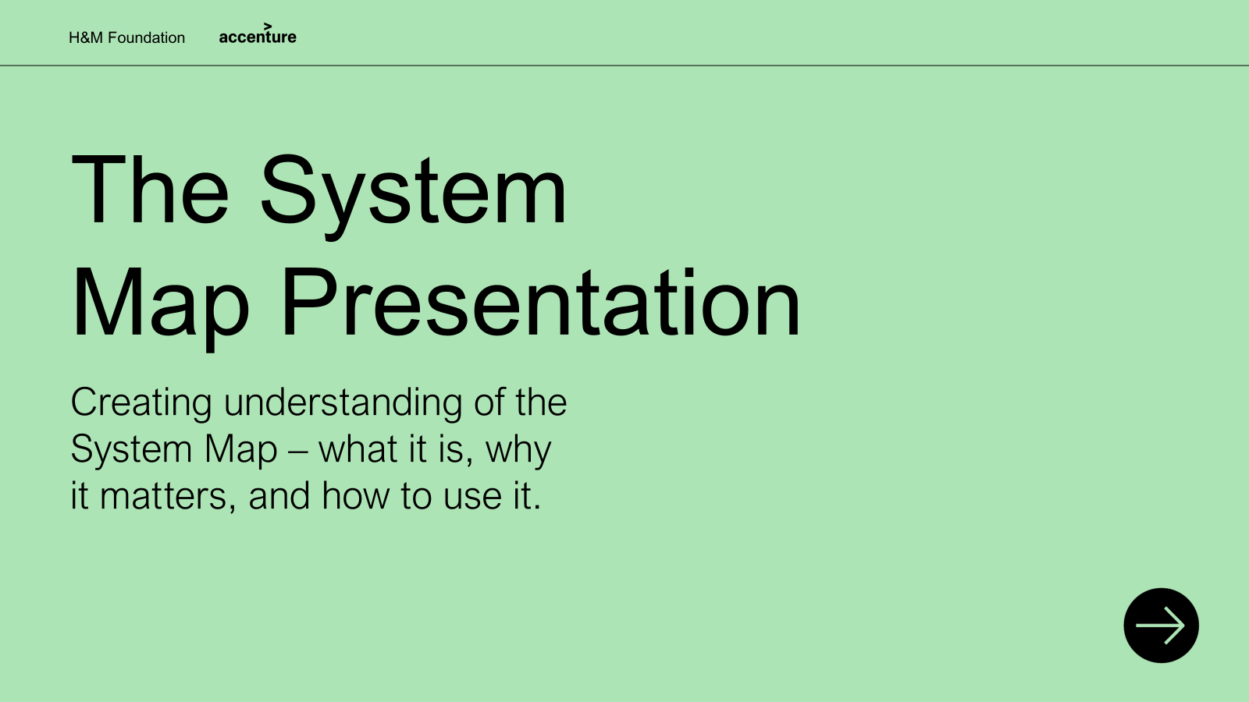
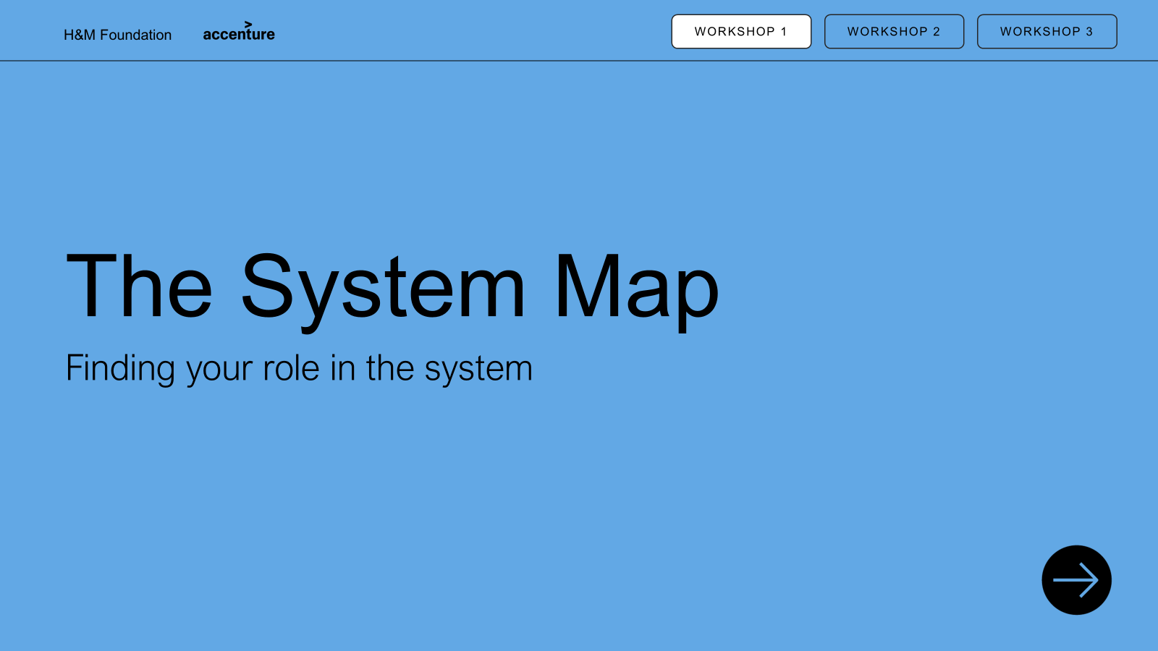
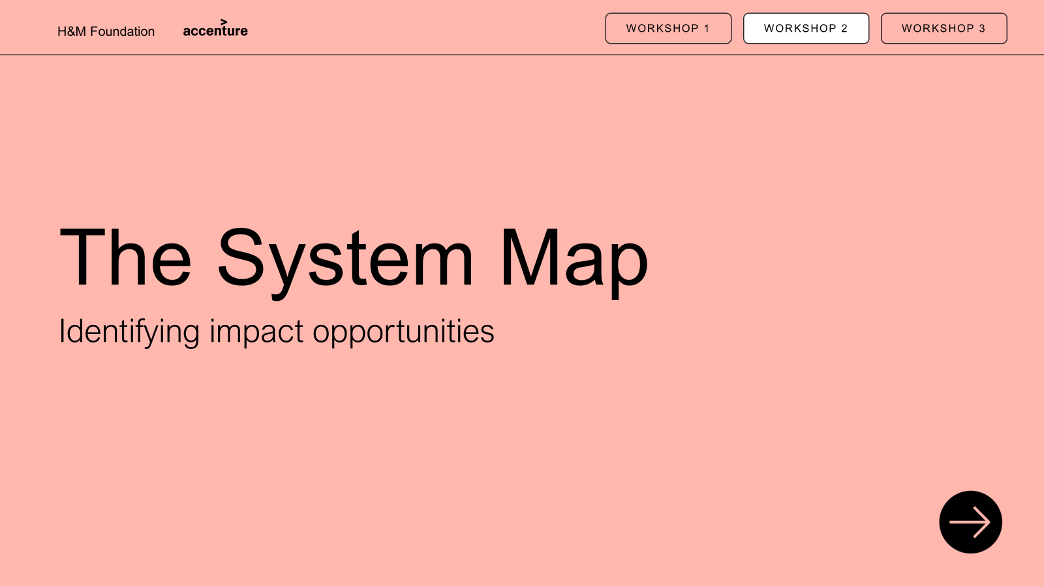
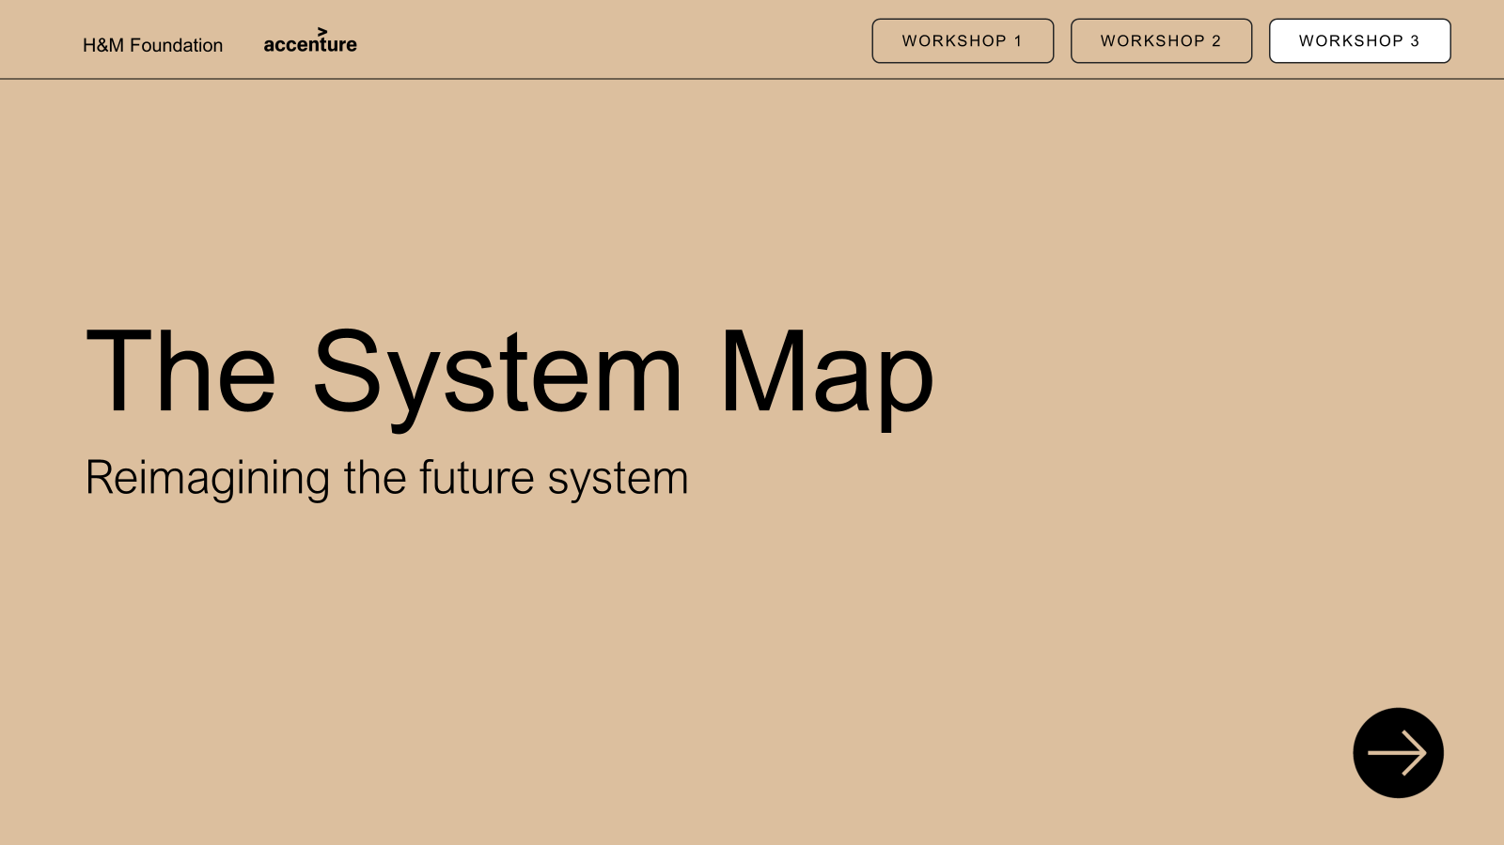
Executive summary: System Map presentation material
PRESENTATION
WORKSHOP 1
WORKSHOP 2
WORKSHOP 3
PURPOSE: This presentation material is developed to introduce the System Map and enable its practical use. The System Map is a flexible framework for making sense of the fashion system by bringing key stages, actors, and levers into one place. The following material introduces the map’s purpose, structure, and use, supporting users in understanding how the fashion system works and where change can be made. Optional workshops provide a deeper understanding of the fashion system, one’s position within it, opportunities for impact, and what a future system could look like to enable decarbonisation.
PARTICIPATION: This material is developed for all actors—whether you are actively working within the system or influencing it from the outside—from industry insiders and innovators to policymakers, investors, donors, researchers, and civil society. It is also designed to support new users engaging with the System Map for the first time.
PRESENTATION: It is optional how much of the material you choose to use—you may deliver only a keynote presentation or build it out with Workshops 1–3. Each workshop builds on the previous one, but the number of workshops you include and when you run them is entirely
up to you.
Content
Internal facilitator guide
Introduction: Trends shaping the industry of the future and purpose of visualizing the system
Read the map: Explain the map layers and elements (layers, flow actors)
Bring map to life: Brief examples of flows to relate to the map
Final: Inspire to start building on the map
Content
Internal facilitator guide
Introduction and purpose
Background
Exercise 1: Place yourself on the map
Exercise 2: Map relationships and influences
Exercise 3: Reflect on opportunities for collaboration
Wrap-up and group synthesis
System Map
30 min: Keynote presentation
Workshop 1
60 min: Finding your role in the system
Creating understanding of the System Map – what it is, why it matters, and how to use it
Opening discussion to familiarise with the map and identifying roles in the system
Content
Internal facilitator guide
Introduction and purpose
Background
Exercise 1: Find what impacts the system
Exercise 2: Place forces on the map
Exercise 3: Turn challenges into opportunities
Exercise 4: Reflect on opportunities for change
Wrap-up and group synthesis
Optional printable content
Content
Internal facilitator guide
Introduction and purpose
Background
Exercise 1: Start finding changes to the map
Exercise 2: Reimagine the System Map
Exercise 3: Start moving the needle
Wrap-up and group synthesis
Optional printable content
Workshop 2
90 min: Identifying impact opportunities
Workshop 3
120 min: Reimagining the future system
Identifying key impacting forces in the system and identifying opportunities to act
Developing the system to achieve decarbonisation though greater, and just impact
Contact Details: We are excited for you to use this material and spread the impact. While the material is public, we ask that it be used with care and credit to support thoughtful, respectful dialogue and action. For any questions or clarification, we ask you to reach out to info@hmfoundation.com. You can credit us in any preferred way, but here is a suggestion hmfoundation.com/system-map-toolkit-and-guiding-material/

Slide 2
Internal facilitator guide: Overview presentation approach
PRESENTATION
WORKSHOP 1
WORKSHOP 2
WORKSHOP 3
Background
Preparation
Follow-up
PURPOSE: This workshop helps participants reimagine the fashion system to enable decarbonisation while supporting a just transition, where impacts and benefits are more fairly distributed across the value chain. By redesigning the System Map, participants explore how structures, actors, forces, and flows need to shift to create a more sustainable future system.
The outcome is a future vision and a set of concrete actions that participants can take—together with others—to start moving the system toward a fairer, lower-carbon reality.
PARTICIPANTS:
No limit to number of participants but recommend 12-24 participants for easier facilitation, physical or digital
Groups of 2-4 people for exercises
Any type of participants can take part in the presentation e.g. brands, manufacturers, customers, policy makers
PRESENTATION: Start to familiarise and
prepare by
Understand the System Map as a design tool — how value chains, actors, forces, and flows can be reshaped to enable decarbonisation and a just transition
Be clear on the purpose of each exercise — exploring what needs to change and translating ambition into action
Prepare prompts— what shifts are needed, who must be involved, and where leverage sits
Technical and material check in advance — modular map elements, screen sharing, sound, and facilitator notes
Plan time management and transitions carefully — balance creative exploration with convergence toward clear ambitions
Set and protect the tone — no right or wrong answers
MATERIALS AND TOOLS:
With tools – This workshop relies on hands-on tools to be fully immersive. Prepare either printed materials (System Map, modular components, cards) or the digital PPT version with drag-and-drop elements enabled. Ensure each group has its own complete set of map components to support active participation, shared exploration, and clear outcomes.
DOCUMENTATION:
Collect and save the material if you utilize material in the workshop to summarize participants reflections
Capture interesting discussions and perspectives sparked by the material to identify what could be developed further
Note any concrete feedback from participants on the presentation or suggested next steps
Document where questions, confusion, or misunderstandings arose to refine content, exercises, or facilitation
REALISING OUTCOMES:
A clear, shared vision of what a decarbonised and just fashion system could look like
Concrete, role-specific actions they can take—individually and with others—to help move the system in that direction

Slide 3
Internal facilitator guide: Overview of workshop agenda
PRESENTATION
WORKSHOP 1
WORKSHOP 2
WORKSHOP 3
Agenda | Time | Slide | Instructions | Key Takeaway | Tips
1. Introduction | 5min | 4-8 | Position Workshop 3 as the shift from understanding today’s system to actively rebuilding the future System Map Clarify that this is about exploring possibilities, not agreeing on one “right” future | Focus on redesigning the future system, not analysing the current one. | Emphasise creative freedom to reshape the map. Avoid detailed explanations at this stage.
2. Background | 10min | 9-12 | Explain that the goal is to rebuild the system to enable decarbonisation while supporting a just transition Reintroduce the System Map components participants will actively work with: value chain islands, actors, forces, bus routes, and carbon clouds Go through example of reimagined map to emphasize that it can be fully reimagined | Participants understand how decarbonisation and just transition are embedded in how the map is redesigned. | Anchor the concept of just transition in concrete map changes rather than definitions. One example is enough.
3. Exercise 1 | 10min | 13 | Explain the exercise and ensure mutual understanding in the group Divide groups beforehand or split into groups 2-4 people during the session Distribute the 10min, explaining the exercise, reflecting in group (e.g. 5min), short group reflection Prepare print or presentation with the System Map for the exercise | Identify immediate gaps or opportunities for improvement in the fashion System Map. | Ask participants why they’d make each change to uncover deeper assumptions or values. Watch for recurring ideas across groups—they indicate priority areas.
4. Exercise 2 | 60min | 15-16 | Explain the exercise and ensure mutual understanding in the group Start with individual reflections based on previous exercise Divide into the same groups of 2-4 people during the session to recreate the map Distribute the 45min, explaining the exercise, reflecting individually (e.g. 5min), group discussion. Plan for 15min reflection in full group Provide pens, post-its to capture thoughts and drawings Present the map from each group if possible, or choose a few if too many Present with the printed map on the table, on a board or share PowerPoint image | Reimagine the system’s structure—actors, flows, and relationships—to envision what a decarbonised and just future could look like. | Encourage bold rethinking, not incremental tweaks. Prompt participants to question what’s missing, oversized, or outdated. Listen for recurring themes and tensions across maps when presenting them.
5. Exercise 3 | 15min | 18 | Explain the exercise and ensure mutual understanding in the group Start with individual reflections using the ambition and action canvas Discuss in open group to conclude key actions Distribute the 20min, explaining the exercise, reflecting individually (e.g. 5min), open discussion Prepare print or use PowerPoint presentation to fill in the ambition and action canvas | Translate shared future ambition into actions—both personal and systemic—to start moving the needle toward change. | Push for specific, realistic actions, not abstract intentions. Encourage ambition but anchor it in the current system context.
6. Wrap-up | 5min | 19 | Highlight common changes across maps (e.g. new actors, stronger flows, repositioned islands) Summarize by reflecting on next steps and actions to take in their roles | Participants leave with a clear ambition steps connected to their role. | Prioritise time to reflect on both the current exercise but also the learnings across all workshops.

Slide 4

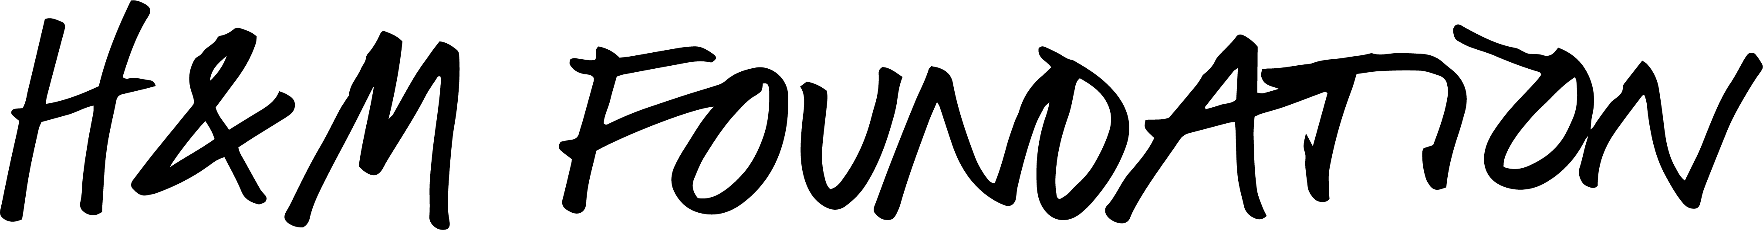
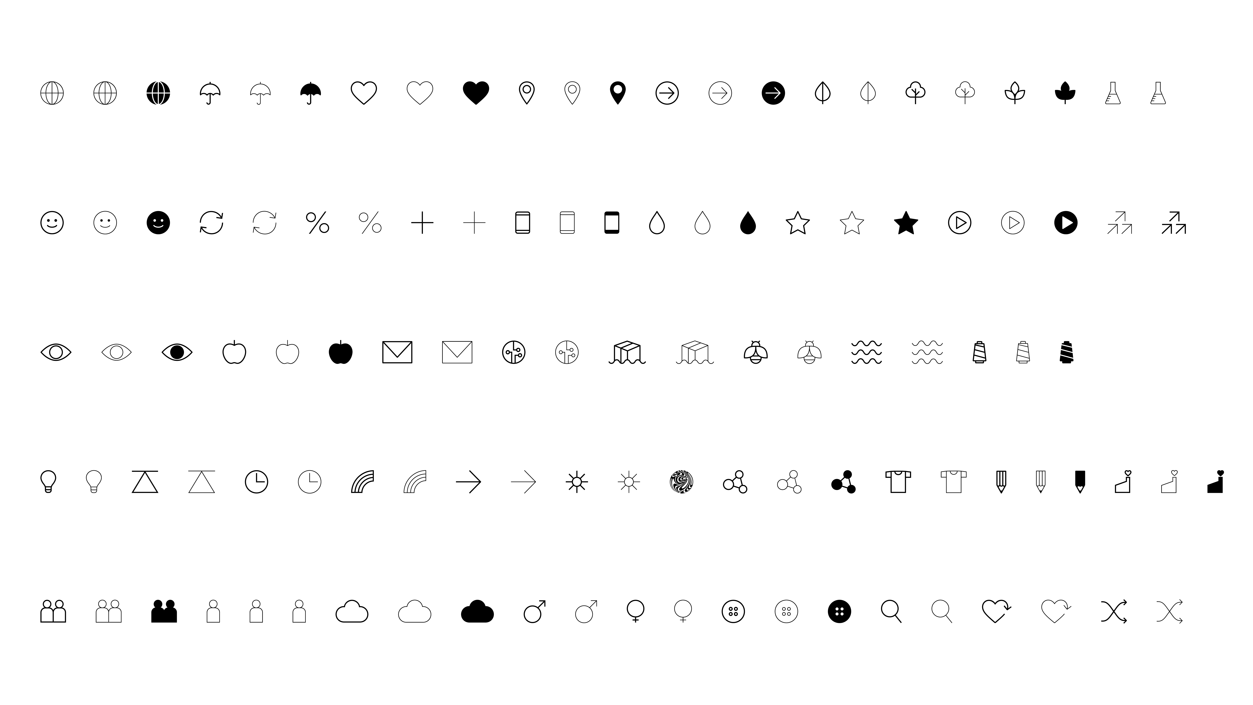
WORKSHOP 1
WORKSHOP 2
WORKSHOP 3
The System Map
Reimagining the future system

Slide 5

Agenda
2 hours
01
Introduction and purpose
Background
Exercise 1: Start making changes
to the map
Exercise 2: Reimagine the
system map
Exercise 3: Start moving the needle
Wrap-up and group synthesis
02
03
04
05
06

Slide 6
INTRODUCTION
BACKGROUND
EXERCISE 1
EXERCISE 2
EXERCISE 3
WRAP UP
Before we have focused on the current system, but now we are shifting focus to the “to-be” system
WORKSHOP 1
WORKSHOP 2
WORKSHOP 3
Finding your role in the system
Identifying impact opportunities
Reimagining the future system: Develop bold ideas for how the system could evolve and where to intervene for greater, faster, fairer impact.
Exercise 1: Start making changes
to the map
Exercise 2: Reimagine the
System Map
Exercise 3: Start moving the needle

Slide 7
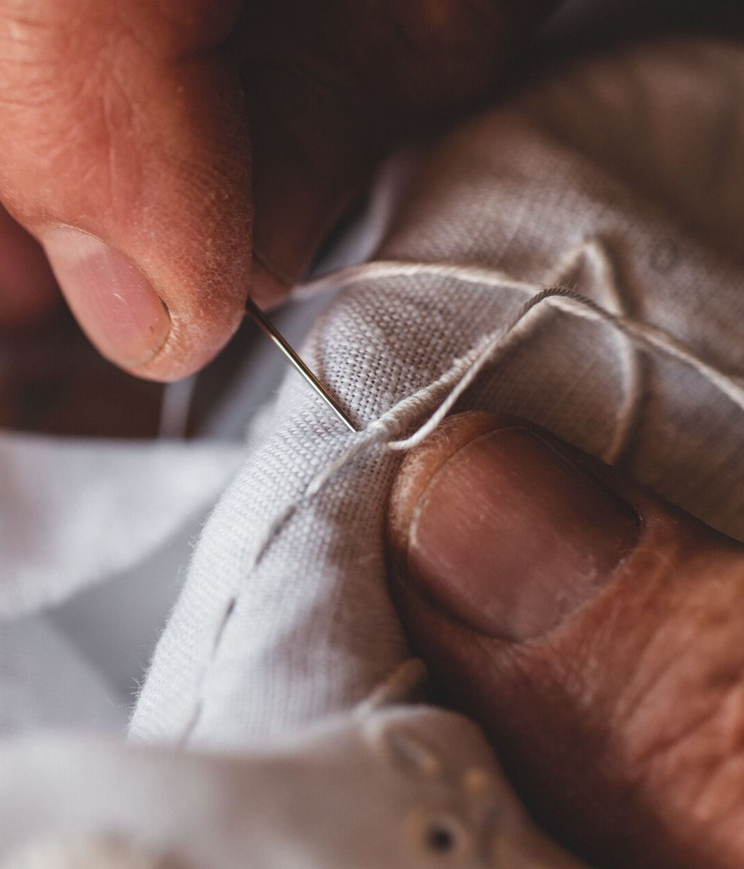
INTRODUCTION
BACKGROUND
EXERCISE 1
EXERCISE 2
EXERCISE 3
WRAP UP
WORKSHOP 3
The objective of this session is to determine what changes are needed
to reimagine the fashion system.
For example, which islands, actors,
and forces need to shift, and how.
Create a shared vision for the future: Align on what the reimagined fashion system could look like and what collective action needs to happen
Align on key enablers for change: Identify the key activities, actors, capabilities and collaborations that will be essential to creating systemic change, and your role within that

Slide 8
INTRODUCTION
BACKGROUND
EXERCISE 1
EXERCISE 2
EXERCISE 3
WRAP UP
WORKSHOP 3
Principles for the workshop
There are no right or wrong answers –
only possibilities.
Think interconnection rather than isolation –
utilize all perspectives and insights in this room!
Leave ‘business as usual’ at the door.
Be open to finding ‘blind spots’ and questioning biases – this is a safe space.
Some conversations
may lead you to places that feel uncomfortable,
and that’s OK.
If you find yourself ‘stuck’ on an activity, speaking to a facilitator might help.

Slide 9
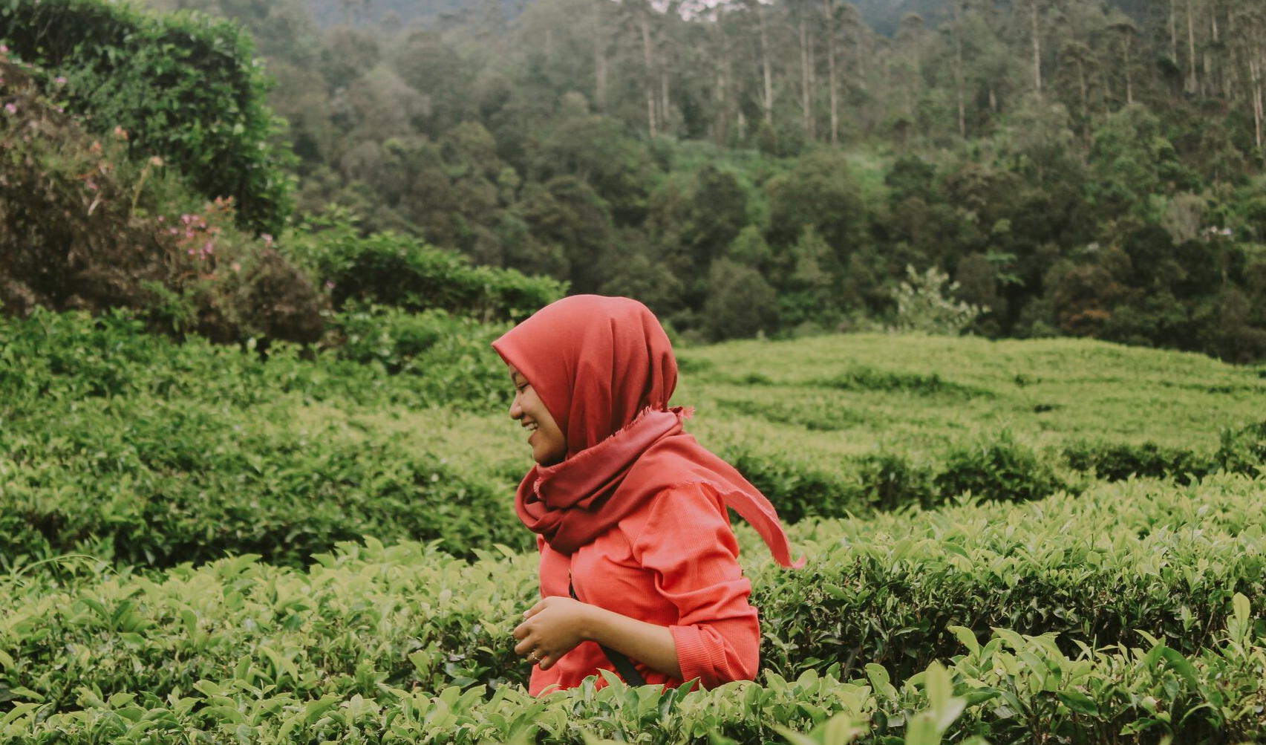
Decarbonising the fashion system with a just transition
INTRODUCTION
BACKGROUND
EXERCISE 1
EXERCISE 2
EXERCISE 3
WRAP UP
WORKSHOP 3
Decarbonising the fashion system involves many different levers — from materials and energy to technology and sourcing
How these levers are used matters, as every climate action creates ripple effects for people across the value chain
A just transition means cutting emissions while considering who bears the cost, who benefits, and who is included in the change
Examples:
Levers of shifting from conventional to recycled or alternative fibers and upgrading factories to lower-carbon processes reduces emissions across fiber, yarn, and fabric production.
Just transition impact means this can change required skills, job roles, wages, and working conditions, making reskilling, worker voice, and shared responsibility across the value chain essential.

Slide 10
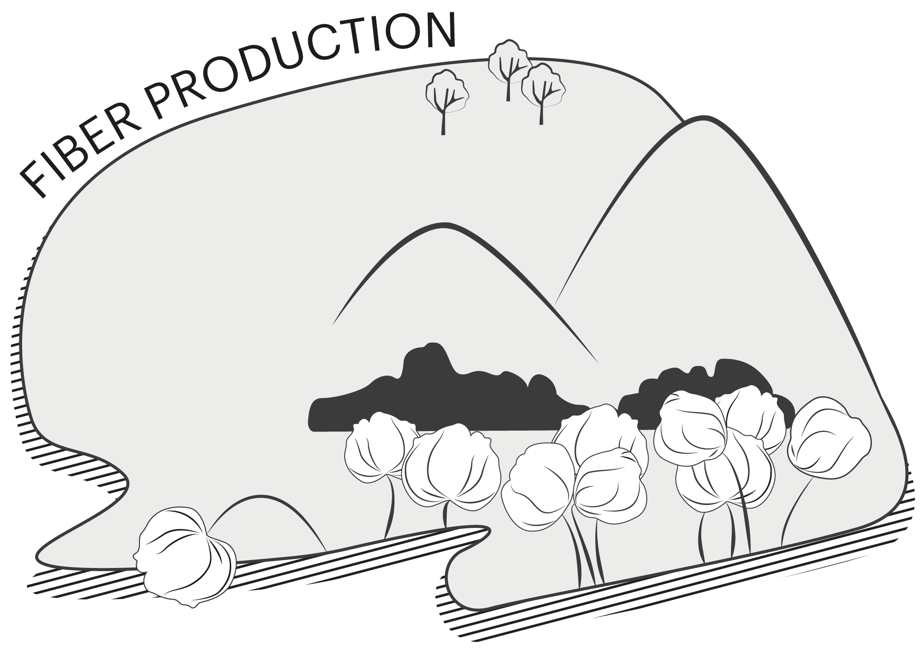
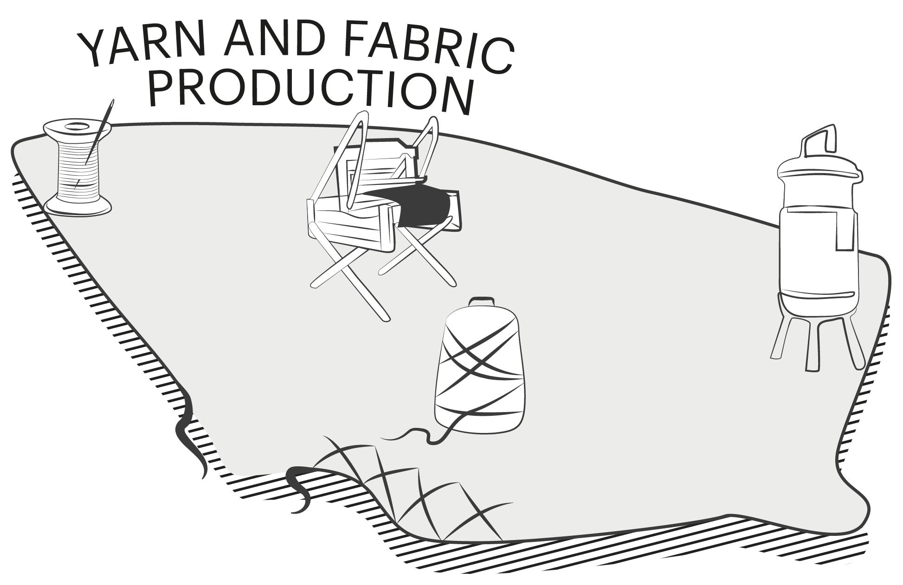
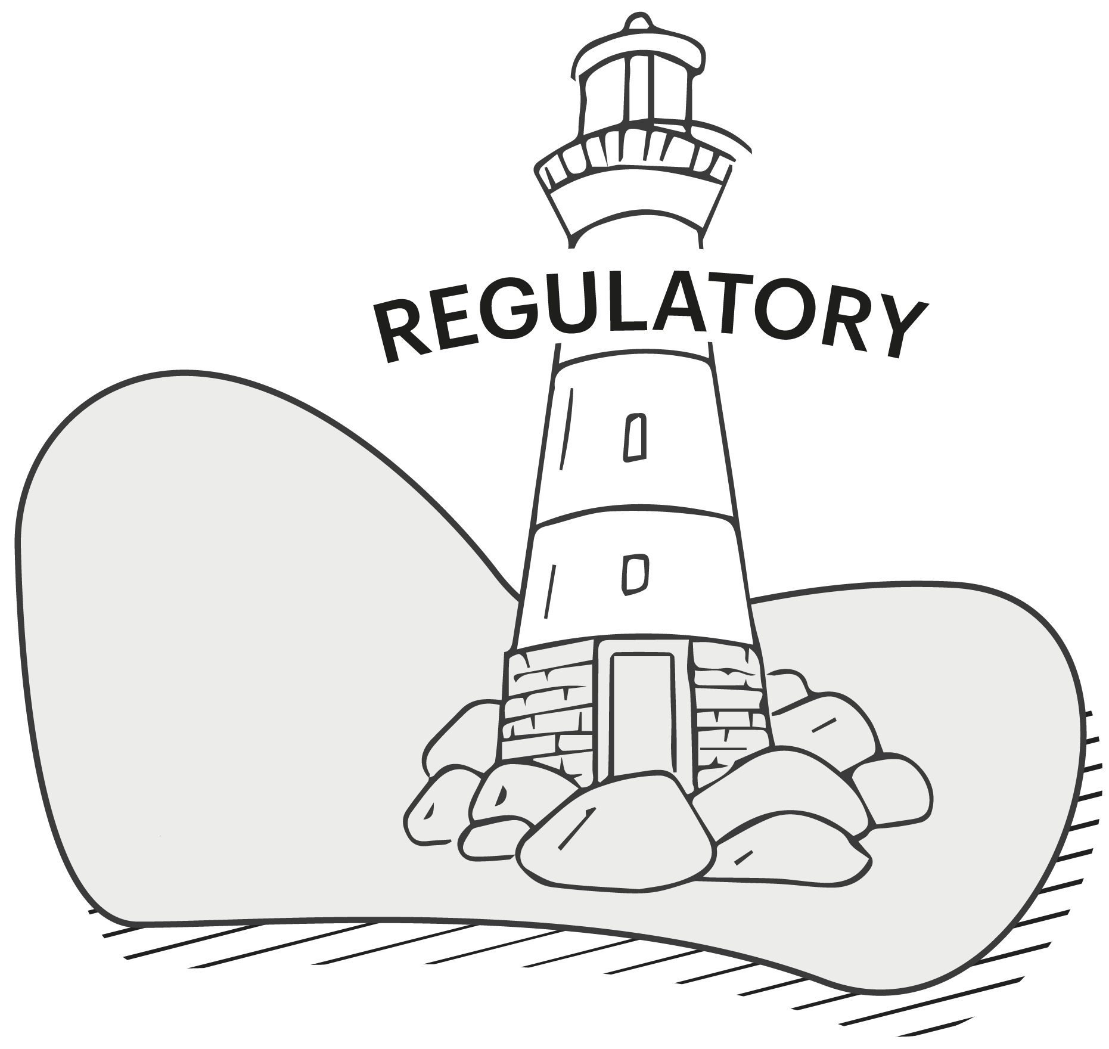
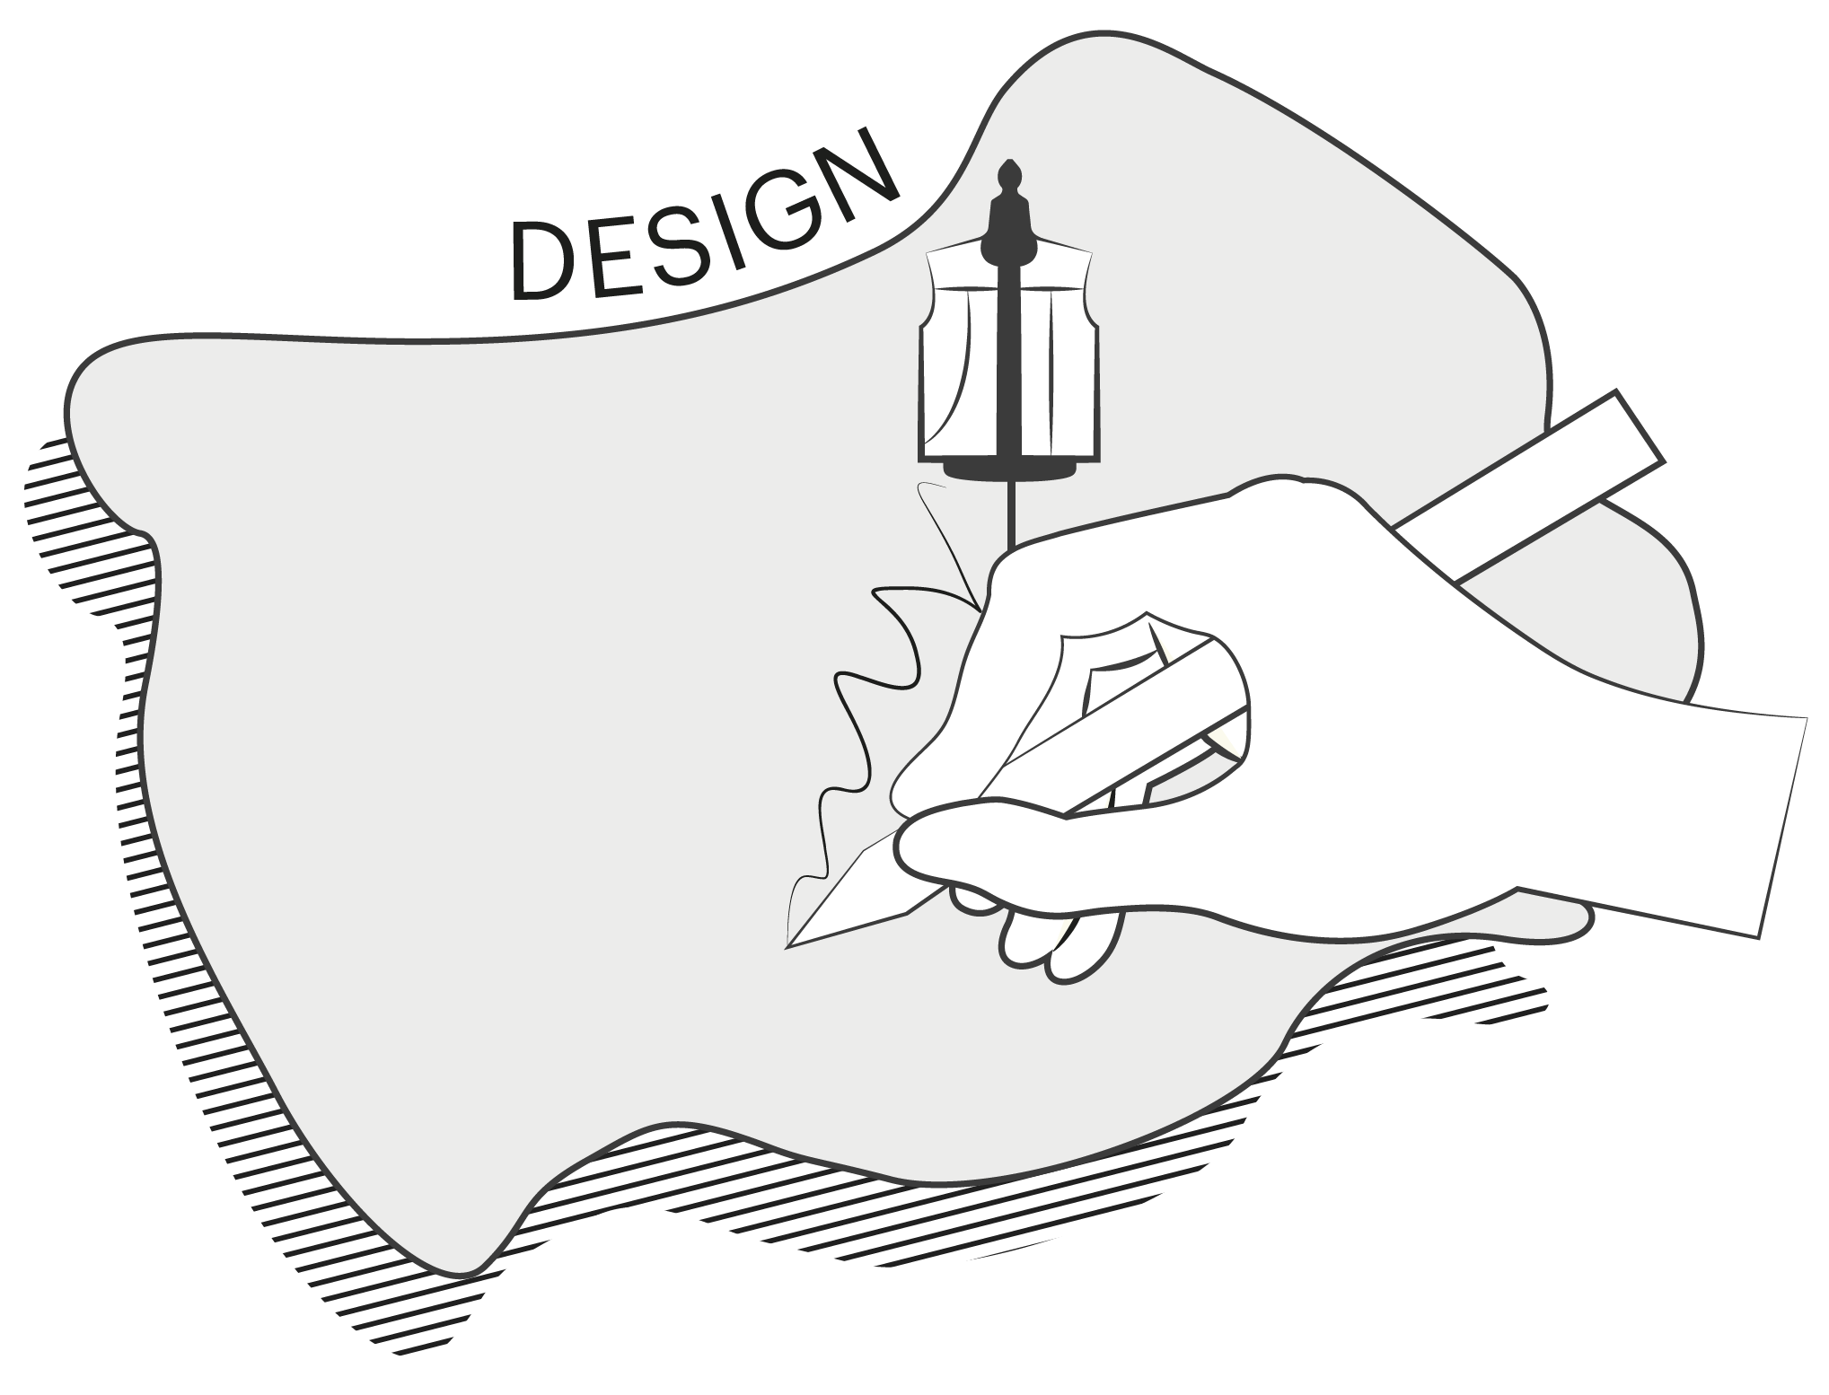
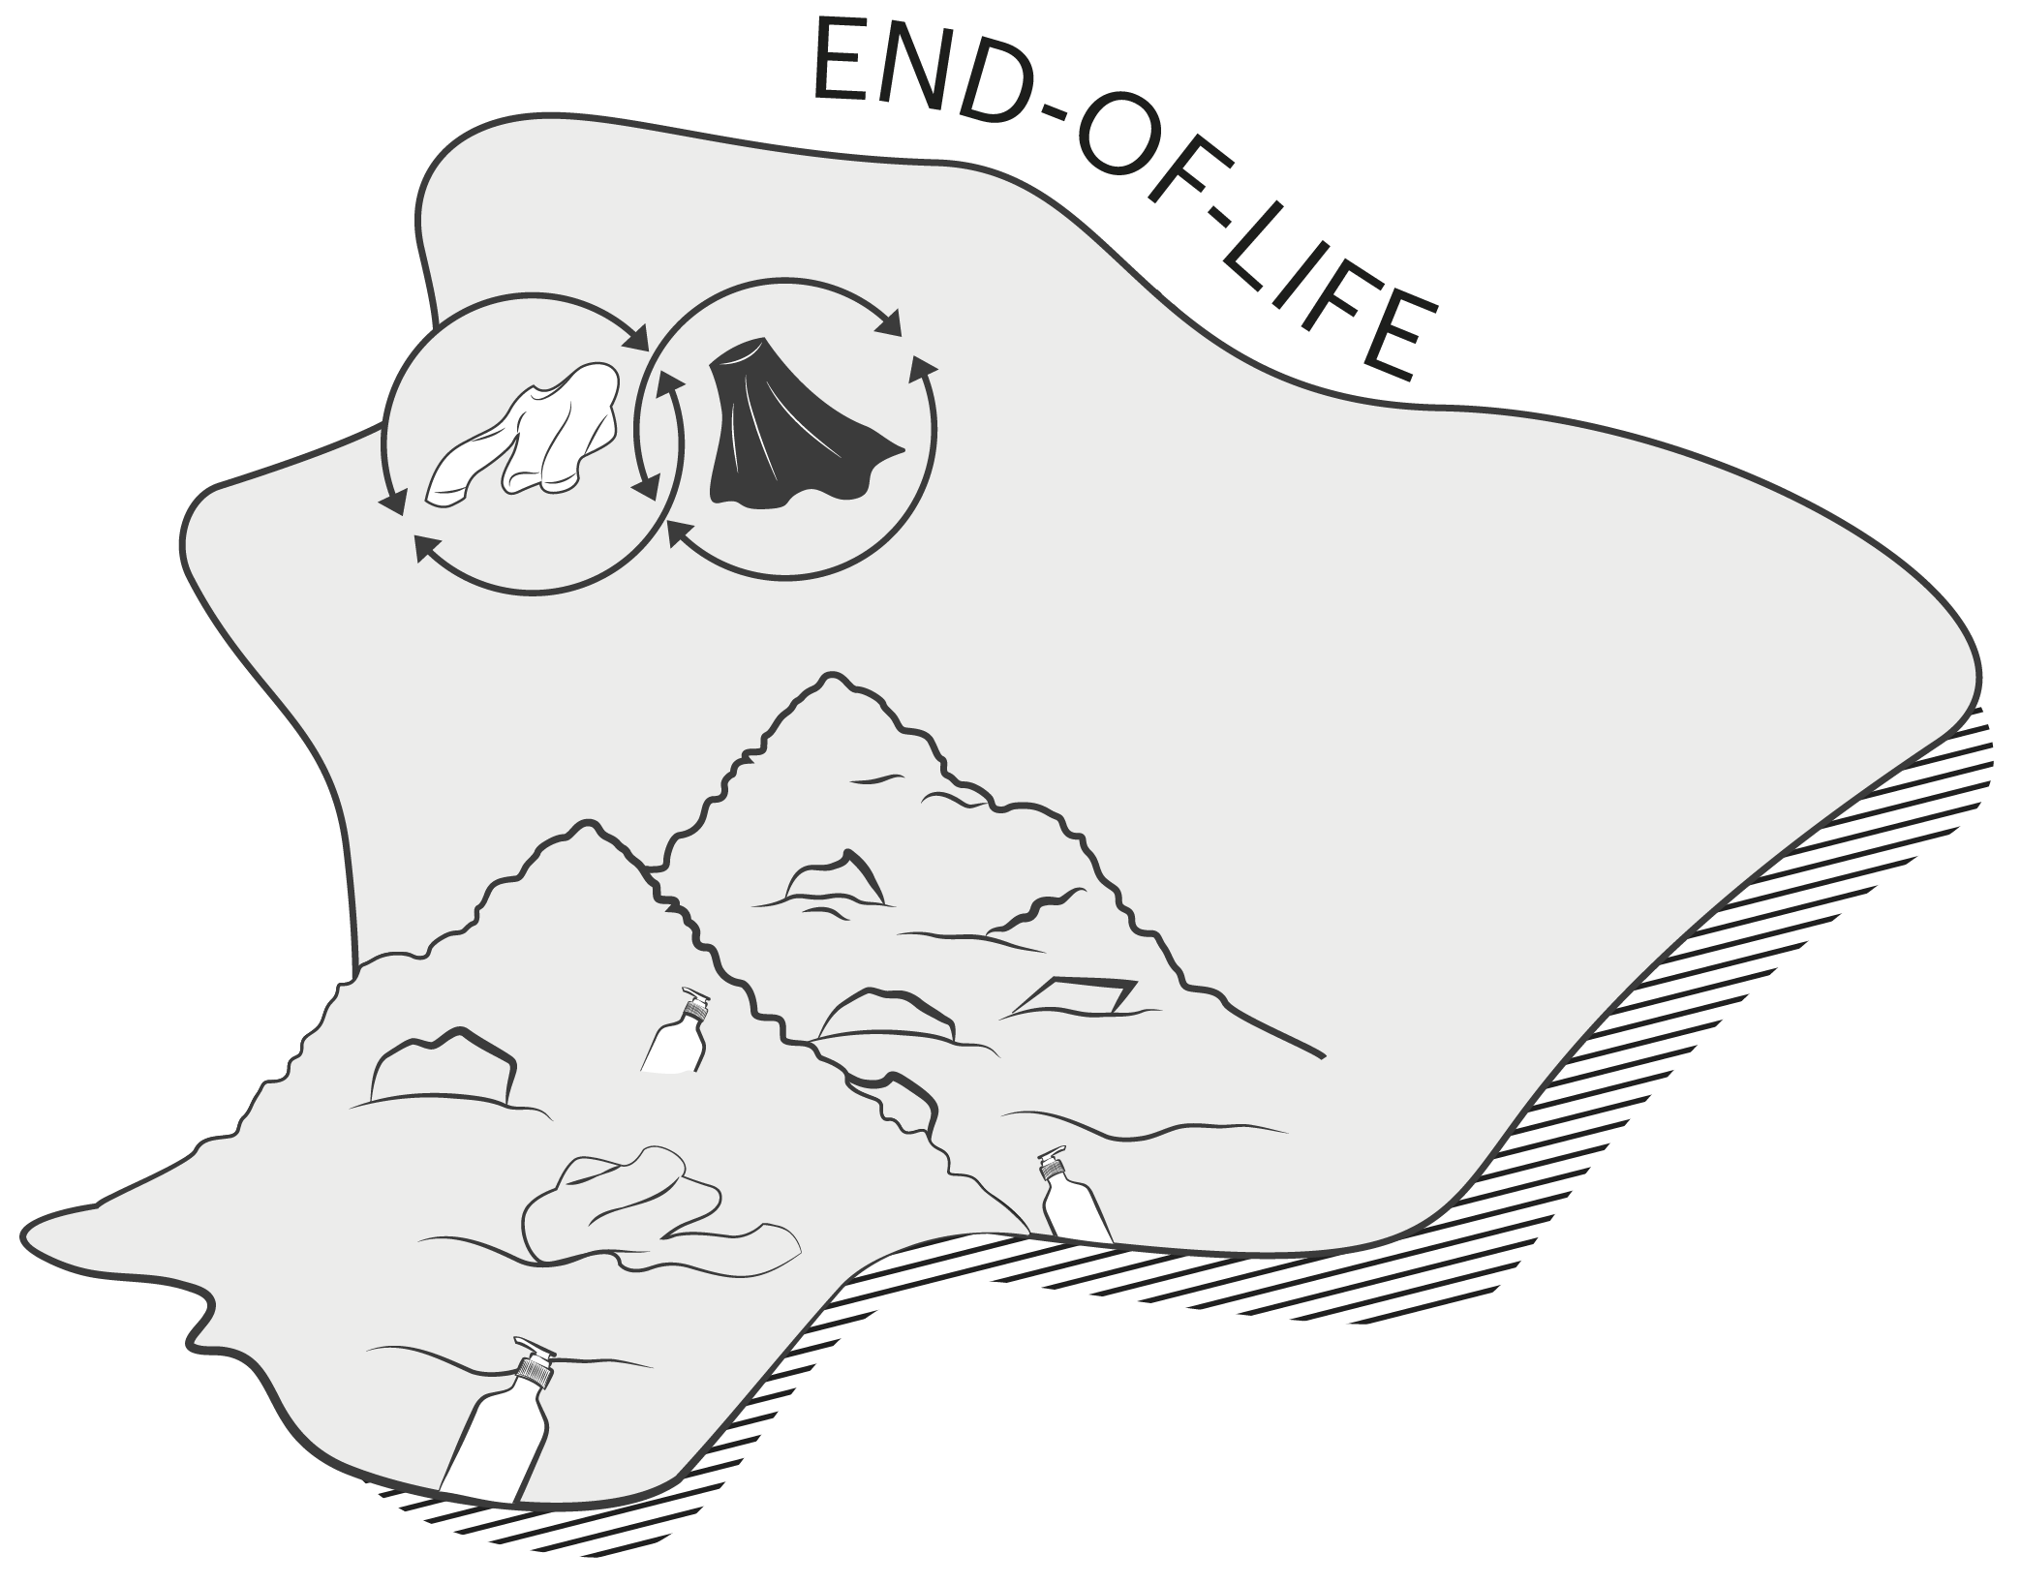
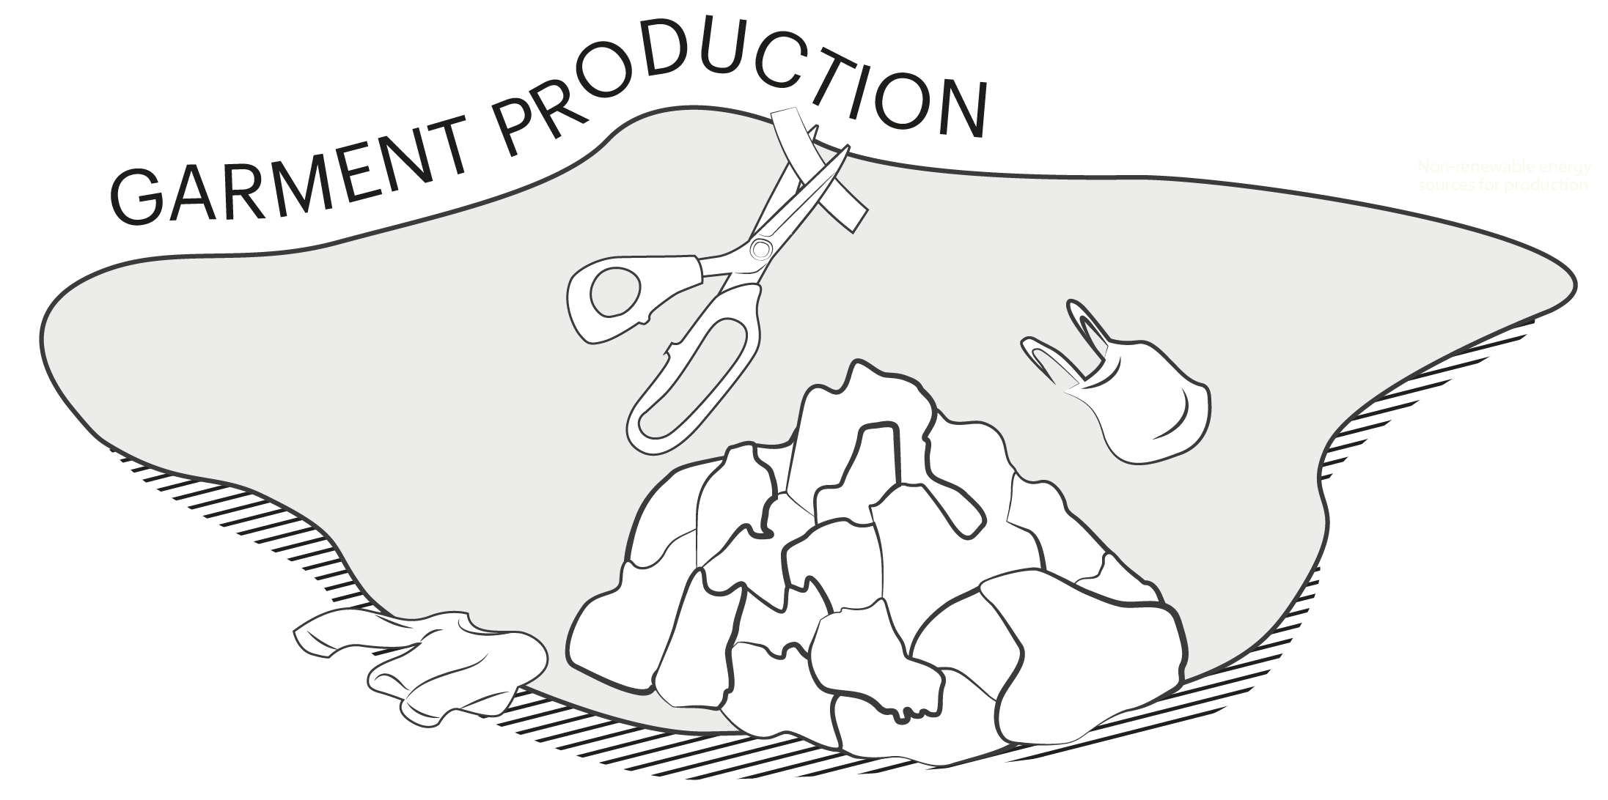
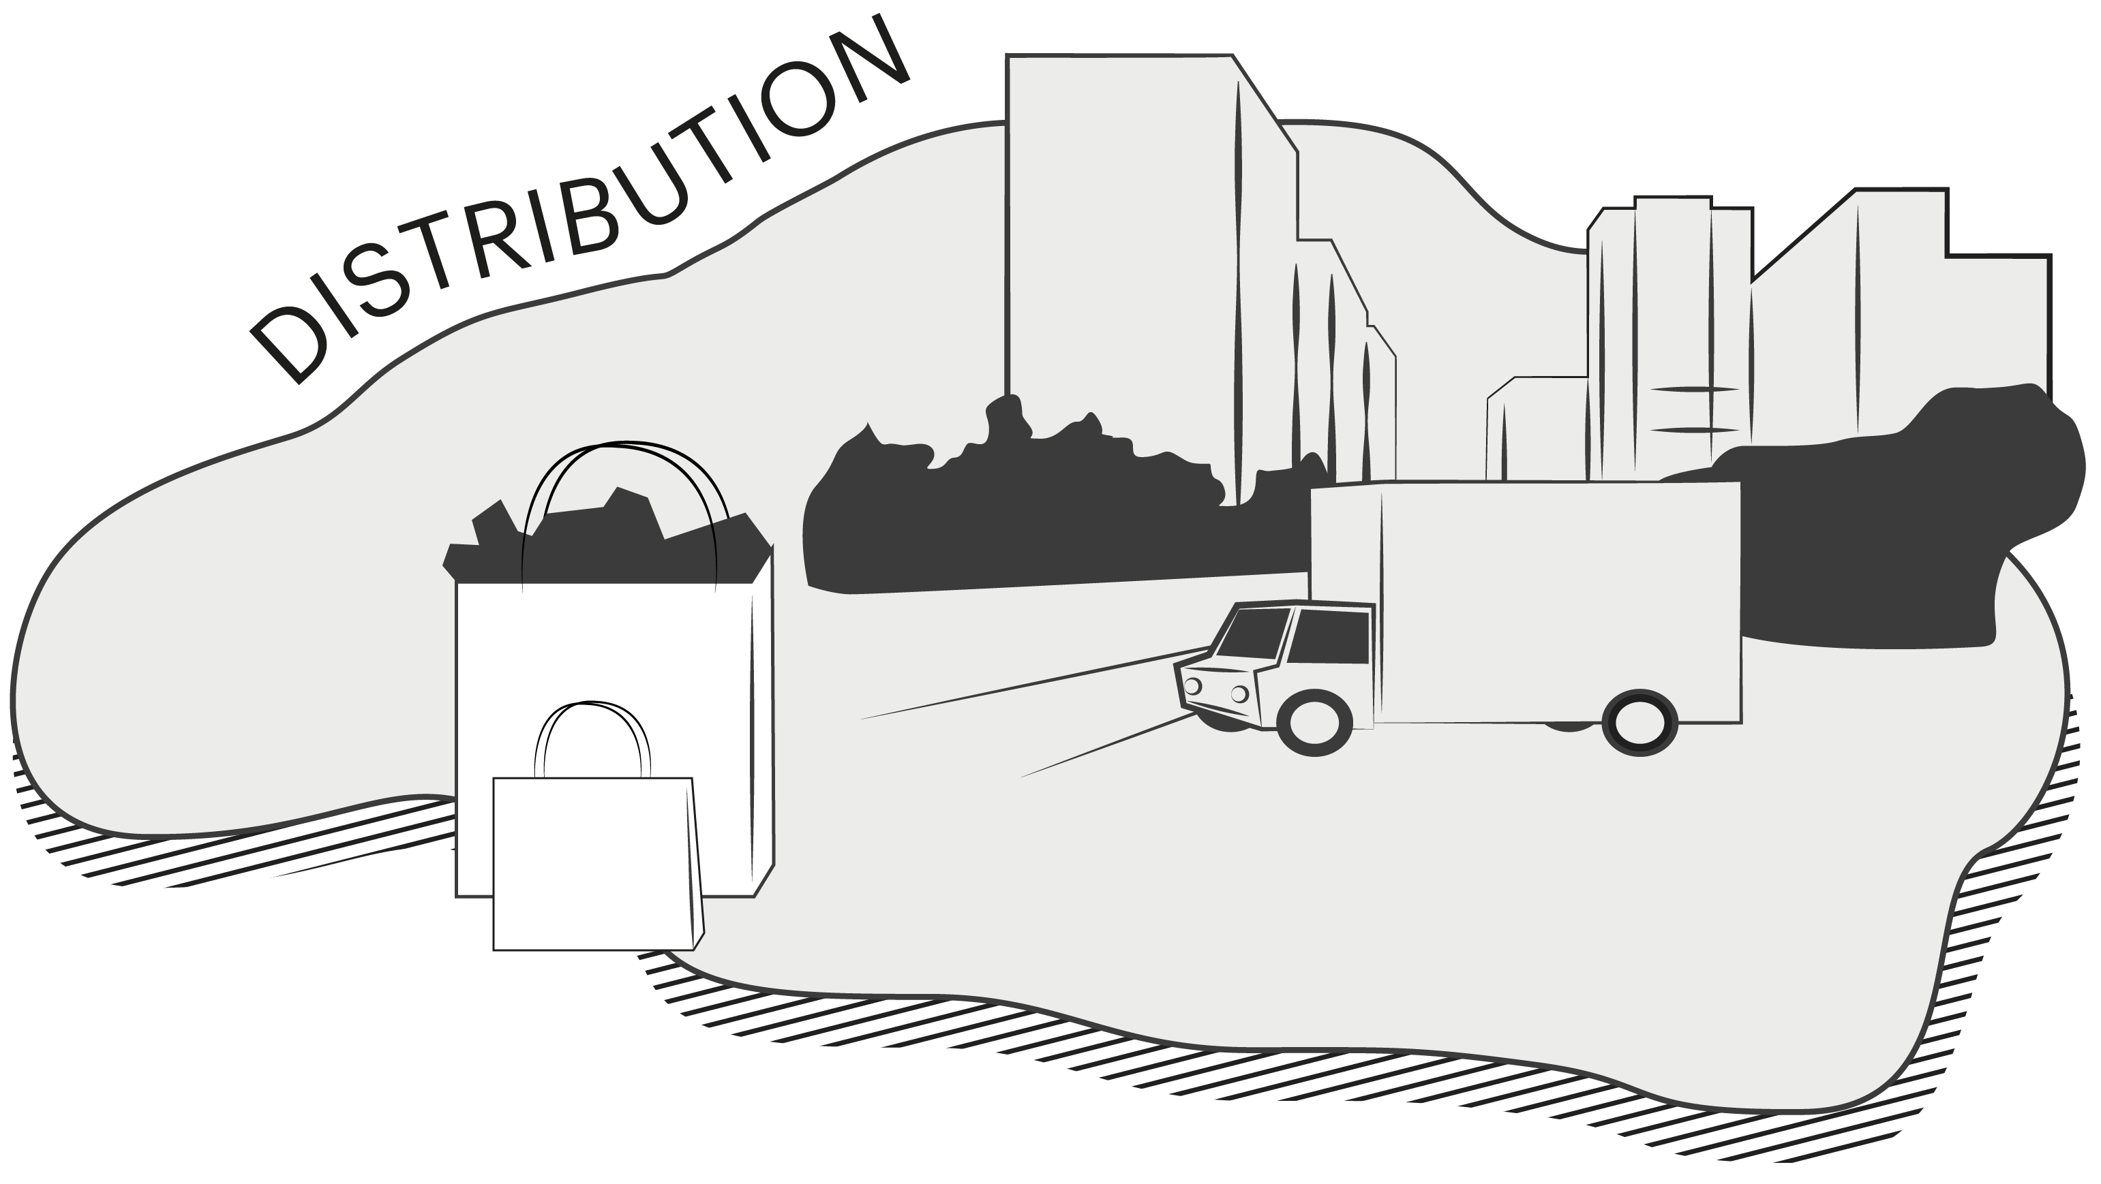
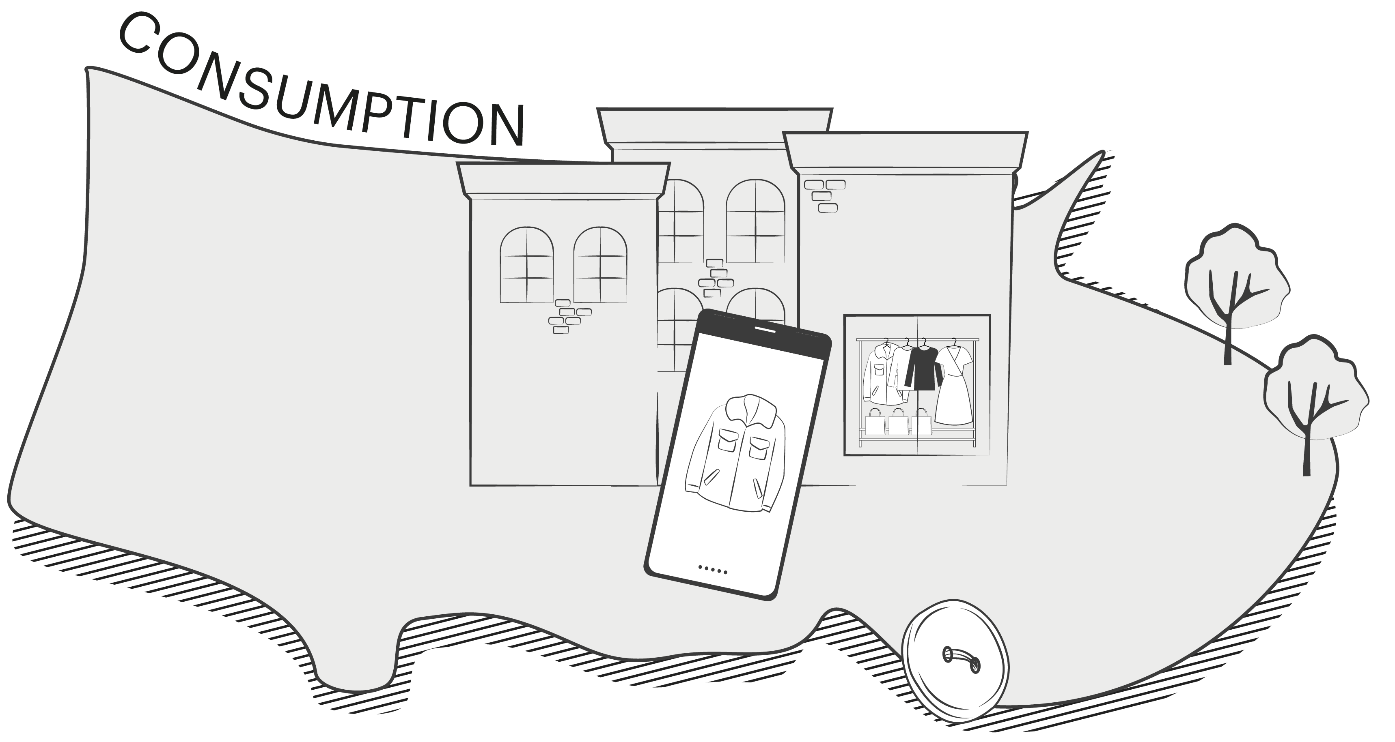
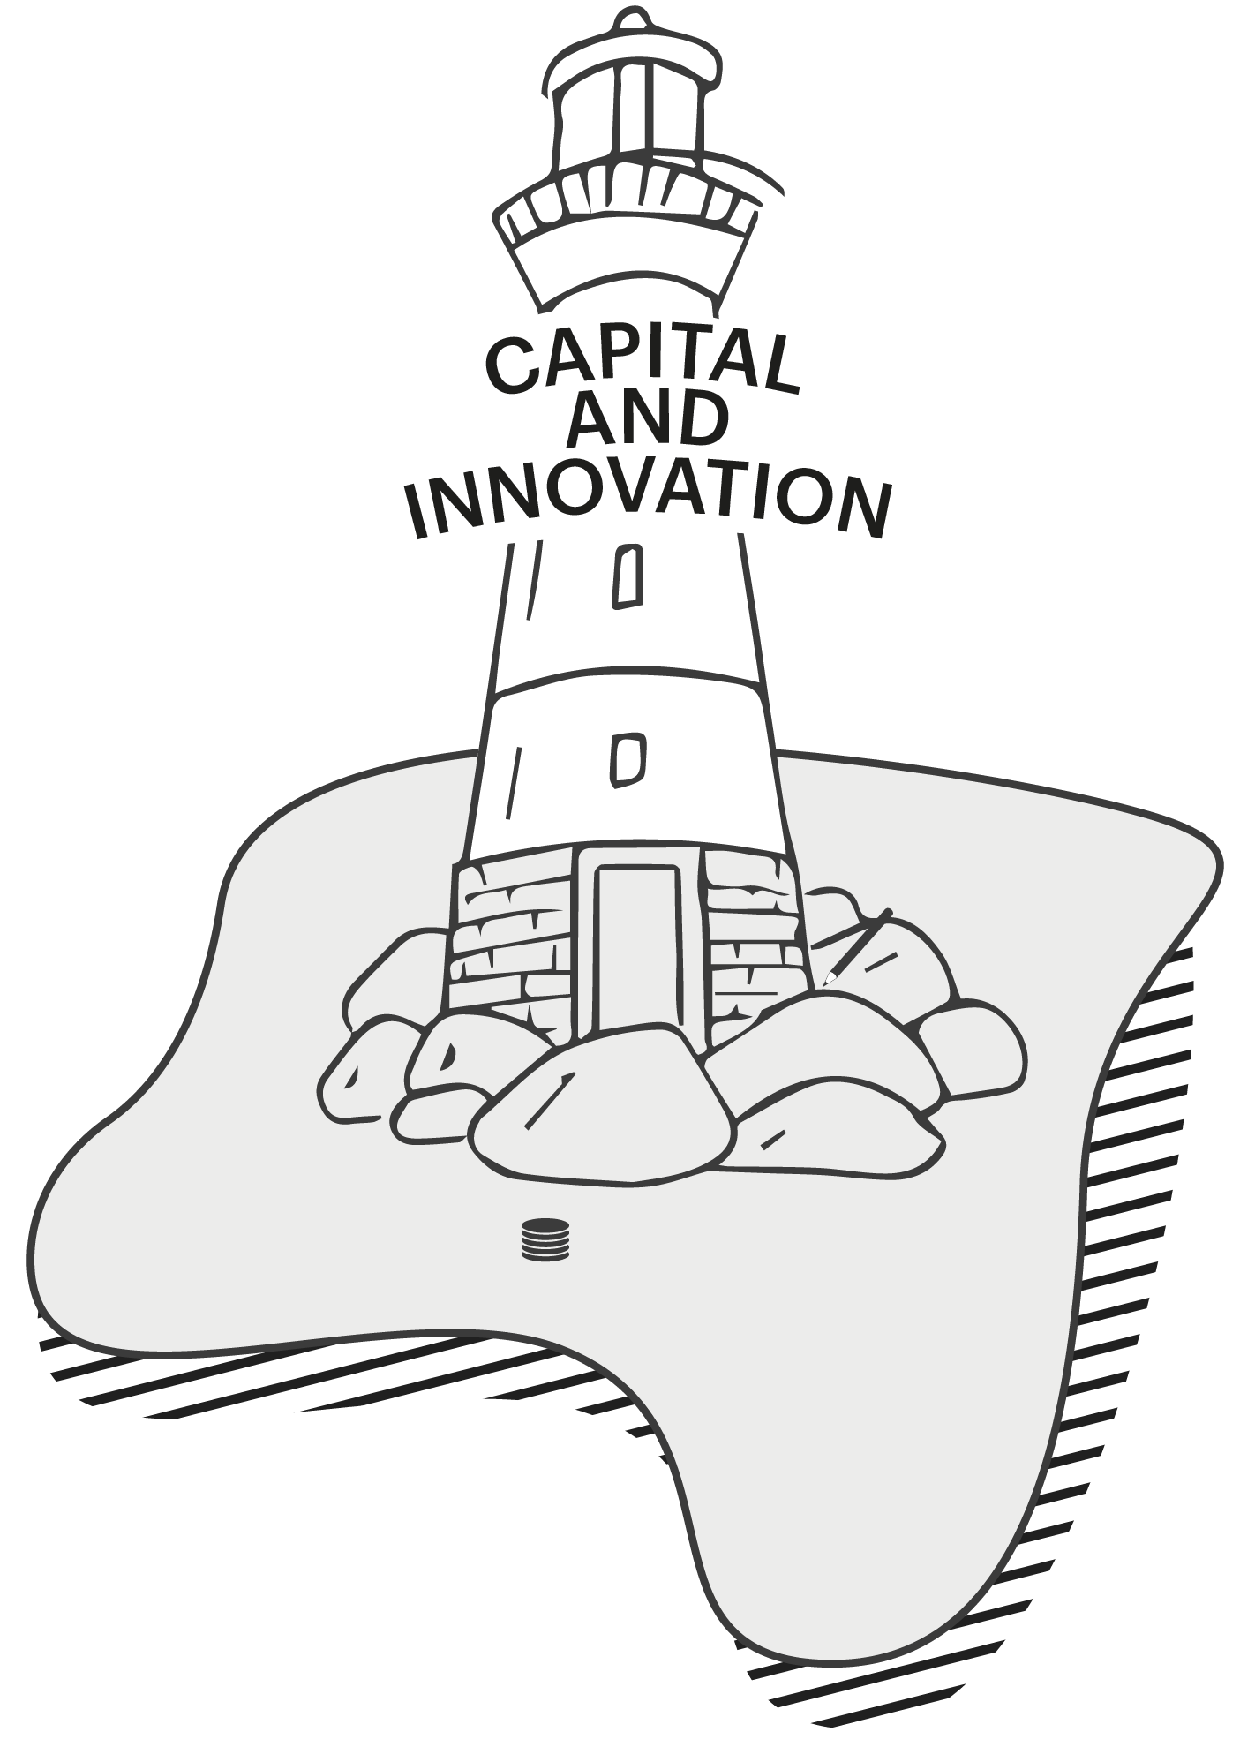
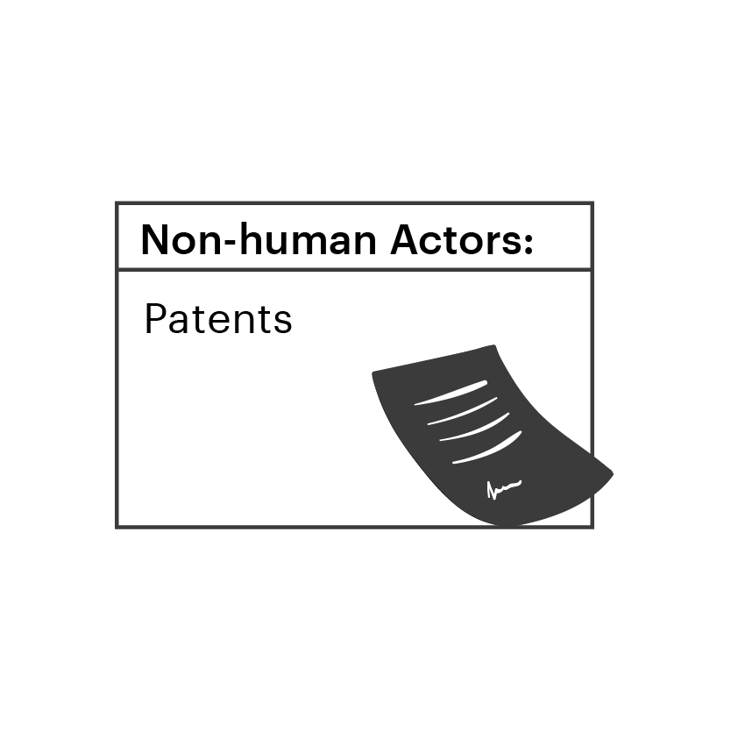
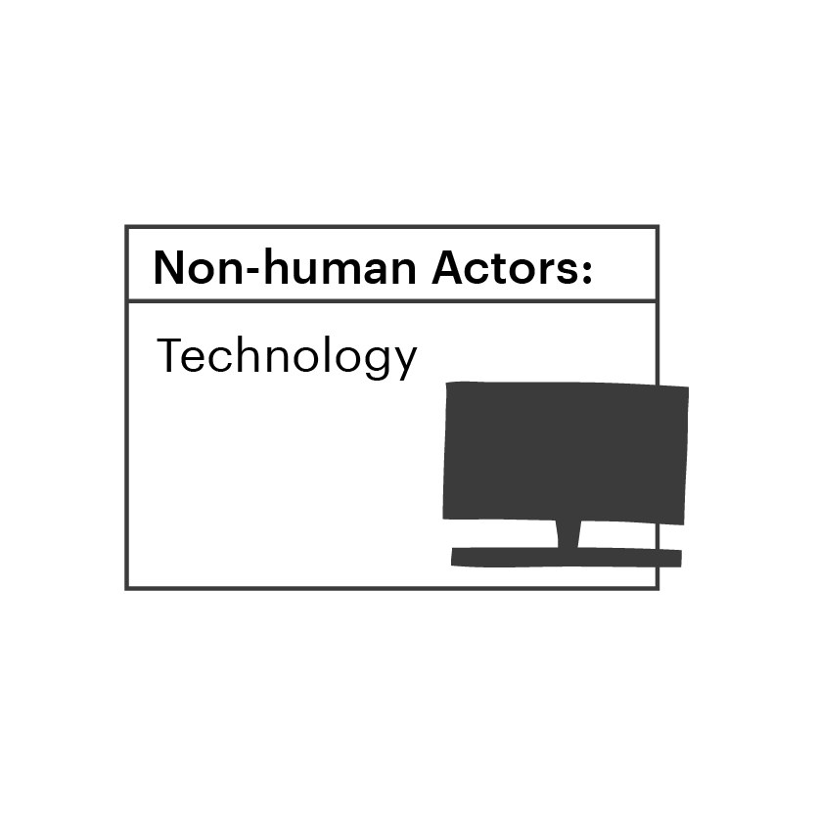
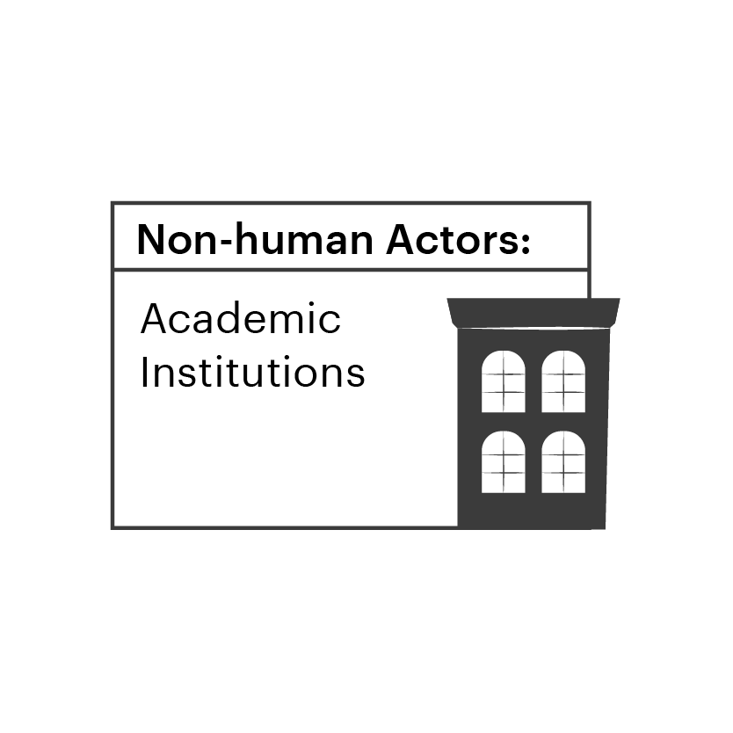
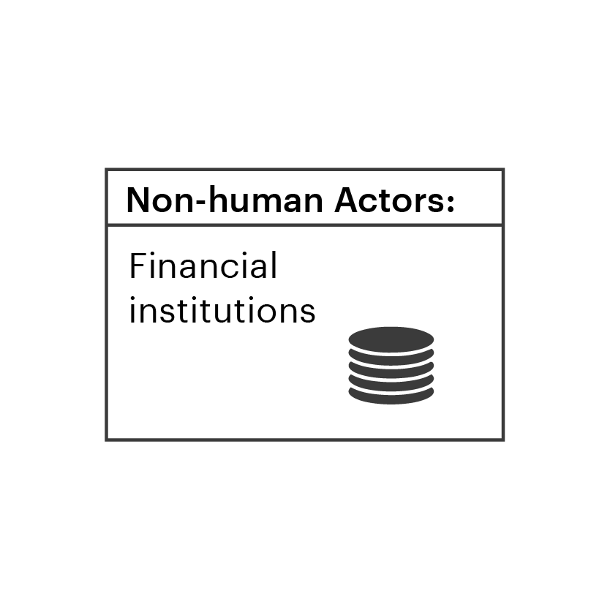
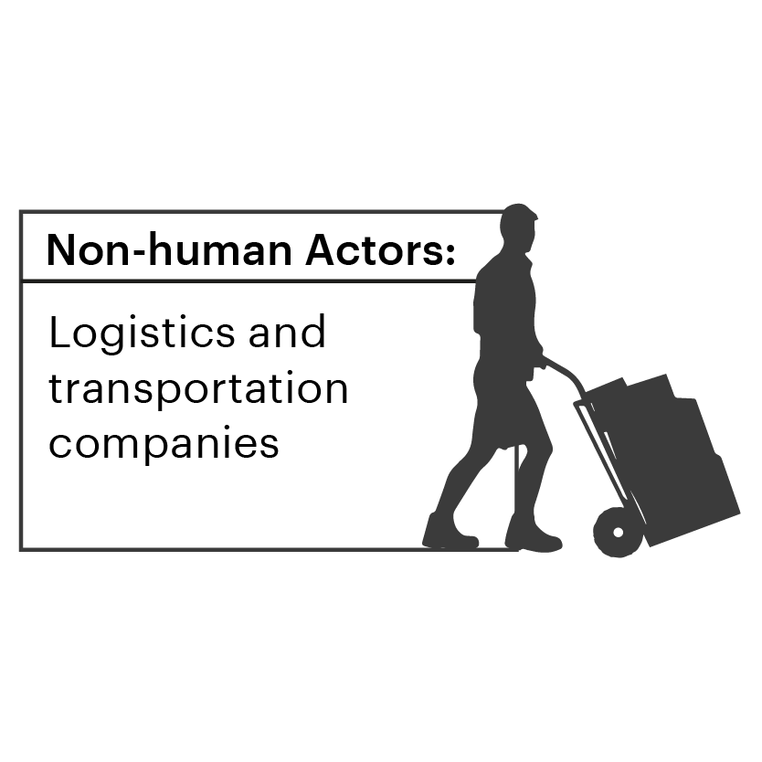
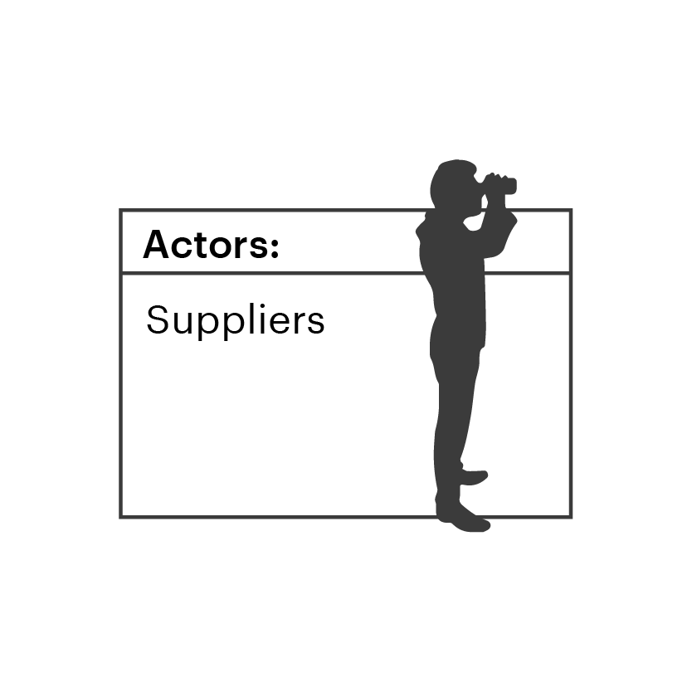
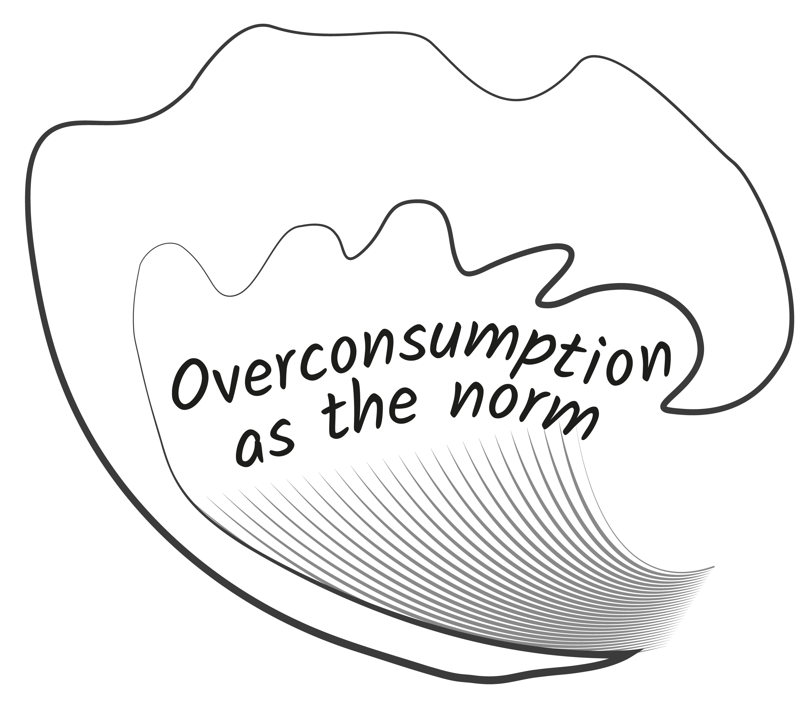


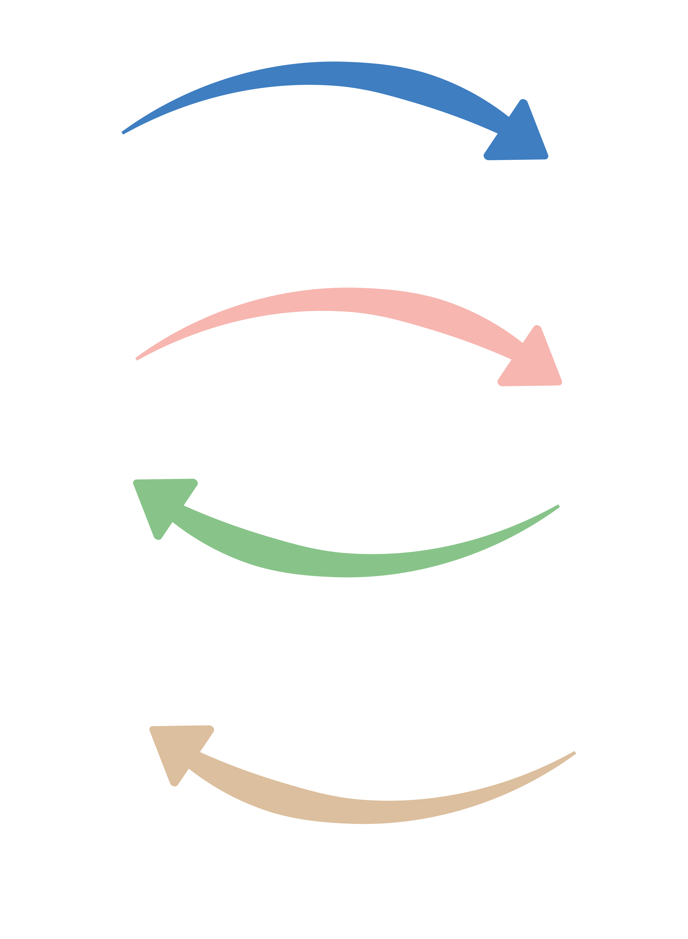
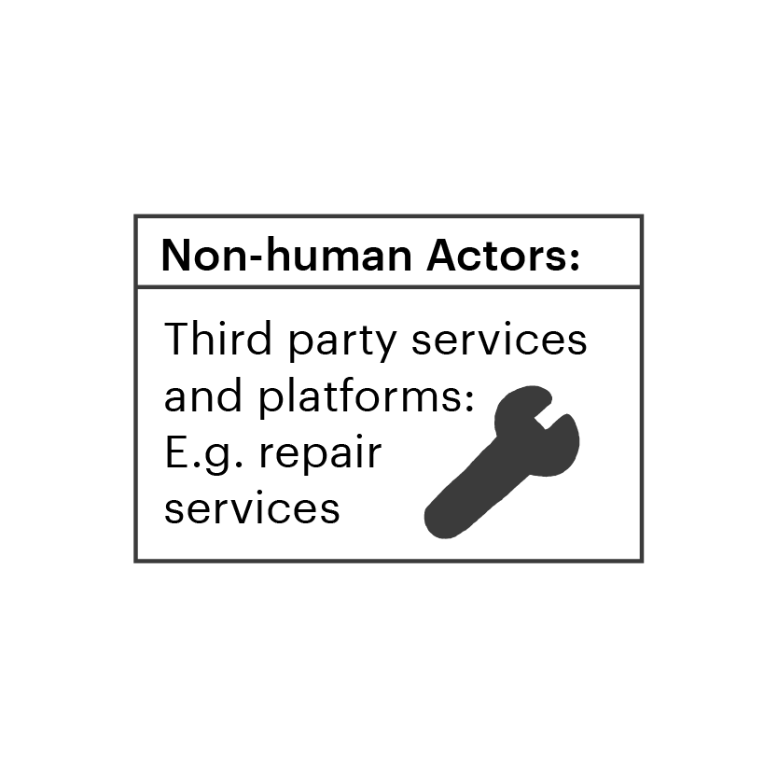
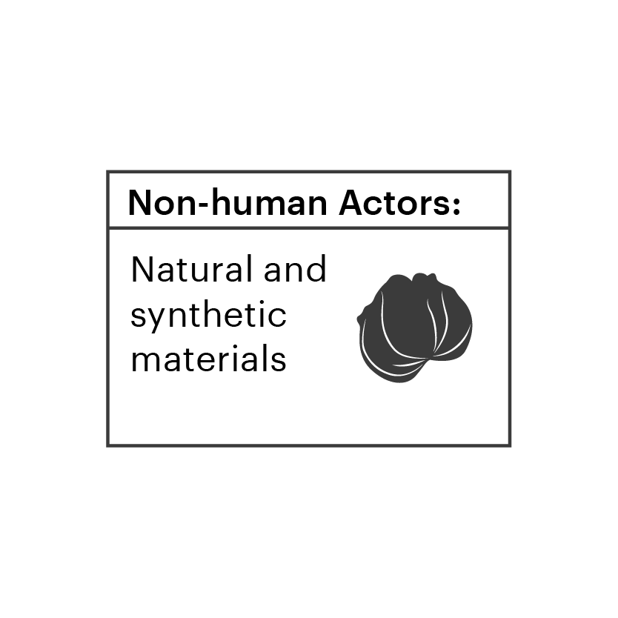
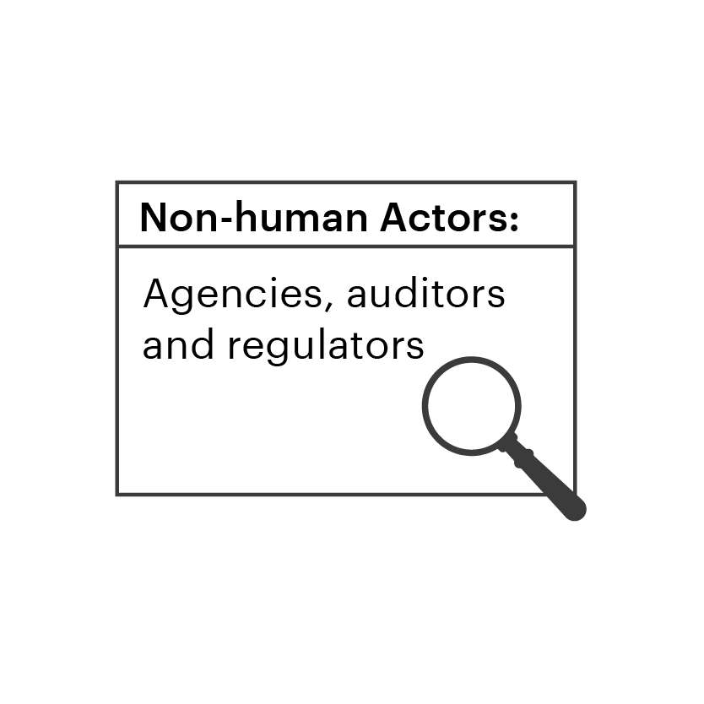
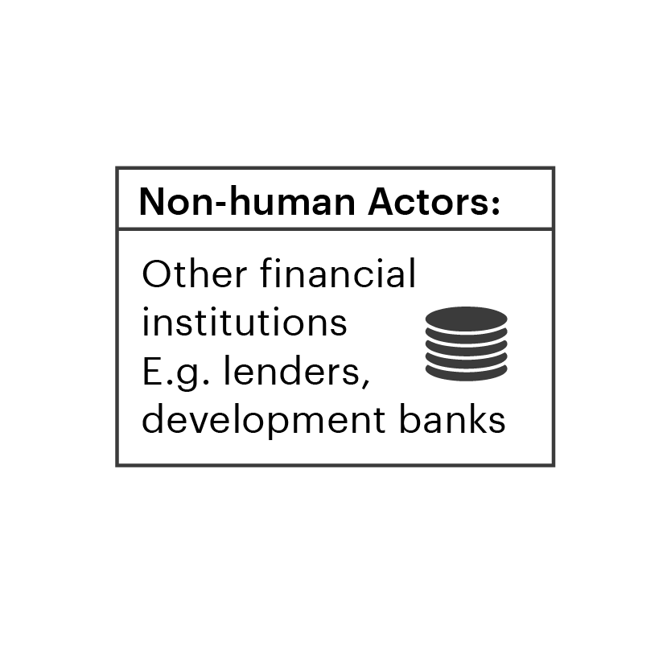
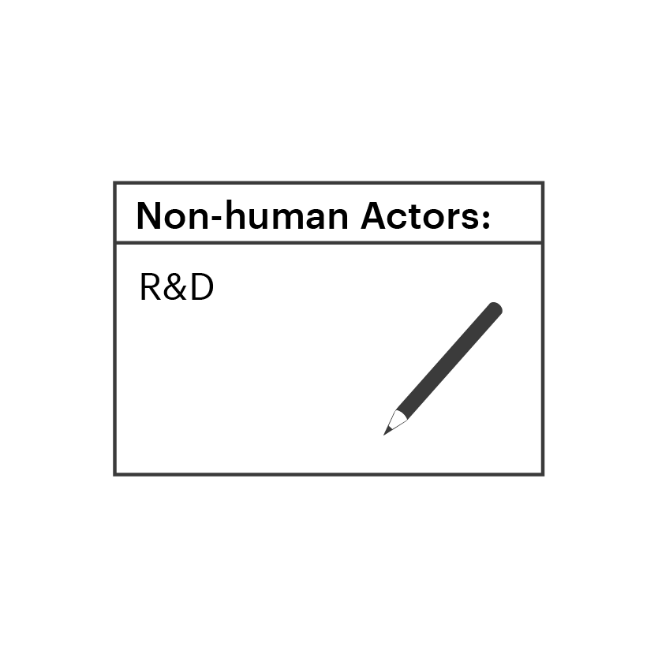
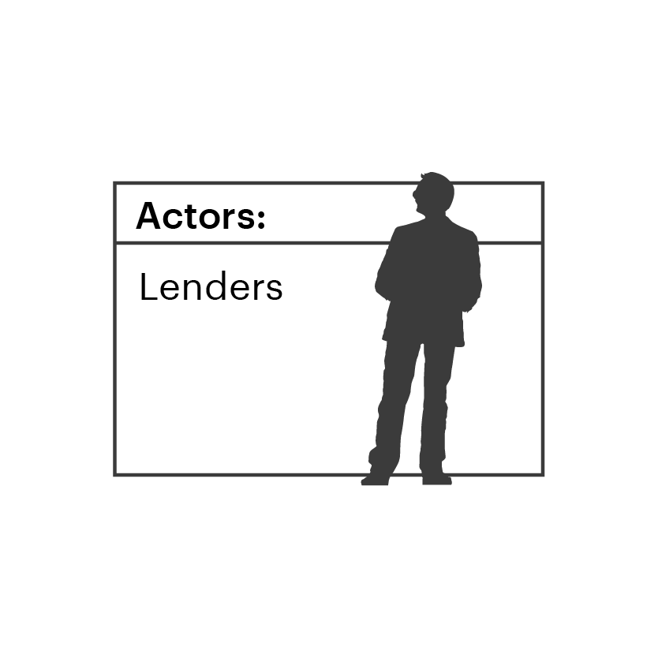
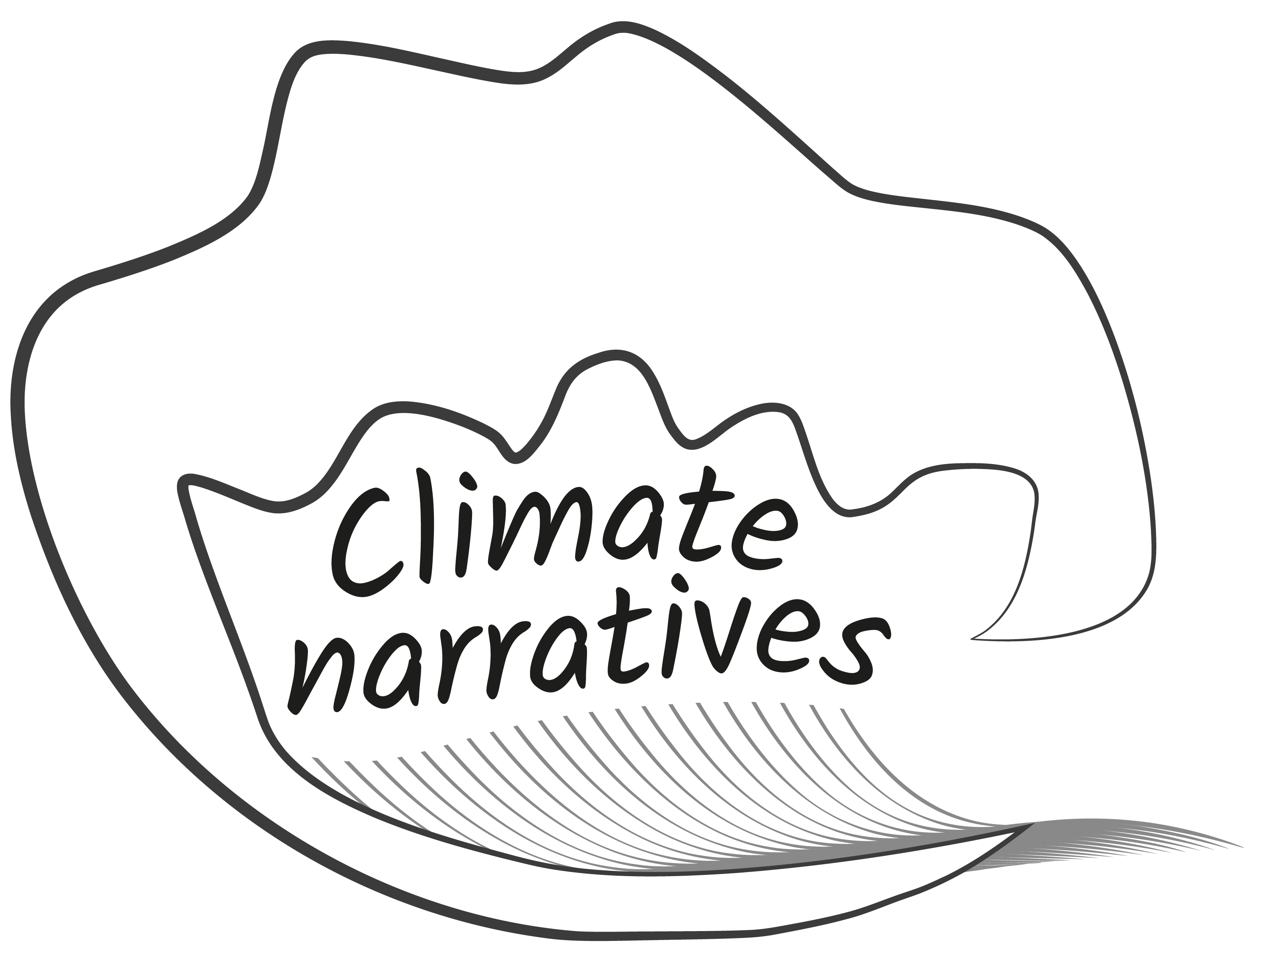
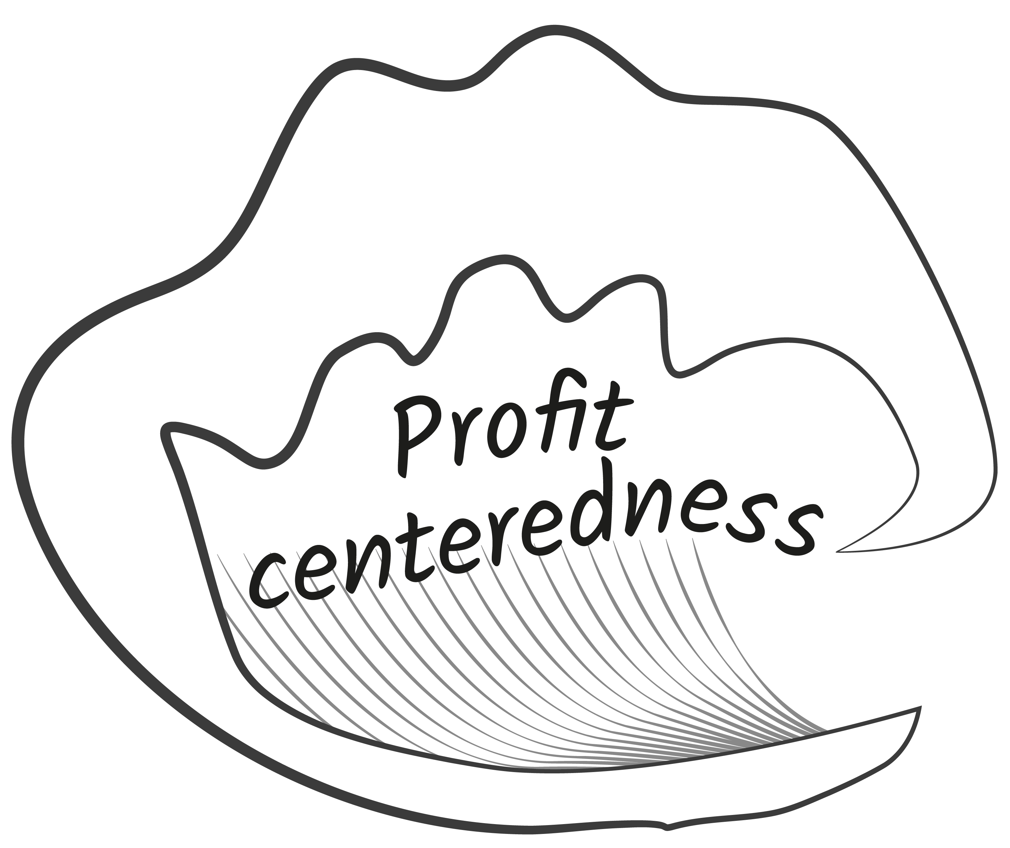

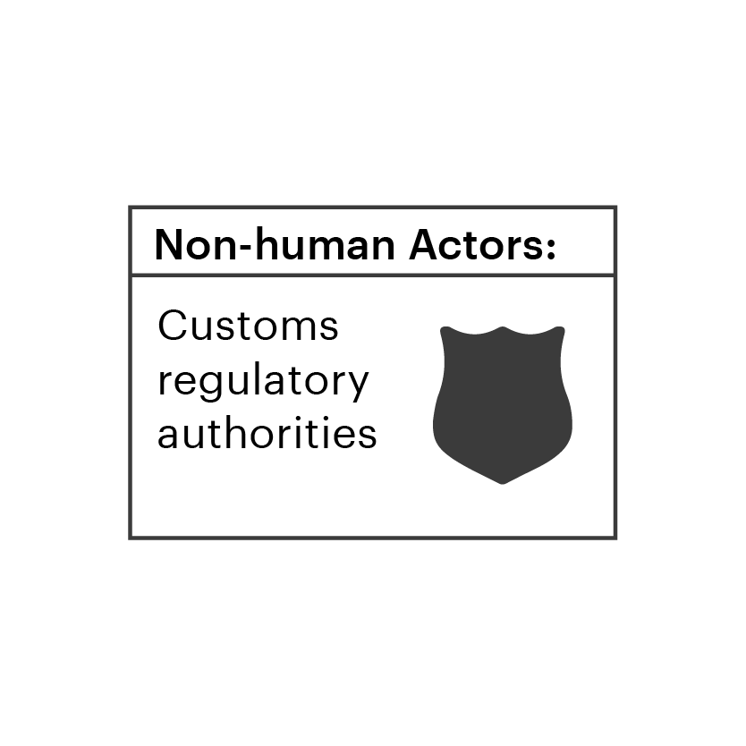
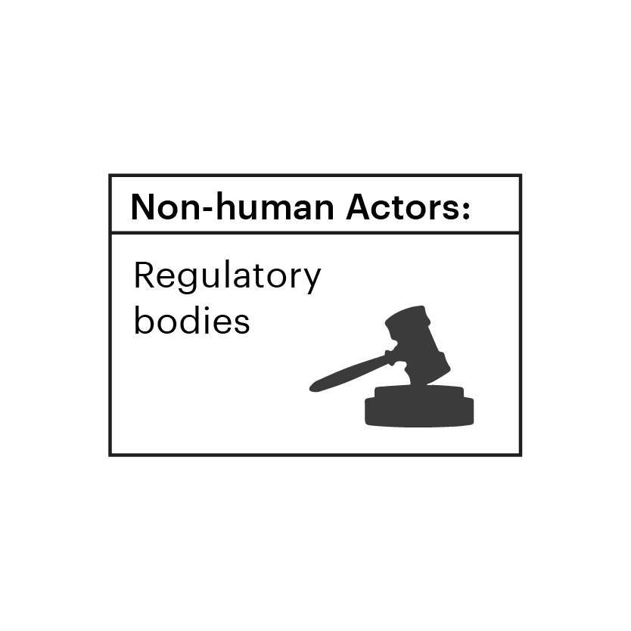
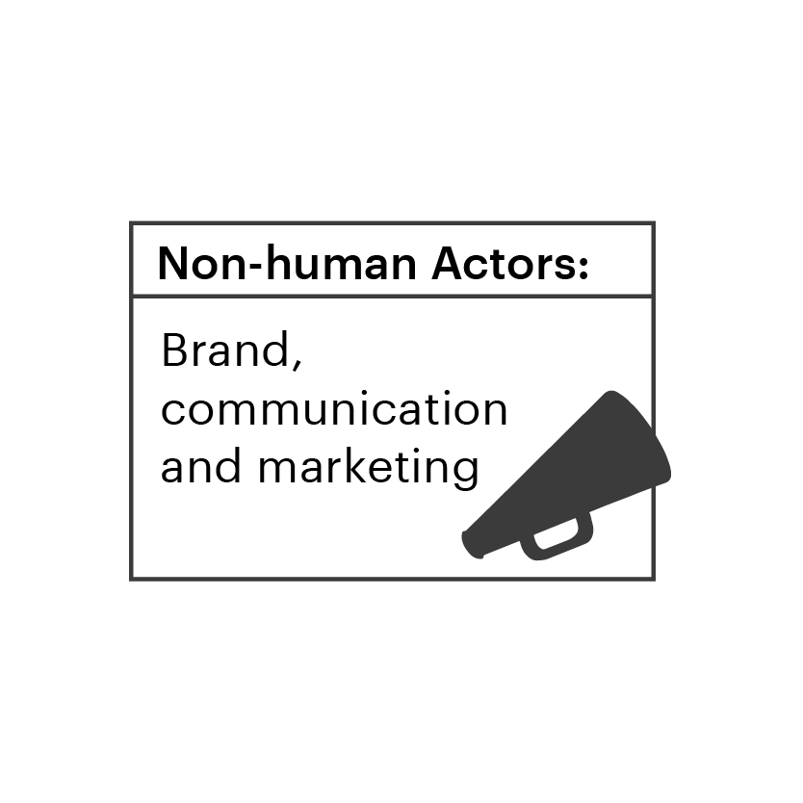
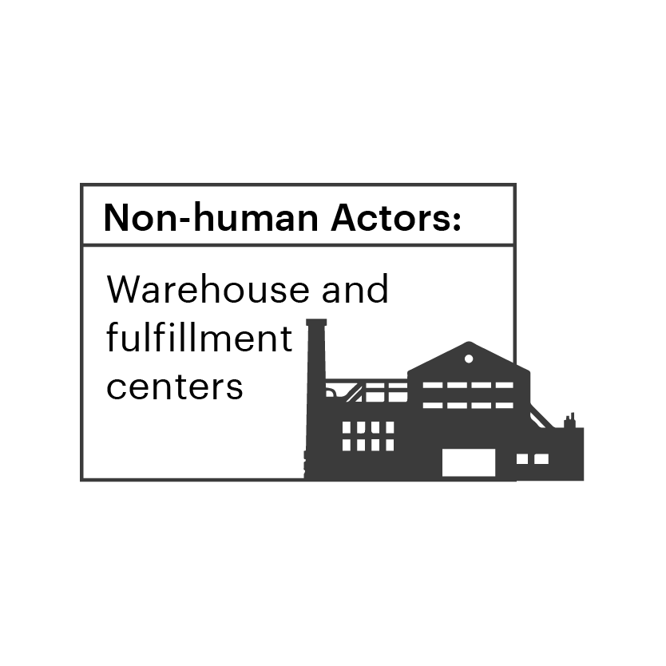
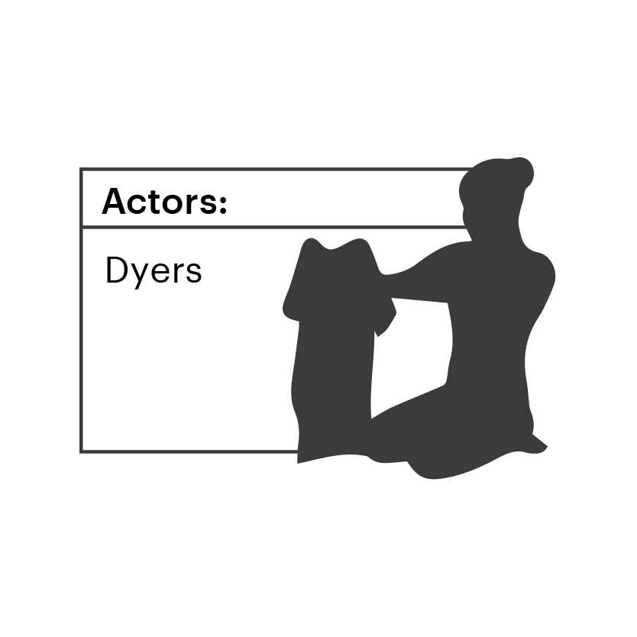
To start reimagining the future system we need to understand the building blocks
INTRODUCTION
BACKGROUND
EXERCISE 1
EXERCISE 2
EXERCISE 3
WRAP UP
WORKSHOP 3
It’s time to start reflecting —what needs to change for a decarbonised and just fashion system? To create the future vision, the components of the System Map can be transformed.
Value chain – foundational pieces that can be moved to display a new flow in the future value chain
Forces – Macro forces that will impact how the future system works and which decarbonisation efforts will succeed
Actors –the people, organisations and technologies that have a role in shaping the future system
Bus routes – shows how compliance, funding, innovation, demand, and will need to flow
Don’t forget that the carbon clouds indicate the emission impact to spark the decarbonization conversion.
Forces
Actors
Arrows / Bus routes
10

Slide 11
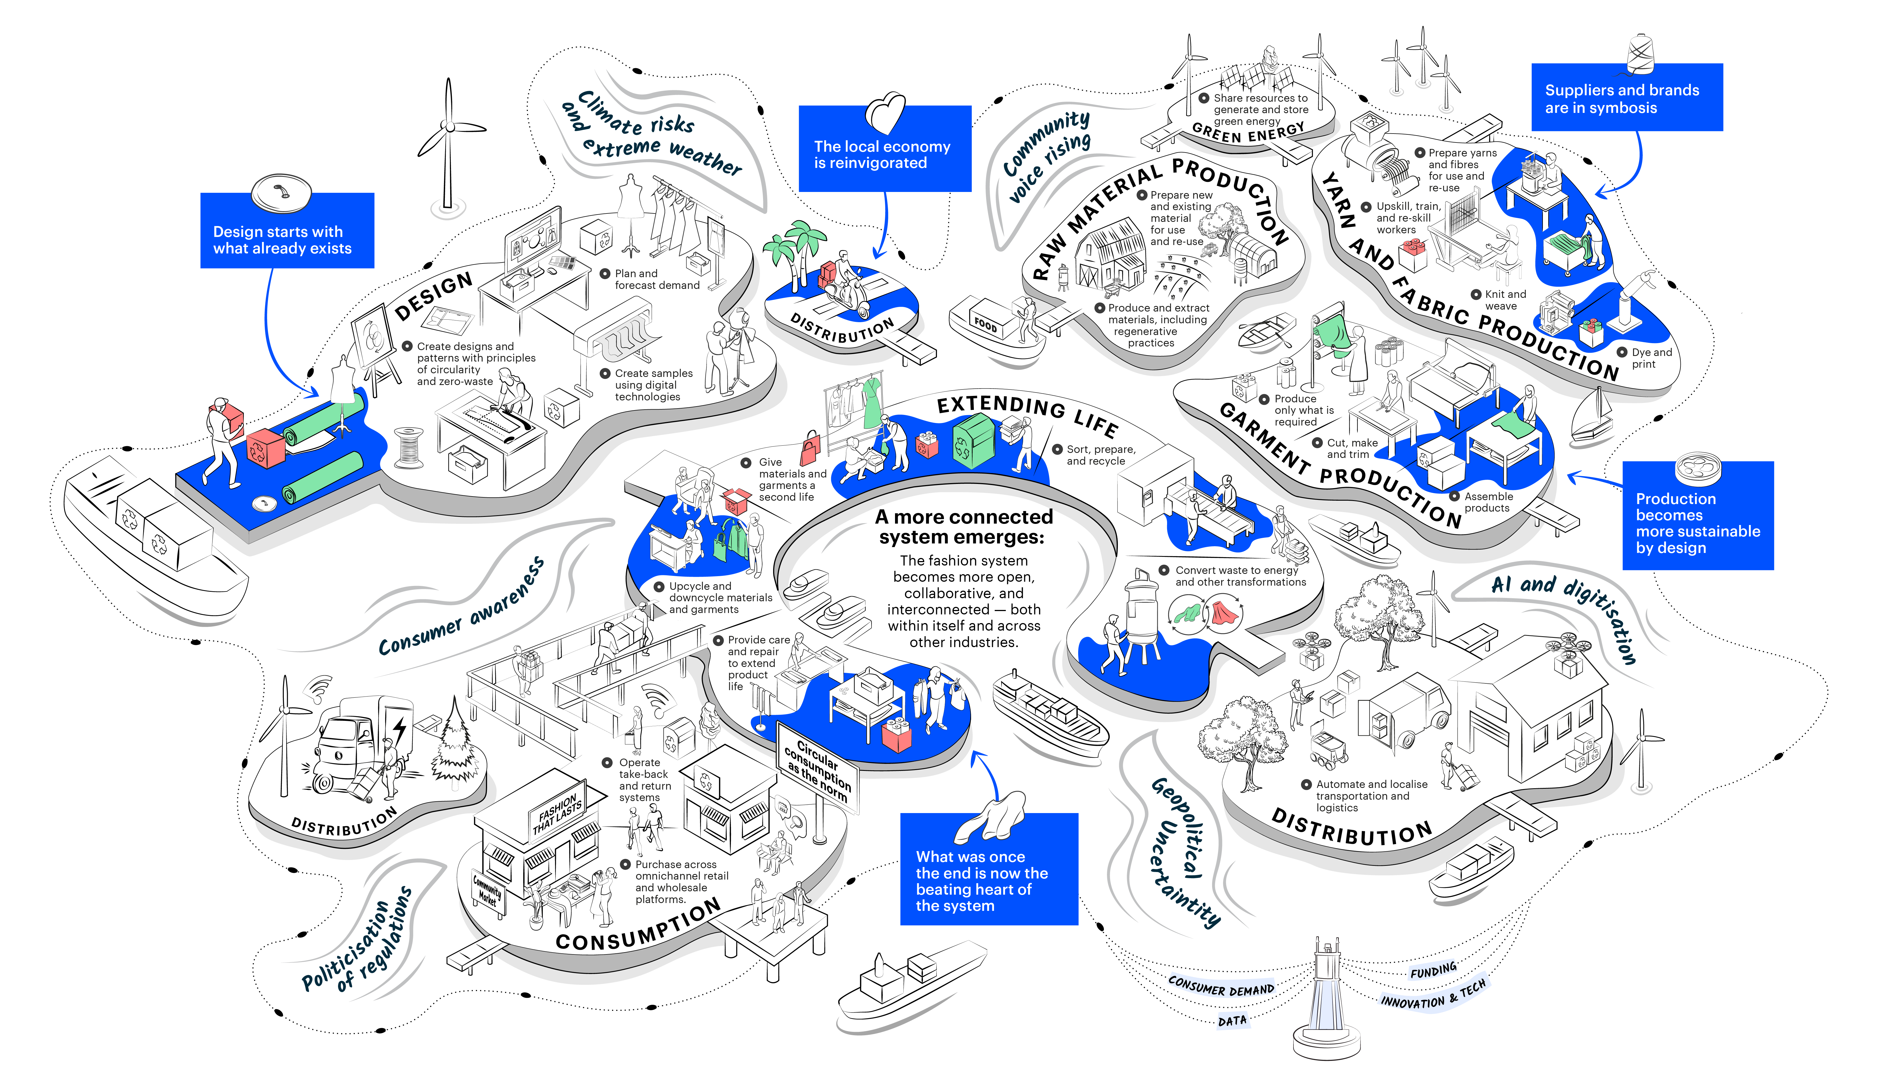
This is an example from when Global Change Award changemakers came together to visualize the future System Map
INTRODUCTION
BACKGROUND
EXERCISE 1
EXERCISE 2
EXERCISE 3
WRAP UP
WORKSHOP 3
This reimagined System Map illustrates one possible future for fashion, where bold innovations are scaled through shared materials, knowledge, and infrastructure, and where all parts of the system—people, technology, ideas, and culture—shape outcomes together.
Here's some examples of what can be reimagined:
Moving and renaming islands - here we changed "end-of-life' to "extending life" and moved it to the
centre of the system
Adding connection points - here we added bridges between islands like 'Consumption' and 'Extending Life’
Adding systemic forces - here we added key forces like AI and political uncertainty

Slide 12
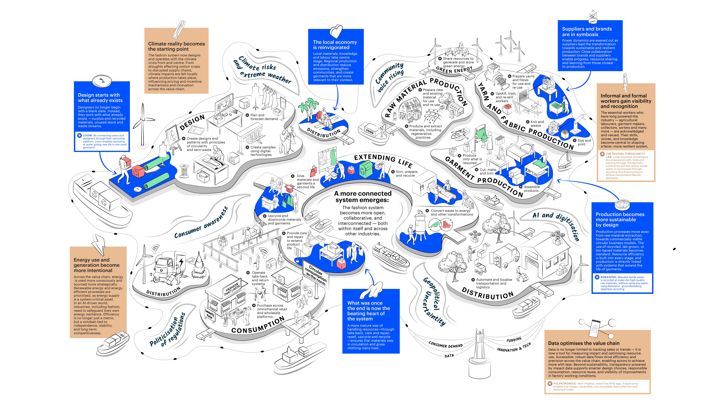

Slide 13
INTRODUCTION
BACKGROUND
EXERCISE 1
EXERCISE 2
EXERCISE 3
WRAP UP
WORKSHOP 3
Start making changes to the map
The mission of this workshop is to rebuild the future fashion system to enable decarbonisation and a just transition.
To initiate the discussion
Looking at the original map, is there anything that you'd immediately like
to change, and why?
Reminders:
10 minutes
Reflect and discuss in groups of 2-4 people
Use the original map to help guide
the discussion

Slide 14
WORKSHOP 3
Break time
10 minutes

Slide 15
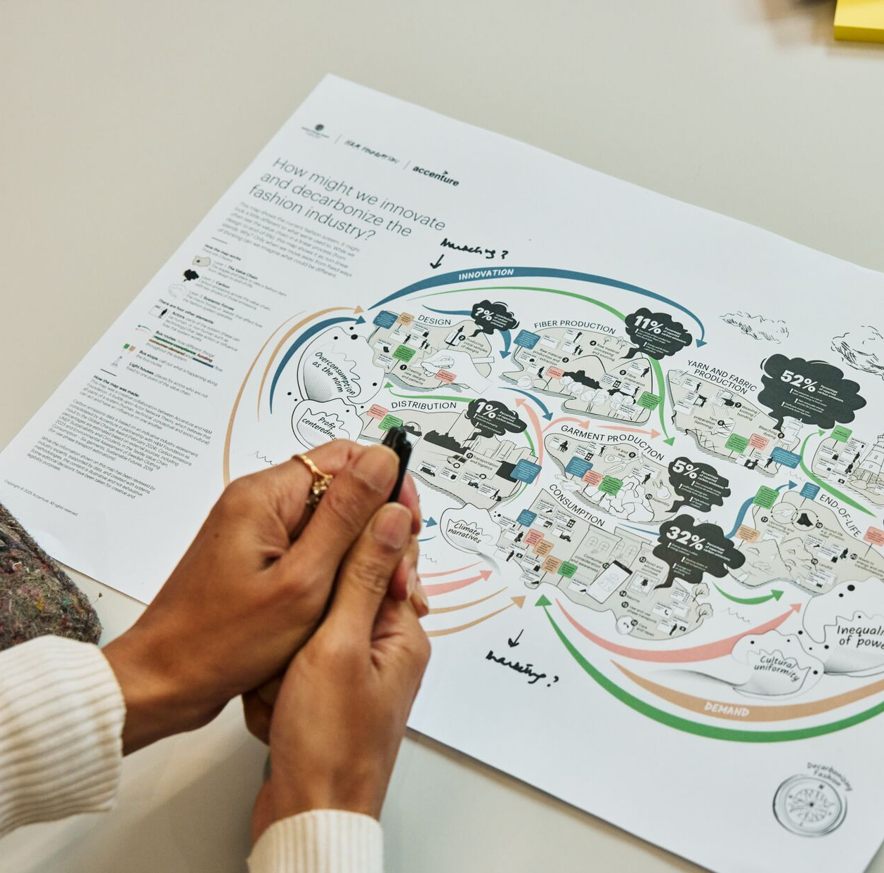
Reimagine the System Map
INTRODUCTION
BACKGROUND
EXERCISE 1
EXERCISE 2
EXERCISE 3
WRAP UP
WORKSHOP 3
Now, reimagine the future system to build a decarbonised and just industry. If you did workshop 2 and have key challenges to solve, revisit these as inspiration for what needs to change.
What the islands should be (e.g., do they need to merge? do they need to change position? do they need to be renamed?)
Add actors (e.g., is there anyone missing or that needs a bigger role?)
Add / change bus routes (e.g., are there any key flows, such as data, that need to be on the map to enable decarbonisation?)
Is there anything else missing, like more local
distribution centres?
Reminders:
1 hour
Reflect and discuss in groups of 2-4 people
You can use PowerPoint to reconstruct the map using the movable elements, or a printed version.
Playback and compare in the whole group at the end of 45 minutes

Slide 16
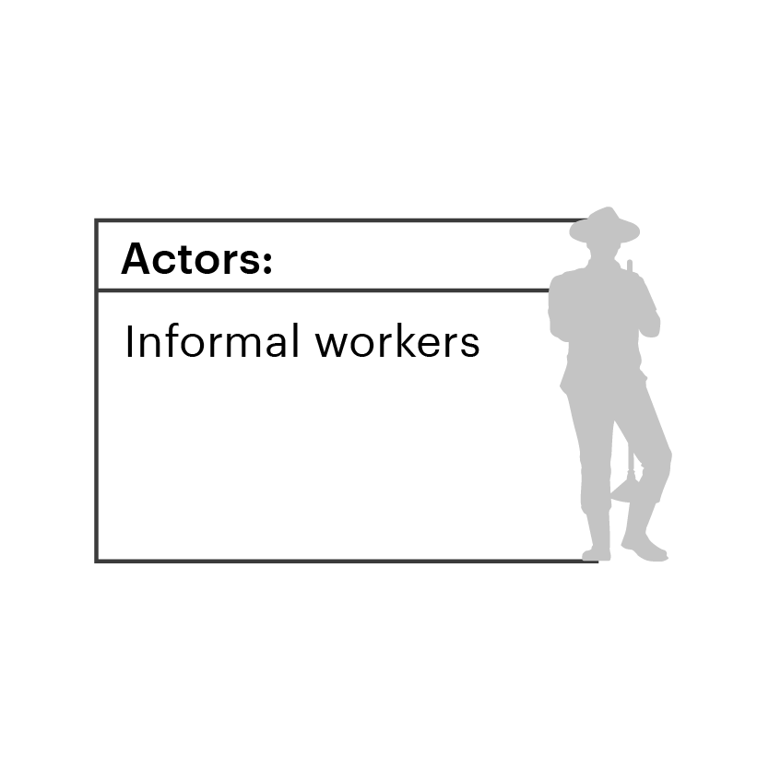
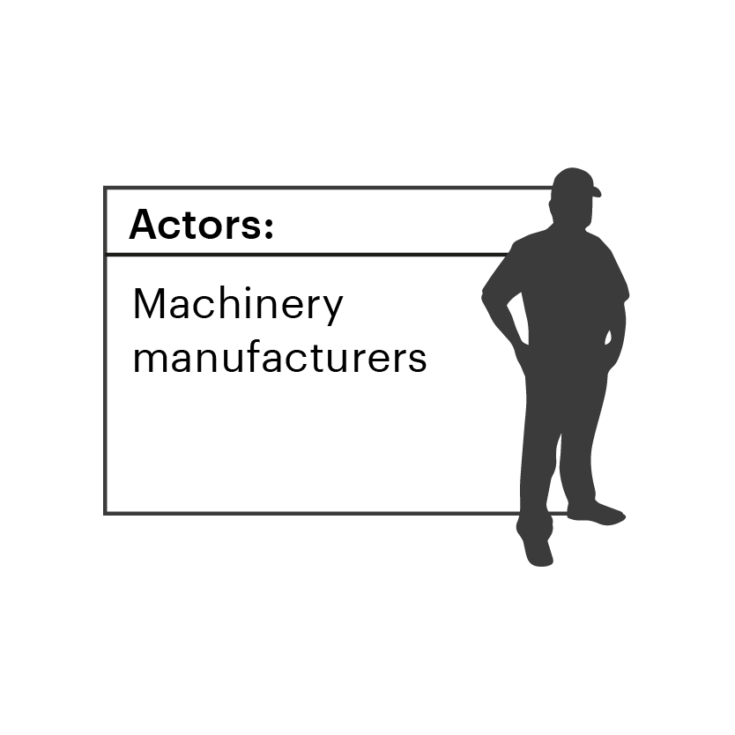
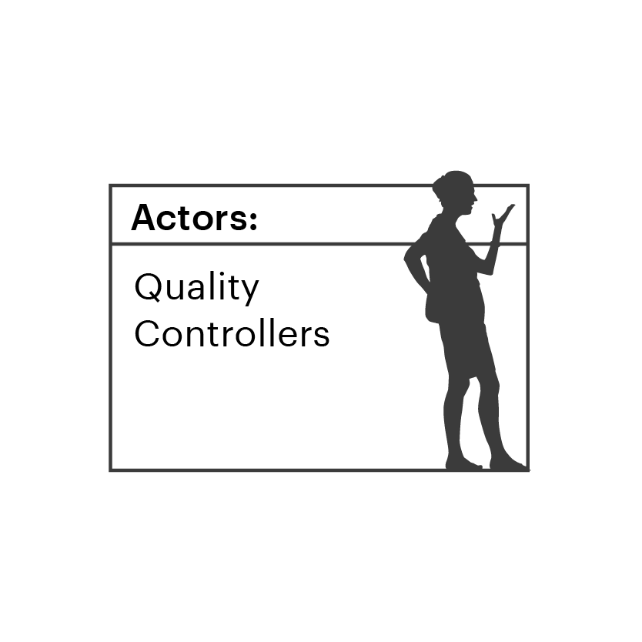
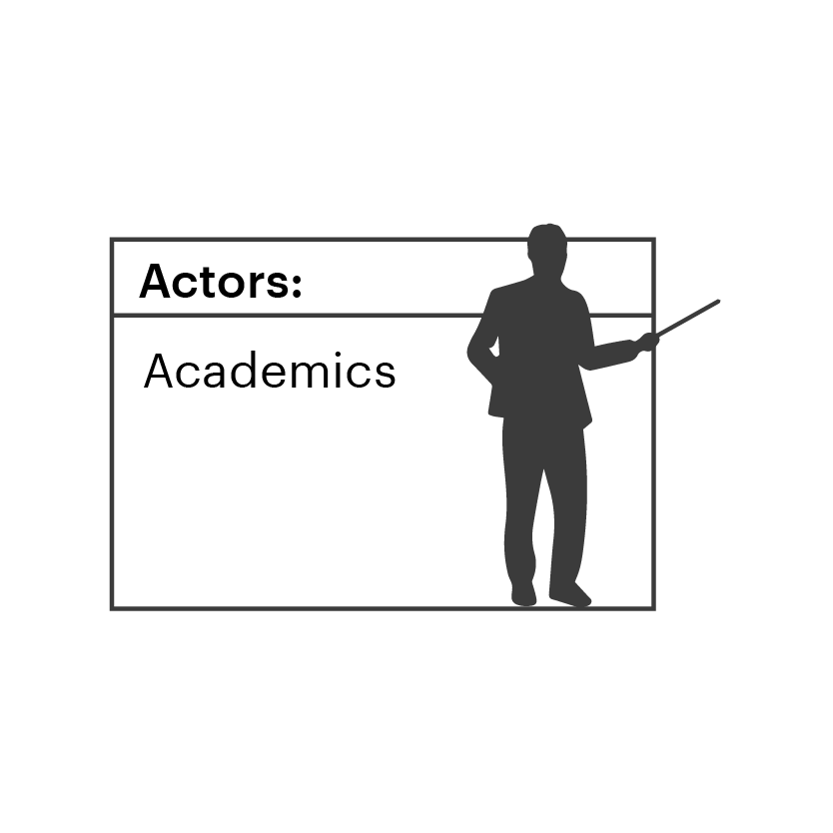

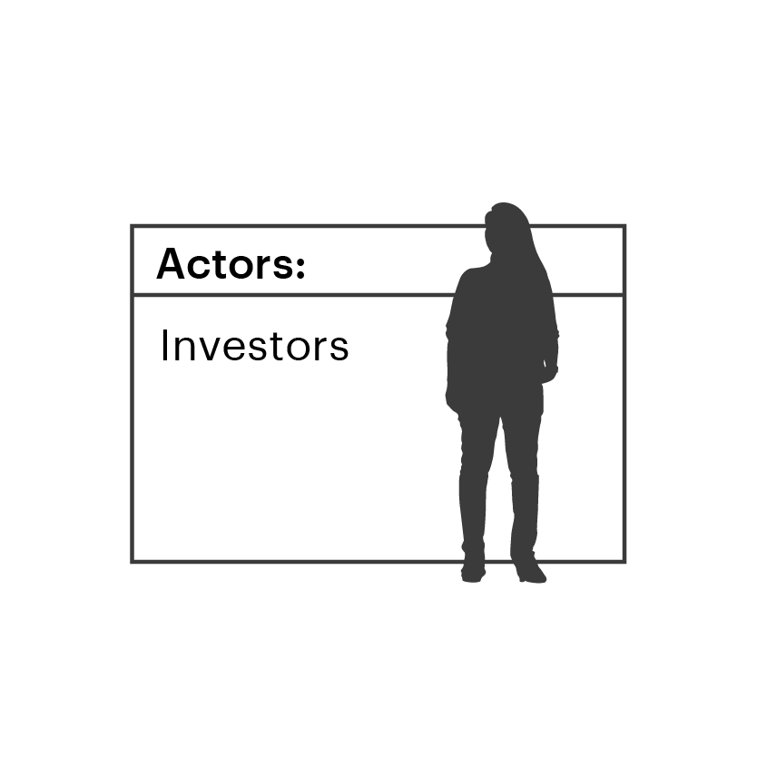
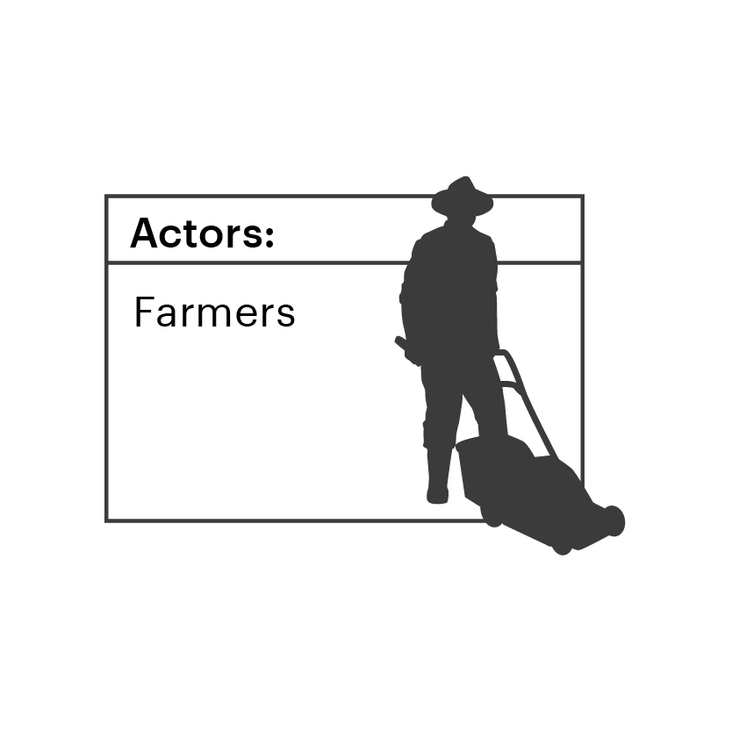
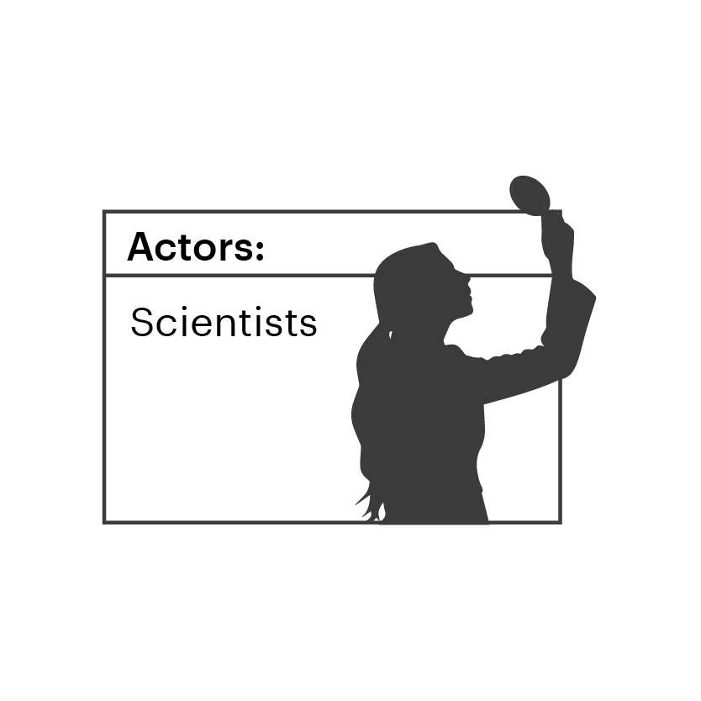
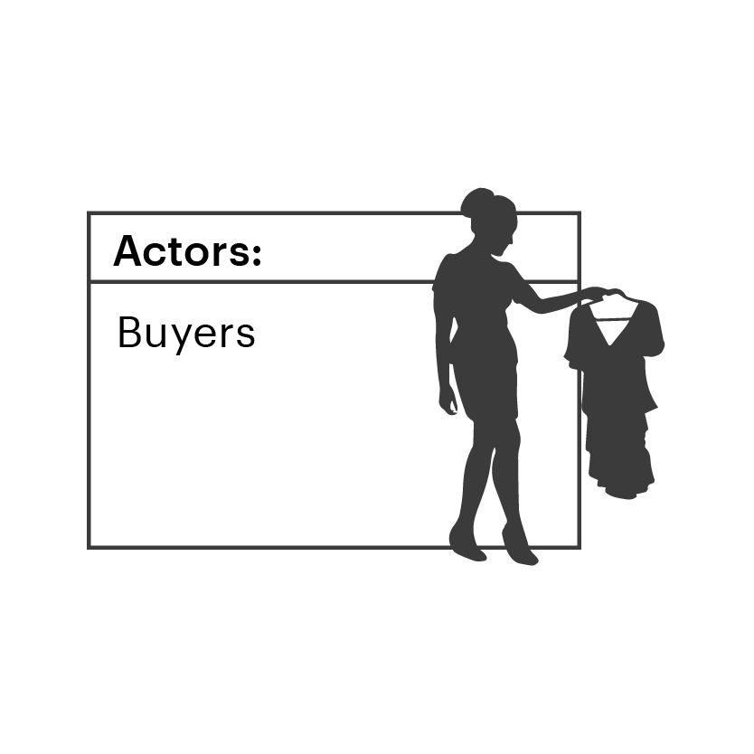
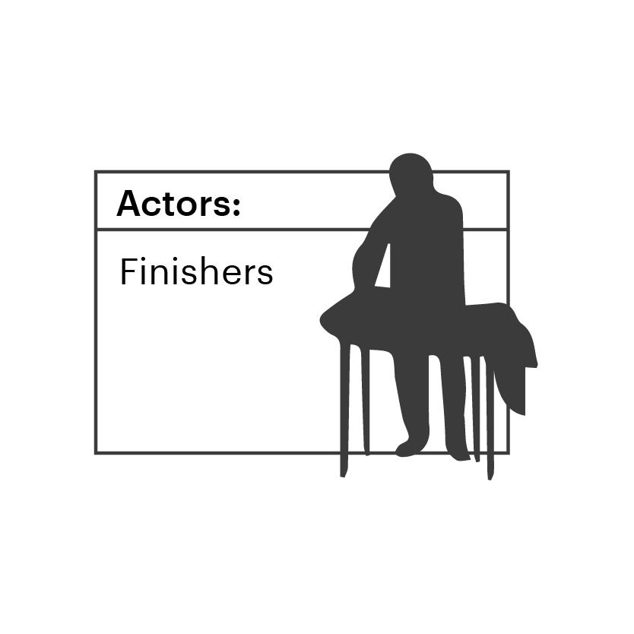












INTRODUCTION
BACKGROUND
EXERCISE 1
EXERCISE 2
EXERCISE 3
WRAP UP
WORKSHOP 3
Modular Map
Forces
Actors
Arrows

Slide 17
WORKSHOP 3
Break time
5 minutes

Slide 18
Start moving the needle
INTRODUCTION
BACKGROUND
EXERCISE 1
EXERCISE 2
EXERCISE 3
WRAP UP
WORKSHOP 3
AMBITION STATEMENT
Let’s take the first step to move the needle towards the “future system”.
Summarize the ambition with your
future map
Write 3 actions that you could take in your role of the system to meet the ambition
Write 3 actions required from other in the system to meet the ambition
(e.g. actors, changemakers)
Summarize the ambition and action and reflect in open group
To innovate and decarbonize the fashion system, my ambition is to rebalance the power between the consumer-facing and production parts of the value chain”
KEY ACTIONS
I could personally take action by …
Others in the system could
take action by …
Reminders:
15 minutes
Reflect and discuss openly
Ambition and action canvas

Slide 19

Thank you
Stay updated
hmfoundation.com
Contact us
info@hmfoundation.com
Follow us​
Instagram, LinkedIn and YouTube: @hmfoundation​
H&M Foundation
19

Slide 20
WORKSHOP 3
Appendix
Printable or interactive PowerPoint material

Slide 21
Modular Map
WORKSHOP 3
Forces
Actors
Arrows

Slide 22
Ambition + action canvas
WORKSHOP 3
AMBITION STATEMENT
To innovate and decarbonise the fashion system, my ambition is to …
KEY ACTIONS
I could personally take action by …
Others in the system could take action by …

